Slide 1
Inspire, Advocate, Communicate
Data Storytelling for Libraries
Dr. Kate McDowell
School of Information Sciences
University of Illinois
at Urbana Champaign

Slide 2
Notes:
Not a delivery of story from teller to audience
Emerges between
Roles can shift or switch, teller becomes listener
Triangle, several things:
Dynamic, story emerges between teller and audience. So practice.
Six relationships. For example, audience can see the teller’s relationship to the story. True whether it’s a data story or a culturally fake/authentic story, audience is aware of how you know what you know

Slide 3
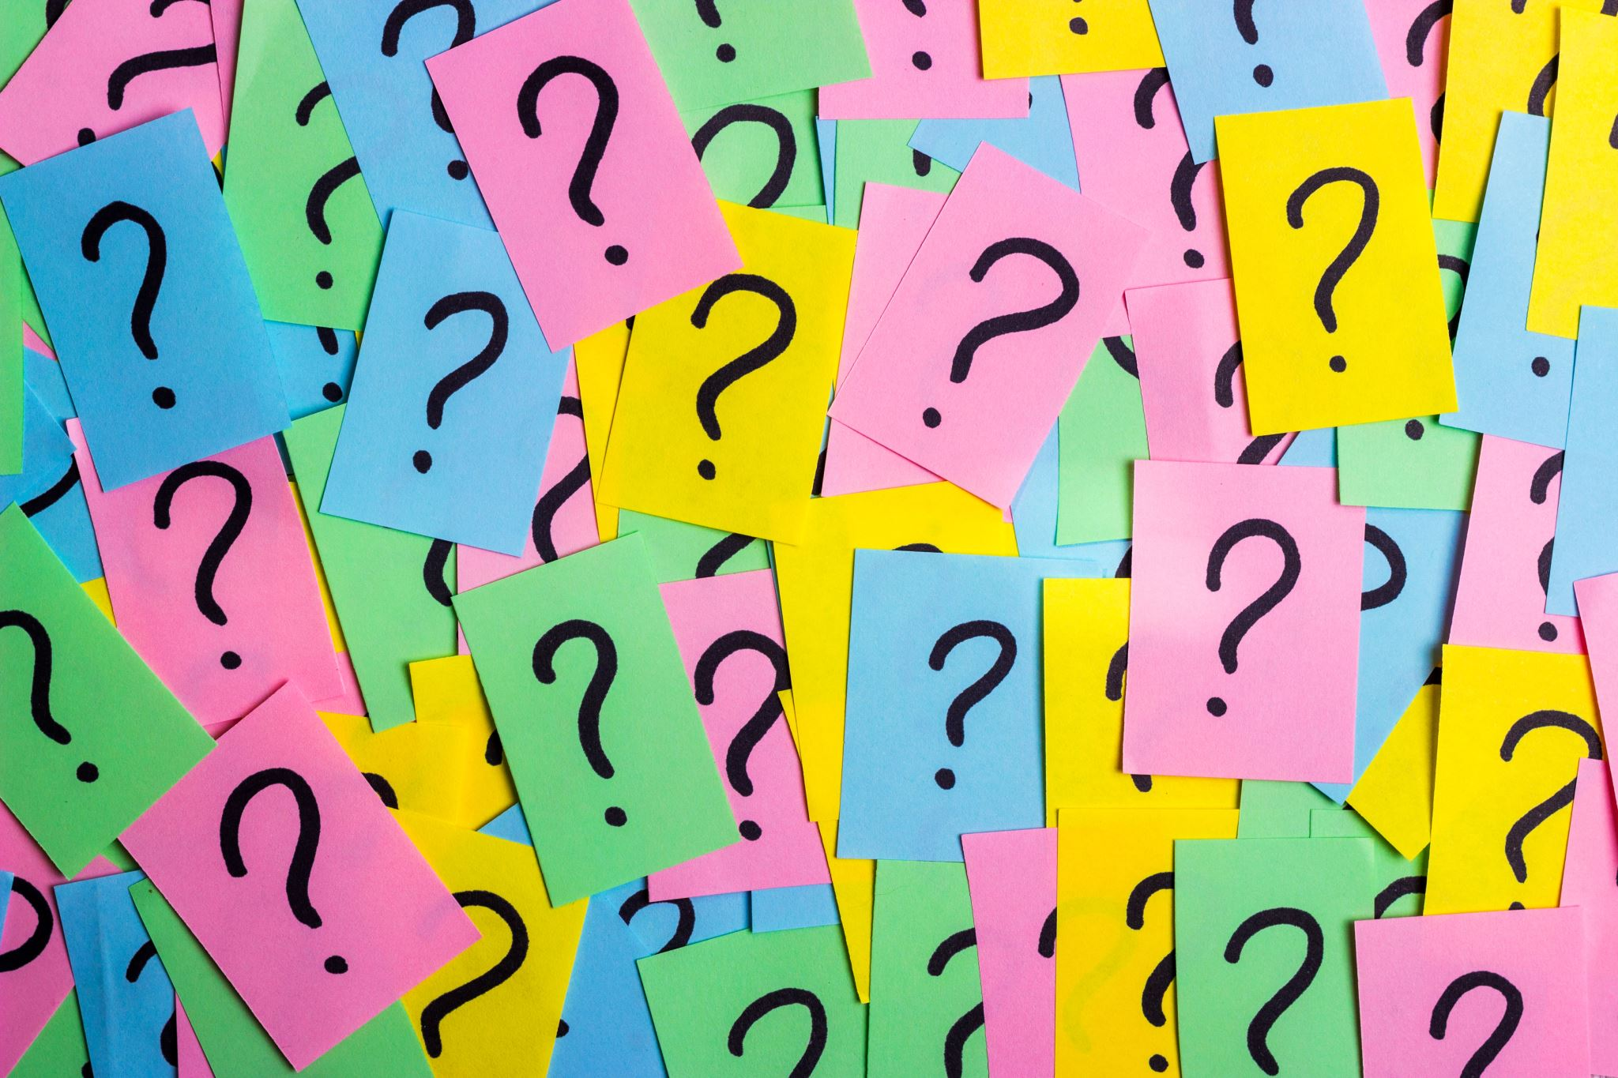
Agenda for today’s talk
What kinds of data do you have as evidence?
What do you know about the audiences you need to reach?
What’s the best narrative structure for your story?

Slide 4
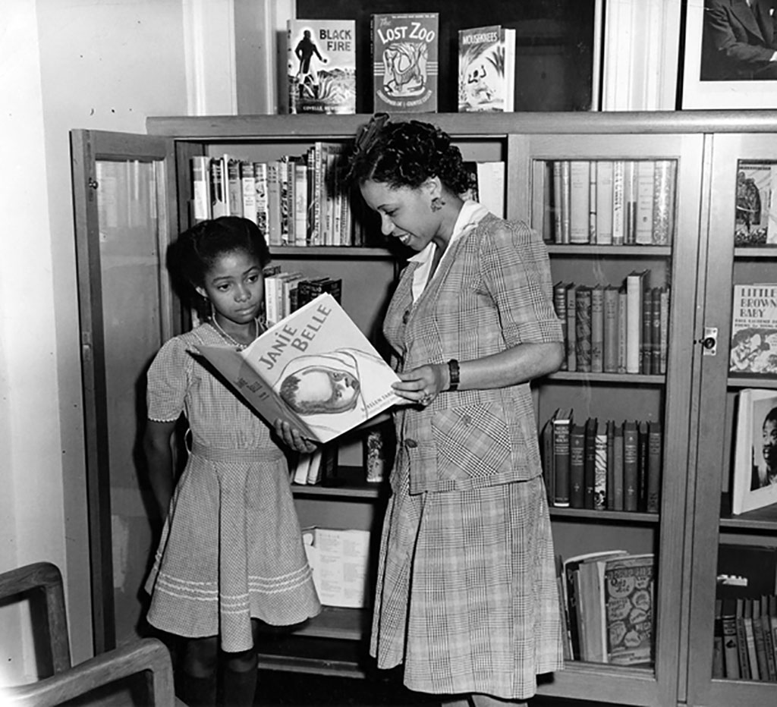
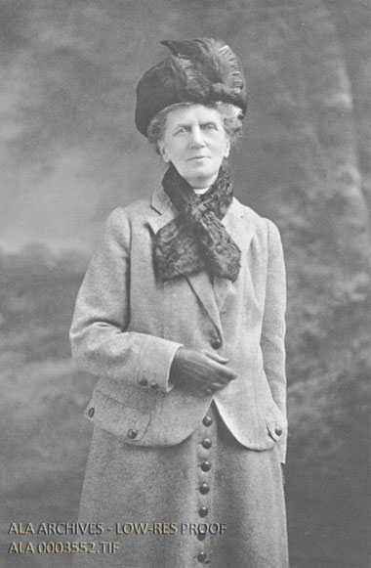
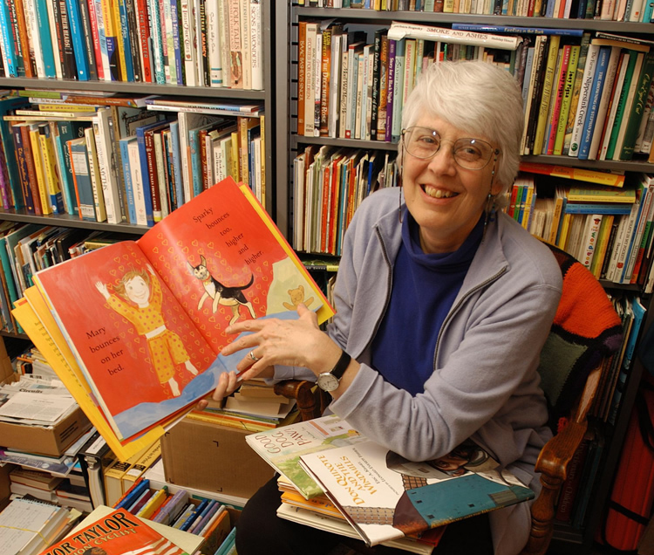
130 Years of LIS Storytelling
Augusta Baker, first to hold the position of Storytelling Specialist at the New York Public Library, emphasized the story rather than the storyteller,
“who is, for the time being, simply a vehicle through which the beauty and wisdom and humor of the story comes to the listeners.” (Baker & Greene, 1977)
Caroline Hewins, Reading of the Young reports (1882-1898) Betsy Hearne, ethics of folktale retelling in children’s books
3
Notes:
Trust between teller and audience
Kate and Zach

Slide 5
Consulting
Notes:
Storytelling for fundraising across the Univ of Illinois statewide system

Slide 6
Data Storytelling
Courses in ethical and accurate information communication, situated in a world of burgeoning data and new storytelling challenges. We take on those challenges directly, acknowledging the flexibility of expression available in data and story while being honest.
Co-created by Dr. Kate McDowell and Dr. Matt Turk. Co-instructors include Dr. Jill Naiman, Dr. Sharon Comstock, and doctoral students Courtney Richardson, Andy Zalot, and Morgan Lundy.
Notes:
Information and emotion together
Kate and Matt

Slide 7
Comfort levels: data, story, both, neither?
Notes:
Data, story, or both? Neither?
1 min

Slide 8
Data Storytelling means any presentation of data using narrative strategies in story form
Notes:
Examples:
People: telling a story (anonymized or with permission to identify without causing harm) about a family whose long-term income prospects changed because they were able to use the public library for parents to do homework while children read and played.“Typical earnings for bachelor’s degree holders are 84 percent higher than those whose highest degree is a high school diploma.” https://www.aplu.org/our-work/4-policy-and-advocacy/publicuvalues/ What are the income differences from library use, from no job to having a job? How many times has that happened in your community because of job services and internet access?
2) Culture: Telling a story about the cultural barriers (literacy to hospitality or lack of it) in access basic food and shelter resources. My own culture: Brother with multiple disabilities, Medicare changes post-pandemic in Florida meant that 250k people were suddenly dropped 82% of them wrongly, took me and my father both researching to understand the scary and contradictory paperwork.
Public libraries will have an inevitable role when legal rights change, so be prepared for that. Have someone on your team who is looking ahead at local/regional/national upcoming changes to laws that impact access to health care, food, shelter.
3) Institution: Changing how we provide services in the form of an online education program orientation: LEEP Boot Camp. When we discovered that more students were reporting difficulties traveling to campus, barriers of funding to afford travel (which is not covered by student loans), and barriers related to time off from jobs. Two weeks, 10 days, one week… barrier arose in learning styles, anxiety, neurodivergence. We had to let go of Boot Camp for equity reasons.
University example, but think about the takeaways: costs of transportation (money and weather), time, and learning demands

Slide 9
What kinds of data do you have as evidence of library value?
Notes:
60 min mark, 10 mins on this slide to 70min/9:40
Talk to someone for about 4 minutes, 2 minutes each
If you’re stuck, think about these:
Continuity of popular programming
Transformation to make popular programs result in more usage increases
Discovery: What makes a program popular? What does the community not already know about the library?
Share out afterwards

Slide 10
Surveying the Field: The Research Model of Women in Librarianship, 1882-1898
Women introduced the systematic use of empirical evidence to librarianship.
They were 20% of the profession.
They created a series of qualitative survey-based reports, the Reading of the Young reports, which were presented at ALA conferences.
This research model was adopted by others for public library research.
This research model changed the field, introducing a collaborative model of discourse.
McDowell, K. (2009). Surveying the Field: The Research Model of Women in Librarianship, 1882–1898. The Library Quarterly, 79(3), 279–300. .Won ALA LHRT Donald Davis award

Slide 11
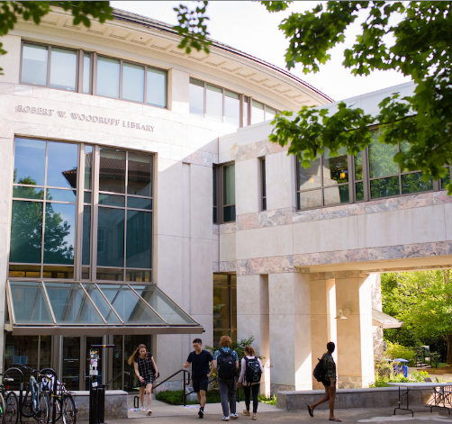
Achivement of Serving Real Needs,
User survey leads to new technology investments
“We have analyzed results from a patron survey and have changed our investments in technology. We are ready to showcase the new computer workstations, laptops, and other equipment ready for checkout.”
Libraries respond to user survey results with technology improvements.
https://news.emory.edu/stories/2023/12/er_library_improvements_04-12-2023/story.html

Slide 12
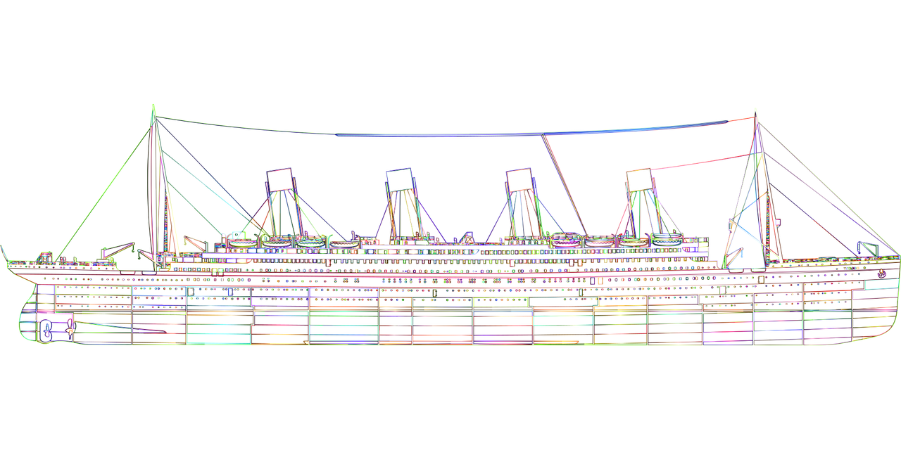
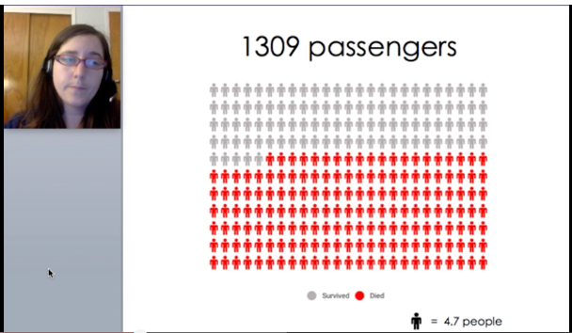
Data Storytelling as
Humanizing Data Literacy
Notes:
Ashley Hetrick
Titanic data set documents individual survival rates as compared with cost of tickets in different parts of the ship
used to teach statistics
in fact, it’s a game, a competition: predict who will die
Ashley’s data story points out the dehumanizing effects of making people’s survival into a game
And the reifying effects of situating wealth (class of

Slide 13
Annual Costs of Being Online
Notes:
Fall 2020 course example

Slide 14
Notes:
[QUARTER WAY 2:25PM]
Structural inequities that become systemic have real impact on their lives

Slide 15
Library data needs story before storage

Slide 16
Storytelling as Information

Slide 17
DIKW Pyramid
Notes:
One of the most fundamental concepts in IS is based on poetry and computing
DIKW as basic definition in IS
Concept is that there’s a pyramid at which higher levels of understanding develop
Material of the pyramid’s base is
Data, the basis of information in fact, actuality, measurable truth
Information means the interpretation of data to communicate with others
Knowledge means what that information suggests to do, from learning procedures to striving for social change
Wisdom is complicated and debated, but I suggest that wisdom is enacted rather than personified. We strive for wisdom, we try to choose and move wisely
I think wisdom is sometimes only visible in story form.

Slide 18
“Where is the wisdom that we have lost in knowledge?/Where is the knowledge that we have lost in information?”
T. S. Eliot, The Rock, 1934

Slide 19
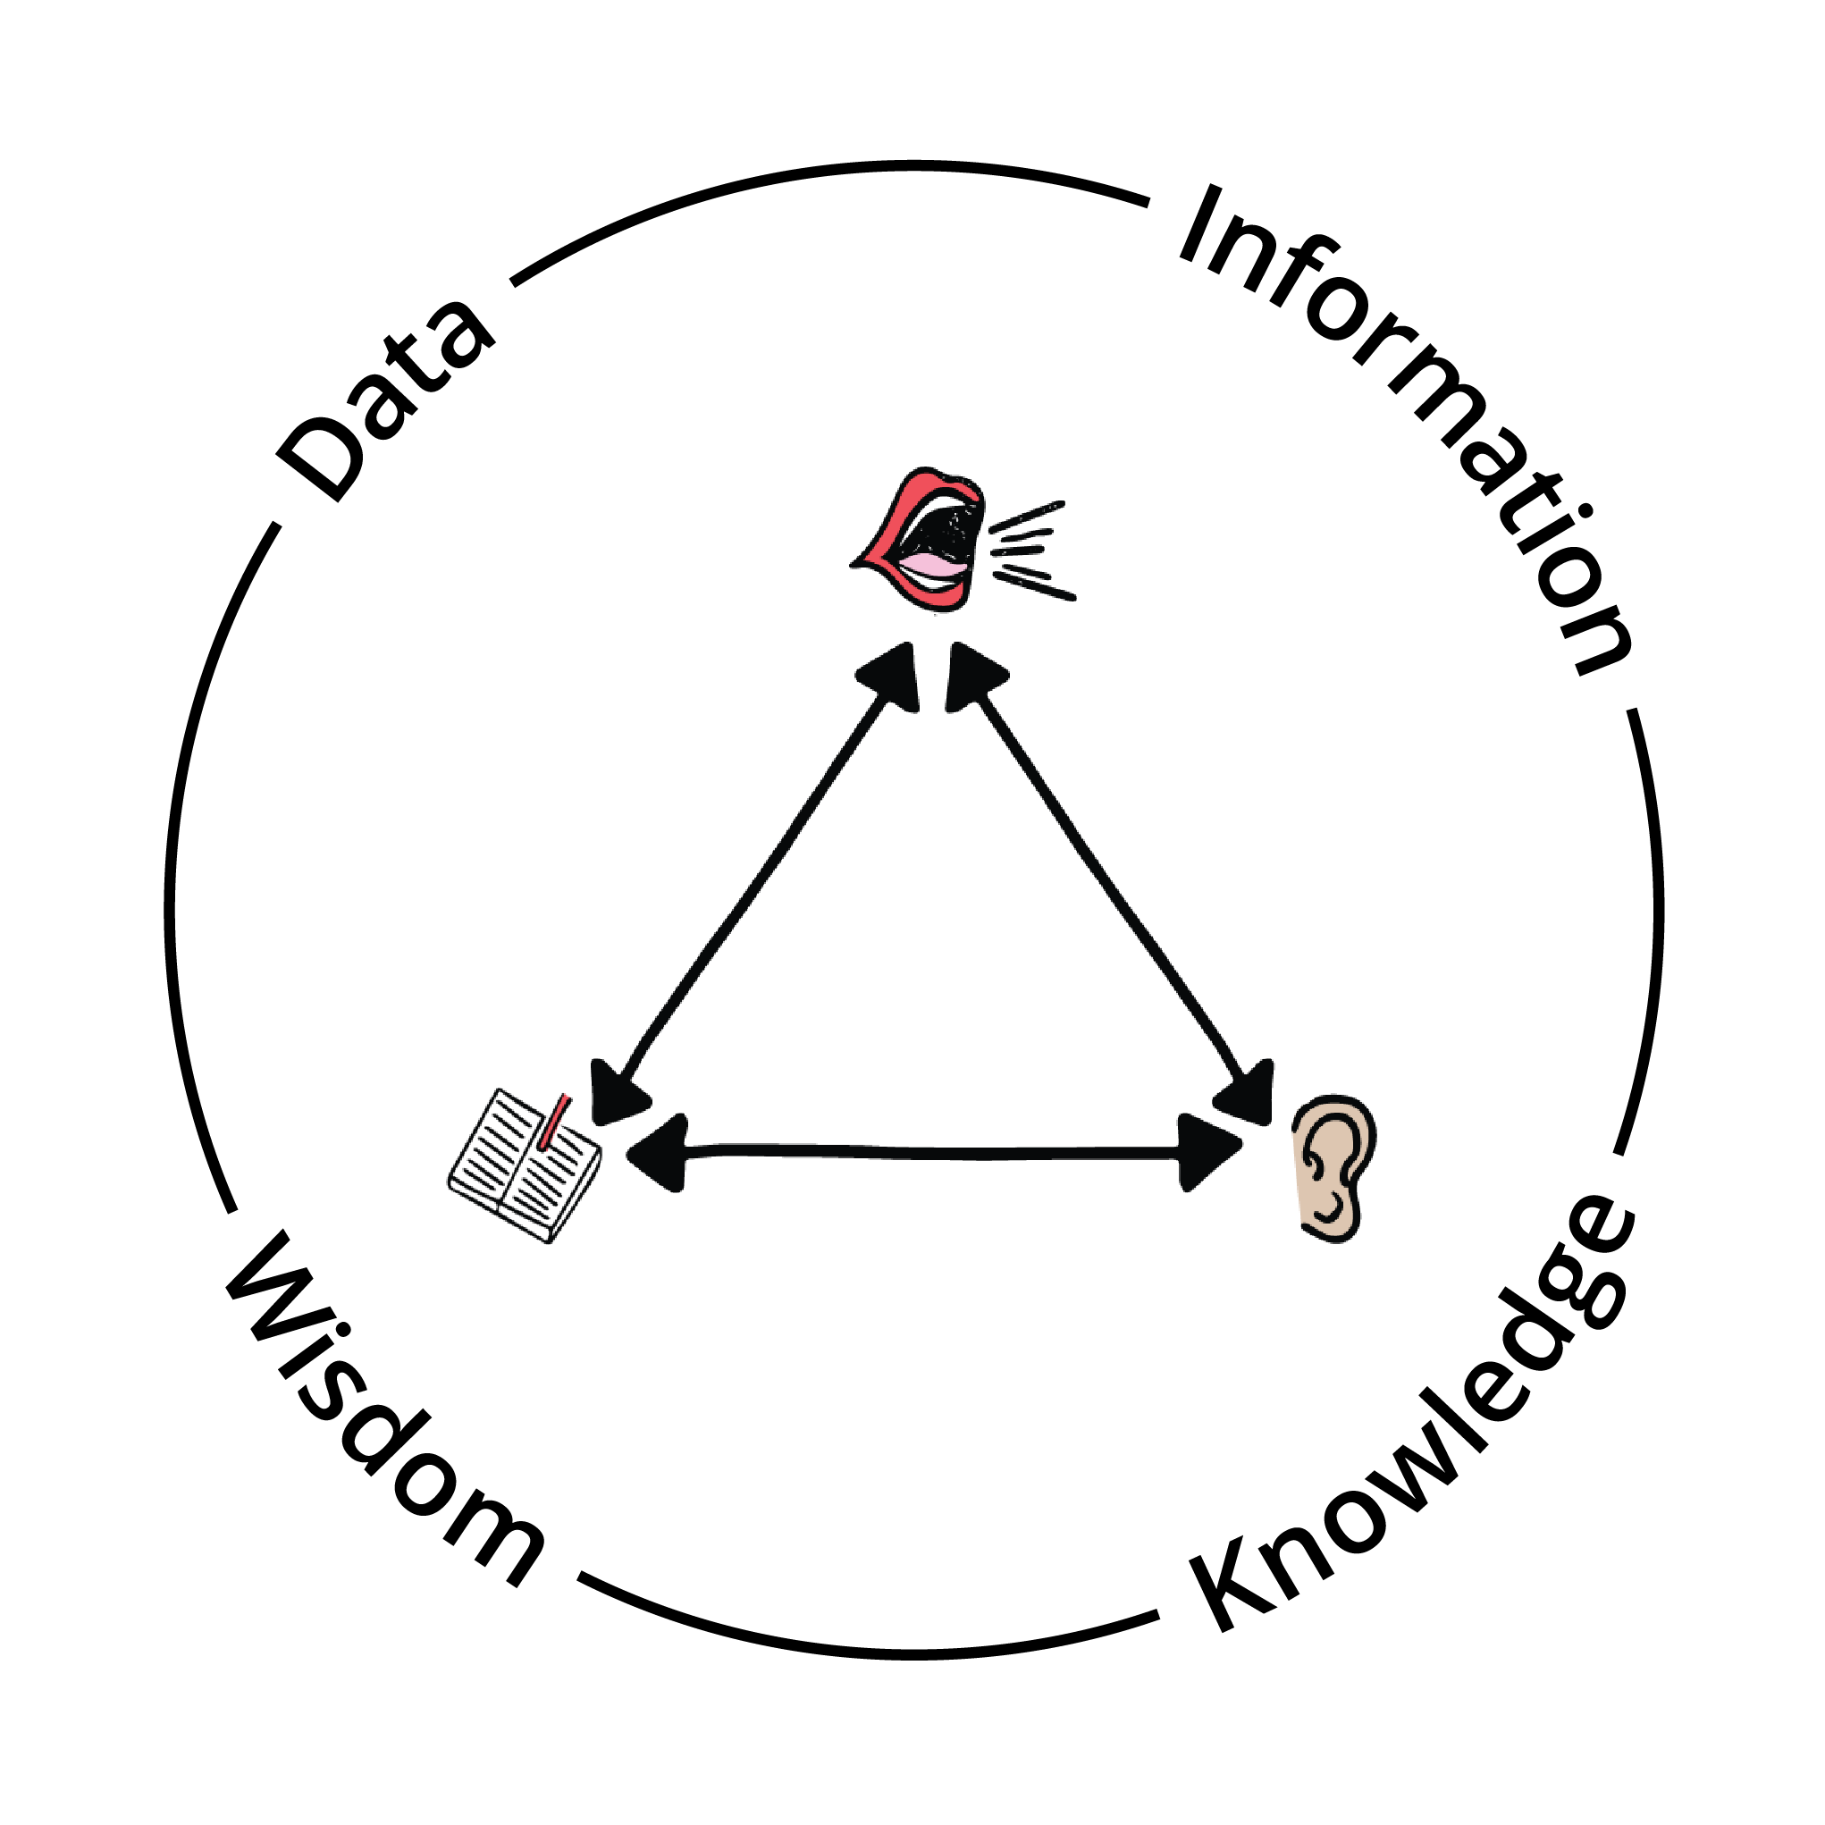
Storytelling Wisdom
Story is a fundamental information form
Storytelling is central to understanding social, collective, and community meaning-making
“In story, wisdom often means discovering a way beyond the ways that seem obvious.”
McDowell, K. (2021). Storytelling wisdom: Story, information, and DIKW. Journal of the Association for Information Science and Technology, 72 (10) (Special Issue: Paradigm Shift in the Field of Information), 1223–1233.
Notes:
Don’t want to presume this is familiar, but it’s the top journal in the information sciences
--Story defined in two ways: structurally as narratively patterned information, and the narrative experience of storytelling. Draws from two intellectual traditions: (a) the beginning-middle-end structure of folktales (story aesthetics and categorization/classification), and (b) the logic of narrative as defined in semiotics (Roland Barthes).
-- In real time, as communities evolve, coordinate, and struggle to survive. Storytelling is a dynamic triangle, polishes stories like editing polishes essays, with the audience serving as editor.
--Wisdom, ways beyond obvious:
King Solomon’s Judgment, two babies, one living one dead, two mothers claim the living one
Tipingee overhears her stepmother talking to a man, selling her as a servant. Red dress.

Slide 20
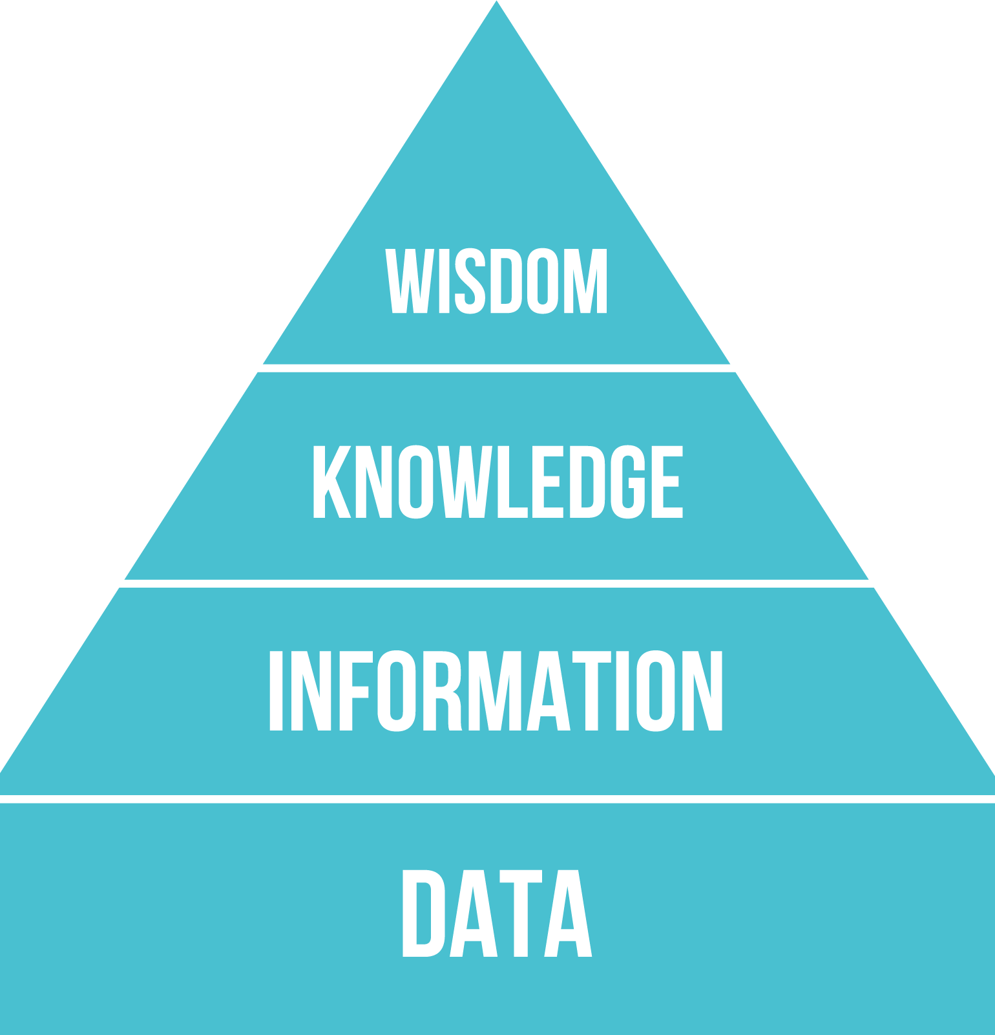
Storytelling Wisdom and S-DIKW
S-Data Basis of information in story
S-Information Data interpretation with context as story
S-Knowledge Actionable information in story
S-Wisdom Which story to tell when, how, to whom, and more
McDowell, K. (2021). Storytelling wisdom: Story, information, and DIKW. Journal of the Association for Information Science and Technology, 72 (10) (Special Issue: Paradigm Shift in the Field of Information), 1223–1233.
Notes:
QUARTER WAY POINT, 2:45
HERE FOR AWHILE
We need is a modification of this pyramid, this way of understanding fundamental information definitions
Storytelling make a significant adjustment
S-Data—what facts remain constant in this story? Or, ask people, what facts did you learn? What evidence does this story carry?
S-Information—interpretation
S-Knowledge—action, what to do
S-Wisdom—which story to tell,
Why necessary?
Theoretical gaps leave researchers baffled by (mis)information dynamics. We have not theorized important everyday information practices.
Online communication mirrors classic storytelling dynamics, and the framework has explanatory power.
Storytelling is a basic and overlooked way that information is shared and reshaped collectively.
Others have seen this work as necessary too
Citations to this work from many different fields so far,
Safety evaluation
Older adults and health information
Misinformation scholarship
Cultural heritage informatics
Intangible cultural heritage
AI research
Online deliberation platforms
Assessment of knowledge exchange

Slide 21
Storytelling and/as Misinformation
Storytelling dynamics and narrative structures for three cases of Covid-19 viral misinformation
McDowell, K. (2024). “Storytelling and/as Misinformation” in Everyday MIsinformation. Cambridge University Press. (in press).
Notes:
ALSO HERE FOR AWHILE Coosa River, Wetumpka, AL
Painting from 1847
https://digital.archives.alabama.gov/digital/collection/photo/id/4449
Alabama Department of Archives and History
Introduction as Story
two historical stories of community experiences related to health and medicine. The first story comes from my family. My mother heard a story from her grandmother about being a young mother herself during the 1918 influenza epidemic, when the whole household came down with the flu. Her parents (my great-great-grandparents) left food on the porch and visited through an open window, using much the same “social distancing” practices in Wetumpka, Alabama in 1918 as in the COVID-19 pandemic. The wisdom of these practices left an impression, and she recognized them immediately when they were called into use globally once again in spring of 2020. Continuity of stories in families can provide a kind of storytelling wisdom that accompanies the stories we inherit. (McDowell 2021)
Also in Alabama, fourteen years later and 51 miles away in Tuskegee, the U.S. Public Health Service launched the Tuskegee Syphillis study in 1932. The history of this study involves racism, torture, and genocidal practices against Black men who were unknowingly subjects of experimentation with untreated syphilis infections. For qualitative researchers, this history is repeated at every basic Institutional Review Board (IRB) training. This unethical study is one of the main reasons for the 1974 National Research Act, which requires “voluntary informed consent” from all human research subjects. (Centers for Disease Control and Prevention 2021)
Families who experienced the pain, suffering, and in many cases the death of their loved ones later learned that they had gone untreated because of deception, as a “scientific” experiment. Here as well, information was inherited in the form of storytelling wisdom. Communities that have been subjected to this and other kinds of systemic persecution are reasonably skeptical of new health interventions. When medicine enacts genocide, it does terrible damage at the level of public trust, with impacts for generations to come, and this is one story in a larger history of federally supported medical racism.
And the resistance of communities impacted should be seen not as an information problem, but as a historically and storytelling-informed wisdom.
Why are stories distorted? Academic and cultural heritage institutions bear much responsibility
The stories of indigenous lives in the Americas have been difficult to tell because of these and other limiting academic beliefs. In her article establishing the “importance of felt experiences as community knowledges,” Million writes:
“The mainstream white society read Native stories through thick pathology narratives. Yet the same stories collectively witnessed the social violence that was and is colonialism's heart. Individually or collectively, these stories were hard to ‘tell.’ They were neither emotionally easy nor communally acceptable. […]
To ‘tell’ called for a reevaluation of reservation and reserve beliefs about what was appropriate to say about your own family, your community” (Million 2009 p. 56).
Million, Dian. “Felt Theory: An Indigenous Feminist Approach to Affect and History.” Wicazo Sa Review 24, no. 2 (2009): 53–76.
Epistemicide, which ideas are killed and how that impacts which stories are told and what information is recorded
The Alabama Department of Archives & History said in a statement in 2020 that for much of the 20th century it promoted a view of history that favored the Confederacy and failed to document the lives and contributions of Black Alabamians.
https://www.al.com/news/2020/06/archives-department-acknowledges-role-in-distorting-alabamas-racial-history.html
--Beth Patin at Syracuse

Slide 22
Narrative Structures
Narrative Structure | Originating Theory | Emotional Impact
Transformation | Campbell, The Hero with a Thousand Faces | Awe at transformation, joy of watching a hero triumph
Continuity | Todorov and Weinstein “Structural Analysis of Narrative” | Stability and resilience despite challenges
Discovery | Roland Barthes S/Z | Mystery, suspense, intrigue, and satisfaction of coming to understanding
Notes:
I draw on my own theoretical knowledge of narrative, and have reframed it for teaching and public use
These theories are used deductively in some of my research
They are also theoretically robust ways of describing common narrative structures that emerge from analysis of organizational narratives
Connective insights that show my humanist foundation even as I bridge to qualitative social sciences

Slide 23
Cases | Insights from Triangle | Insights from Narrative Structure
Medicine Misuse: Desperation and Ivermectin | Teller allies with audience against “them” and “what they’re not telling you” “Secret” revealed to audience, aura of mystery | Transformation story, teller as “hero” revealing “truth” discovery narrative, revealing something everyday with hidden uses
Exploiting Vaccine Hesitancy: Faked Magnetism | Teller uses shock based on trickery to activate audience emotionally to resist If audience trusts teller, then likelihood of retelling increases | Continuity story, in that the underlying message is to focus on maintaining the status quo despite disruption
Aftermath of Medical Racism: Vaccine Questioning | Inherited information, teller and audience are insiders together as families who survived Governmental medical officials expect trust because of expertise and believe that more information is the answer | Transformation structure makes those survived despite terrible obstacles heroes Public health officials hope to tell a discovery narrative about the invention and value of vaccines
Storytelling Insights
Notes:
Medicine Misuse: Desperation and Ivermectin
could have been true, but the data weren’t fully collected yet
“What they’re not telling you” rhetoric to enlist “truth-tellers”
Transformation: “truth-telling” actually propagating misinformation
Discovery: revealing something everyday with unexpected and hidden uses
Exploiting Vaccine Hesitancy: Faked Magnetism
Video “evidence” that vaccinations caused bodily magnetism
Conspiracy tellers and audiences locked into interrelated stories with ever-narrowing window for contrary evidence
Continuity: resist change no matter the circumstances
Aftermath of Medical Racism: Vaccine Questioning
Inherited information resulting from traumatic medical racism
Distrust between public health authorities and BIPOC audiences
Two narrative structures at odds
Transformation narrative about heroic family members who survived federally funded medical torture
Discovery narrative about invention and value of vaccines in a pandemic
Language of “questioning” vs. “hesitancy”

Slide 24
Misinformation S-DIKW Framework
Bad S-Data: Evoking cultural cues that imply factuality for data that is false
Bad S-Information: False data with context that misinforms in story
Bad S-Knowledge: Stories based on false information that lead to ineffective or harmful actions
Bad S-Wisdom: Reactivity that leads to retelling misinformation as story without checking sources in ways that amplify harm
McDowell, K. (2023). Storytelling Dynamics and Misinformation: The Bad S-DIKW Framework. Information Matters. https://informationmatters.org/2023/04/storytelling-dynamics-and-misinformation-the-bad-s-dikw-framework/
Notes:
Third iteration, based on https://asistdl.onlinelibrary.wiley.com/doi/10.1002/asi.24466
How can a person teach information literacy, data literacy, in this kind of environment?

Slide 25
USA Public Library Threats
“Parents’ rights” groups center homophobic and racist views
Targets are school and public libraries. In 2023 so far, 50% of banning attempts are in public libraries (16% in 2022)
Most of the challenged books were by or about people of color or L.G.B.T.Q. people
“Free speech advocates warn that the next phase of the movement may be harder to quantify and counteract,” as some libraries stop buying books that could be controversial.
https://www.nytimes.com/2023/09/21/books/book-ban-rise-libraries.html
Notes:
As an example of public spaces
https://www.nytimes.com/2023/09/21/books/book-ban-rise-libraries.html#:~:text=Some%20libraries%20have%20received%20bomb,and%20called%20groomers%20and%20pedophiles.
Some libraries have received bomb threats;
others are at risk of having their funding slashed,
or even face closure, over disputes about book removals.
Librarians have been harassed, threatened and called groomers and pedophiles.
In some places, librarians have been threatened with prosecution for providing books to children and families
https://www.ala.org/news/press-releases/2023/03/american-library-association-condemns-ongoing-threats-against-libraries
Chicago bomb threats: https://chicago.suntimes.com/metro-state/2023/9/17/23875812/libraries-threats-books-ban-state-leaders-fight-protect
Some wins:
https://www.seattletimes.com/seattle-news/embattled-wa-library-wins-lawsuit-wont-shut-down-after-fight-over-books/
The only library in tiny Columbia County will survive.
The Dayton library — which was on the verge of becoming the first library in the country to shutter over disputes about what books it offers — will remain open after a Columbia County court Wednesday barred an initiative to close the library from appearing on the November ballot.

Slide 26
USA Book Banning, 2022-23 American Library Association’s Office for Intellectual Freedom
2021
729 attempts to censor, 1,597 unique titles
2022
681 attempts, 1,651 unique titles
2023:
695 attempts to censor library materials and services and
documented challenges to 1,915 unique titles.
Challenges to unique titles increased 20%
Each year has had the highest number of attempted book bans since ALA began compiling these lists more than 20 years ago.
https://www.ala.org/news/press-releases/2023/09/american-library-association-releases-preliminary-data-2023-book-challenges

Slide 27
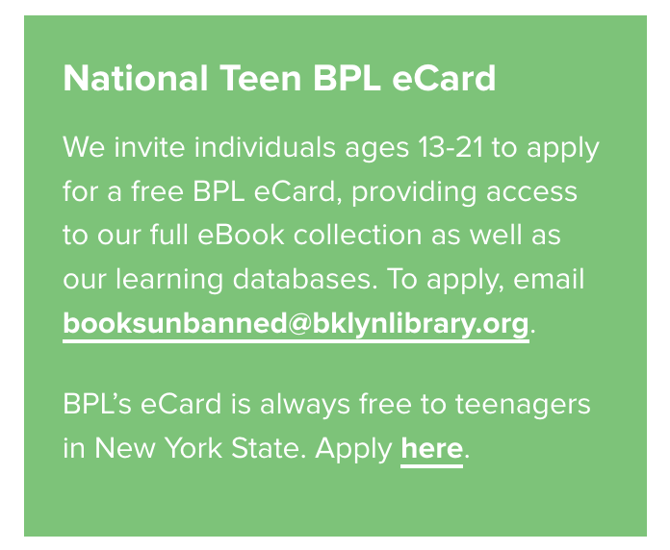

Slide 28
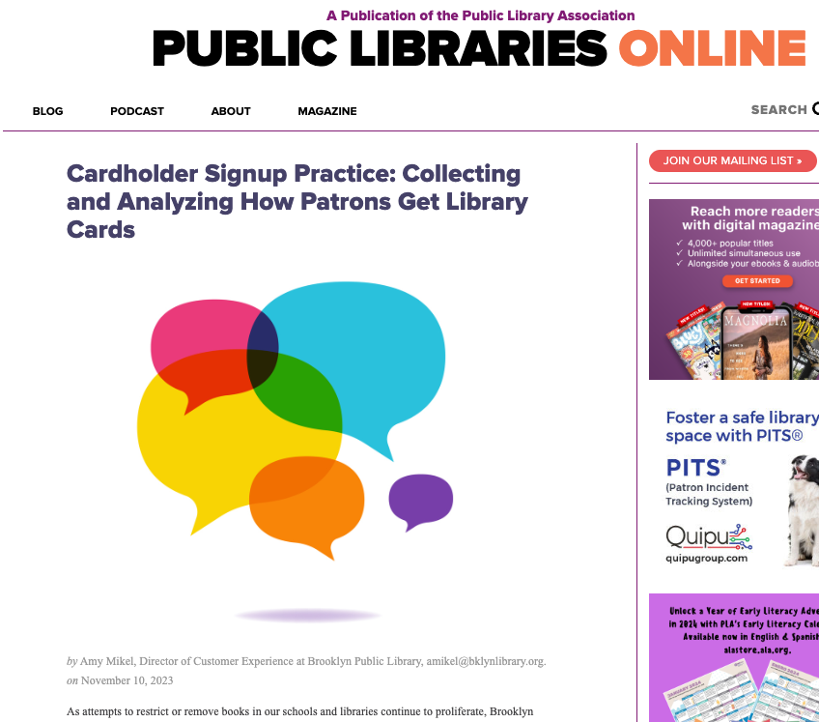
“BPL launched an 18-month research project to collect and study cardholder signup policies from public libraries across the nation.”
Notes:
https://publiclibrariesonline.org/2023/11/cardholder-signup-practice-collecting-and-analyzing-how-patrons-get-library-cards/

Slide 30
DSTL

Slide 31
Data Storytelling Toolkit for Libraries
USA nationally funded by IMLS
co-PI Matt Turk
DIY guide to data storytelling for common data uses in libraries
Notes:
Designed with librarians

Slide 32
DSTL Research Methods
interviews (34 participants, 2016-2022)
questionnaire (28 participants, September 2021)
ranking exercise (25 participants, April 2021)
workshop discussions (942 participants, 6 workshops, 2021-2022)
structured focus groups (5 groups, 55 participants, September-October 2023)
ranking, sorting, and writing exercises plus discussion
User persona development
Notes:
[HALFWAY 12:25]
GRATITUDE to all participants. Broad interest in the project.
with 680 registrants for the first DSTL open workshop in fall 2022.
Responses to our fall 2022 survey came from 12 states.
GRATITUDE (Any librarians in the room?)
Forty librarians from 26 states comprised our Core Design Team.
Learning Experience: Learning experience, professional development. Every session is an exchange, presentation and opportunity to learn and then request to provide input/feedback on models generated from previous interview research.
Credit: All who participated are credited; https://storytellingscholar.blogspot.com/2023/03/ala-and-data-storytelling-toolkit-for.html
presented this work at seven conferences from May to September 2023, including ALA and RIPL, in Wisconsin, Illinois, and Florida.
Transition to FINDINGS as OBSTACLES

Slide 33
DSTL Goals and Narrative Strategies
Story goals | Narrative strategies
Understand the real needs of their communities | Discovery
Serve the real needs of their communities | Continuity or Transformation
Keep up with other libraries | Continuity
Build on existing strengths | Transformation
Address deficits | Transformation
Notes:
We learned from the stories that were out there
This is the model, encoded from the deductive content analysis
These are the pattens that we found in the stories that libraries were using
And that the available data could support
We also learned from the storytellers
After finding and naming these patterns, we workshopped them with real people working in the field to learn from them
Just because data available supported comparisons didn’t make them valuable, In fact, it felt crass to participants.
“toxic, disheartening, icky”
PLs like environmental organizations are hyper-local
The DSTL provides
Storytelling guidance that builds successful justifications
by extracting the theoretical insights that
allow for abstract representation of story strategies
Every field that strives to justify funding for public service would need to re-examine its own stories as folklore and see the patterns

Slide 34
Goals and Motivations
Goals | Motivation: Justification | Motivation: Benchmark | Motivation: Achievement
Understanding real needs | Use evidence of needs to justify resources (investments, time, money). | Use evidence of needs to compare with outside standards or trends. | Demonstrate that needs are understood and next steps to meet needs are clear.
Serving real needs | Design or maintain services based on evidence of needs. | Use evidence of needs met through services to compare with outside standards or trends. | Demonstrate that services are successfully meeting needs.
Build on strengths | Use assessment of strenghts to justify resources that sustain or expand those strengths. | Use evidence of strengths to compare with outside standards or trends and contribute to the larger library community. | Demonstrate that investments to build on strengths are effective and valuable.
Address deficits | Use assessment of deficits to justify resources that can make improvements. | Use evidence of deficits to compare with outside standards or trends and keep up with the larger library community. | Demonstrate that investments to address deficits are effective and valuable.

Slide 35
Goal: Address Deficits Motivation: Justification
"We are assessing our library's deficits in __[programs or services related to needs]__ to justify resources that improve __[related programs or services]__."
We are assessing our library's deficits in services to rural areas following the recent closure of our mobile services. We will use what we learn to justify resources that improve access for remote users at existing library building locations.
"It was with a heavy heart that we closed our mobile library service." https://www.midweekherald.co.uk/news/23920174.we-made-decision-not-close-mobile-libraries/
Data Visualization: Consider using a mix of pie, line, and bar charts to depict the inherent challenges or complexities associated with the deficit being addressed.

Slide 36
Process for DSTL User
Introduction to toolkit and navigation (text and video)
Reach Audiences (tutorial)
Choose Motivations and Goals (interactive)
Structure Narratives (tutorial)
Visualize Data (interactive)

Slide 37
Process for DSTL User
Introduction to toolkit and navigation (text and video)
Reach Audiences (tutorial)
Choose Motivations and Goals (interactive)
Structure Narratives (tutorial)
Visualize Data (interactive)

Slide 38
Reach Audiences
Knowledge
Demographics
Attitudes

Slide 39
Quick Guide to Audience Attitudes
Attitude | Shared reality? | Tone | Tactics
Positive |  | Open | Build trust. Don’t take audience sympathy for granted. Make the story easy to retell.
Negative |  | Calm | Focus on persuasion. Restate concerns in positive terms to build common ground. Find compromises, even if disagreements continue. Slow down to de-escalate conflict.
Mixed |  | Open and calm | If some are persuaded, consider the story they need to tell about why.
Indifferent |  | Curious | Start with why it matters for these specific people. Model the interest that you hope to instill. Keep it simple. Ask questions and wait for responses.
Polarized |  | Non-reactive | Stay on message. Do not repeat false information. Consider the value of debate strategically. If the intent is to confuse the voters, avoid debate.
Notes:
THREE-QUARTER TIME POINT, 3:15
From the storytellers, identified these patterns

Slide 40
Structure Narratives
Narrative Structure | Originating Theory | Emotional Impact
Transformation | Campbell, The Hero with a Thousand Faces | Awe at transformation, joy of watching a hero triumph
Continuity | Todorov and Weinstein “Structural Analysis of Narrative” | Stability and resilience despite challenges
Discovery | Roland Barthes S/Z | Mystery, suspense, intrigue, and satisfaction of coming to understanding
Notes:
How emotion and information are connected
Awe
Stability
Suspense

Slide 41
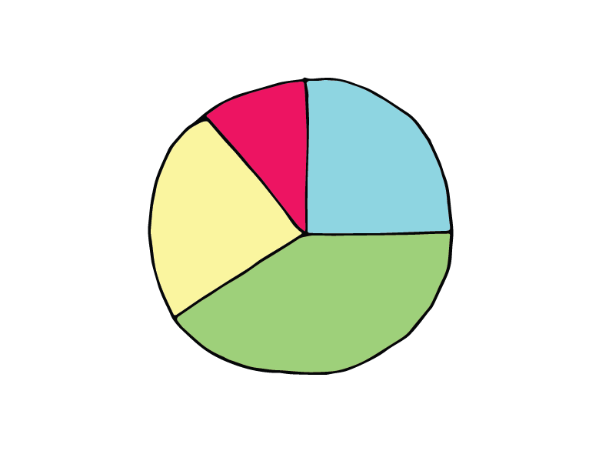
Notes:
Data to teller-our first goal

Slide 42
Notes:
Dig Deeper, story of library renovation
The bigger goal: data to teller to teller. Retelling.
For example, warn your friends: Did you know that those rental costs for internet access add up?
We need to tell stories that sustain beyond the moment of first telling.
How will we know? We check in with audiences, especially practice audiences.
Ask: What did you hear, ask them to tell it back to you
Libraries eliminating fines is good, but some barriers still persist.

Slide 43
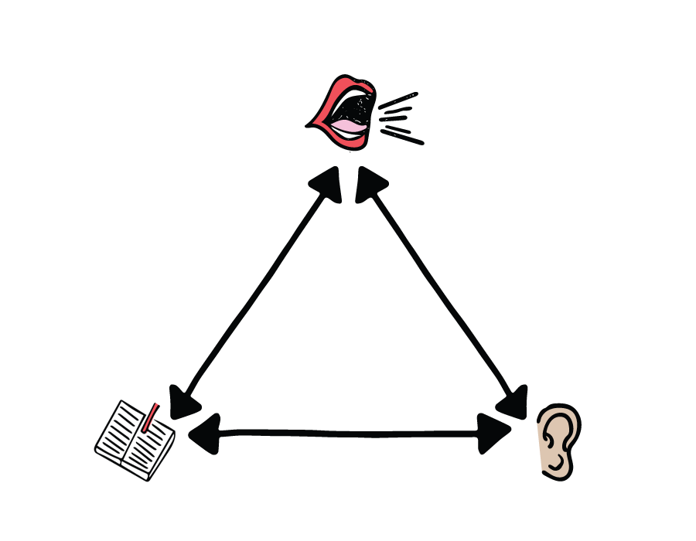
Audience Surveys?
Collection with connection
Building relationships
Responses as the beginning
Of the story
Of the dialogue

Slide 44
Structure Narratives

Slide 45
What’s your story’s narrative structure?
Notes:
60 min mark, 10 mins on this slide to 70min/9:40
Talk to someone for about 4 minutes, 2 minutes each
If you’re stuck, think about these:
Continuity of popular programming
Transformation to make popular programs result in more usage increases
Discovery: What makes a program popular? What does the community not already know about the library?
Share out afterwards

Slide 46
Notes:
Beginning, middle, end, yes, but a list has these too
What makes story different is the intertwining of information and emotion, and middles are hard
Big campaign to expand the library taxing district. Smaller than school district, so uneven access. Some kids could have cards, some could not.
“Demonstration district” gave everyone in the school district temporary access to working library cards for a limited time
Publicized this offer: farmer’s market, grocery stores, school open houses, skating rink. Everywhere!
Could not lobby for the change to district, could only explain the temporary offer and give information that this would be on the ballot. Difficult!
Ultimately, ballot measure failed, but the demonstration increased awareness so that kids outside of the library taxing district could come to the library and use resources even without a library card.

Slide 47
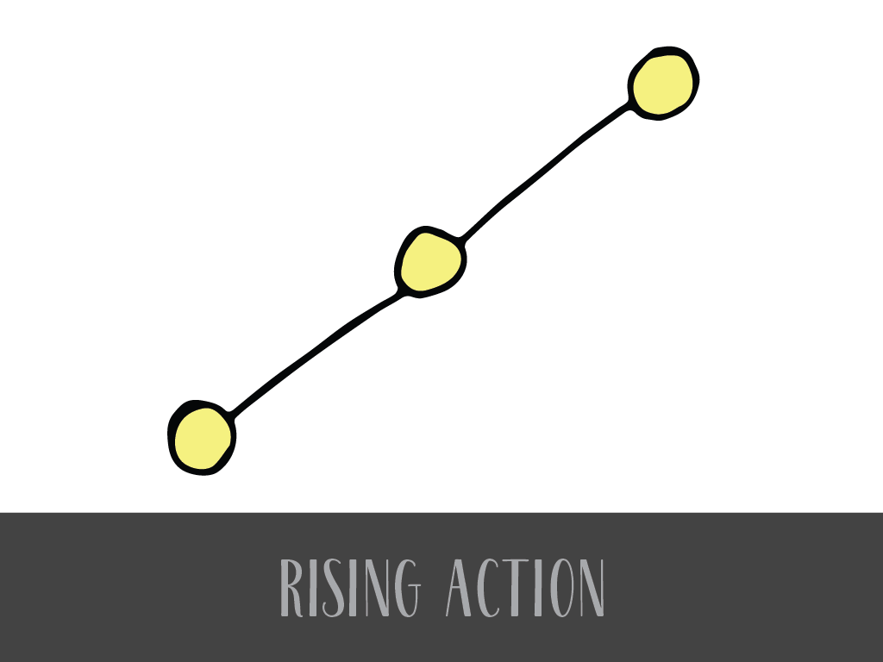
Notes:
Rising action
increasing information and emotional tension. What sequence can do this?
“Demonstration district” gave everyone in the school district temporary access to the library for a limited time
Publicized this offer: farmer’s market, school open houses, skating rink. Everywhere!
Could not lobby for the change to district, could only explain the temporary offer and give information that this would be on the ballot. Difficult!

Slide 48
Continuity
Notes:
(15 MINUTES) 3 structures. First one: Equlibrium. Find trouble? Good, now find the resolution.
Equilibrium, continuity, recovery from disturbance

Slide 49
Notes:
Still pool, big splash, still pool again.
Think “despite the challenges of Covid, we sustained service to people without homes or jobs in our computer lab. Here’s what we learned, here’s what we did. Example: installed software to allow librarians to control computer remotely, to help with filling out housing or job applications & maintain 6 ft distance.”
Feeling is that of a still pool, disrupted, and then still again.

Slide 50
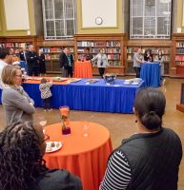
Achievement through Building on Strengths
Book Stories: 20 Years of Library Book Plate Celebrations
Faculty promotion book plating ritual at the University of Illinois at Urbana-Champaign library to celebrate promotion and tenure.
“Libraries in the midst of pandemic reinventions should consider sustaining, reviving, and innovating new forms of storytelling to extend the impact of the library as the bedrock of academic community.”
https://doi.org/10.5860/crl.84.1.49

Slide 51
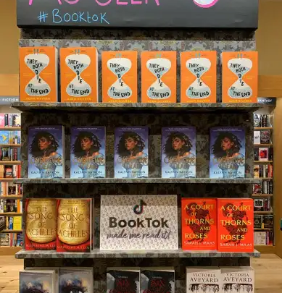
Build on Strengths, Benchmark
We are assessing our library's strengths in social media presence to compare with other libraries and recent online trends so that we can contribute our unique strengths to the larger library community by adding more local and staff book recommendations to our social media presence.
The scope of this project will be informed by similar work at other libraries.
You’ve Heard of TikTok, But Do You Know About BookTok And LibraryTok? https://publiclibrariesonline.org/2023/08/youve-heard-of-tiktok-but-do-you-know-about-booktok-and-librarytok/

Slide 52
Achievement in Serving Needs
“Your Library Too”
Academic staff can be forgotten in marketing of library resources and services.
Designed an engaging and creative event called Summer Fest as an alternative to the traditional workshop.
Creating a campus community of staff that are informed about the library, comfortable using library services and spaces, and powerful library advocates.
https://doi.org/10.5860/crln.84.11.434

Slide 53
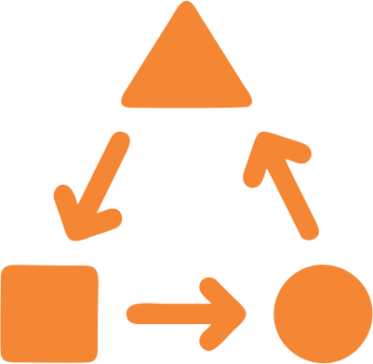
Transformation
Notes:
Hero’s journey, story of transformation, overcoming obstacles
Think awe, amazing accomplishments. Superhero stuff. Think
“how the library helped one person get a job so they could stop living in their car and rent an apartment.” Reaction should be “wow, the library can do that?”
One person’s story may be “anecdata” or it may be inspirational to help make sense of data. But focusing on one person can help to overcome the phenomenon of numbness when we are flooded

Slide 54
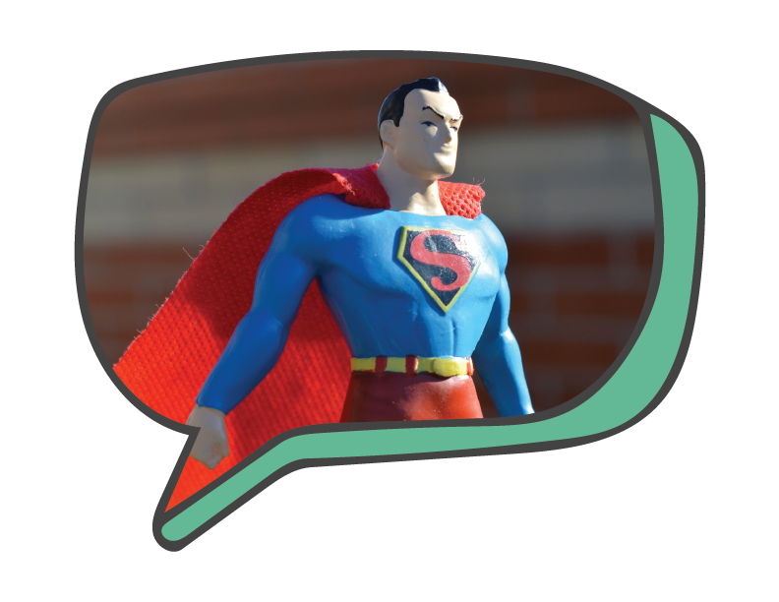
Notes:
Only danger: Superheroes, not most of us. Breaks trust.
Feeling should be that of awe.

Slide 55
Justification for Serving Needs
Academic Library use increases student success
“The analysis of multiple data points (e.g., circulation, library instruction session attendance, online database access, study room use, interlibrary loan) shows that students who used the library in some way achieved higher levels of academic success (e.g., GPA, course grades, retention) than students who did not use the library.”
https://www.ala.org/acrl/sites/ala.org.acrl/files/content/issues/value/y3_summary.pdf

Slide 56
Discovery
Notes:
Leading an audience through information. Revealing more as you go.
Enigma, story of exploration and discovery. Learning, exploring data, coming to understand something complex, difficult, mysterious
Mystery and Revelation
Primary mystery: “Why are you telling me this now?”

Slide 57
inquiry
uncertainty
data
question
information
mystery
revelation
Notes:
Think
“We knew there were children without library cards, but we didn’t know how many, so we used census data and then conducted a survey to find out more about how many, where they live, and what the barriers are. Here’s what we found out and here’s what we’re doing next.”

Slide 58
Achivement of Serving Real Needs,
User survey leads to new technology investments
“We have analyzed results from a patron survey and have changed our investments in technology. We are ready to showcase the new computer workstations, laptops, and other equipment ready for checkout.”
Libraries respond to user survey results with technology improvements.
https://news.emory.edu/stories/2023/12/er_library_improvements_04-12-2023/story.html

Slide 59
Structure Narratives
Continuity
Transformation
Discovery
Notes:
9:40

Slide 60
A Story Worth Retelling
Notes:
https://publiclibrariesonline.org/2021/11/ending-late-fees-a-case-for-equity/
Started much earlier
2016 saw changes: https://www.oakpark.com/2016/12/05/no-more-late-fines-at-the-library/

Slide 61
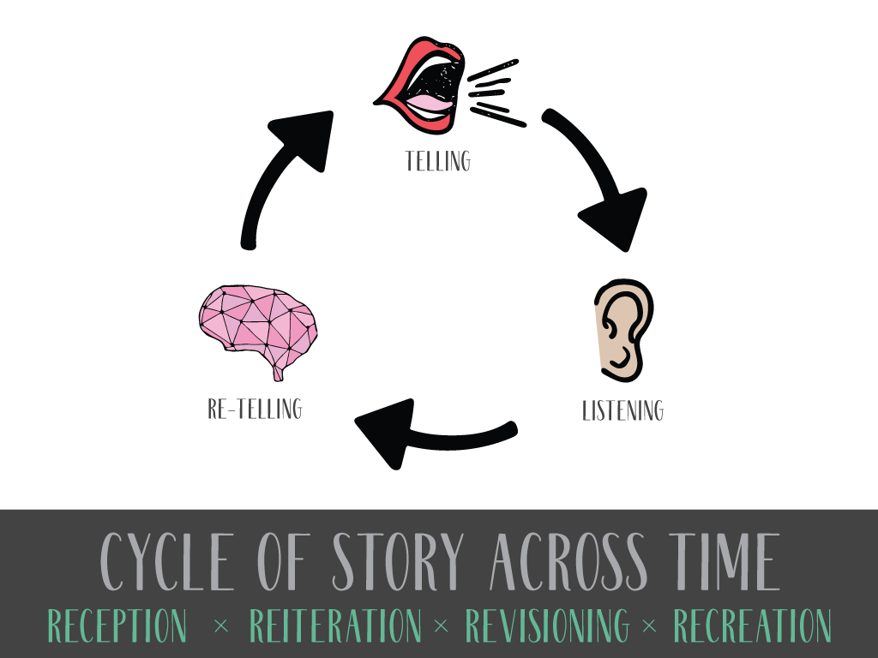
Notes:
COULD cut if demo
Stories that LAST
Good leaders tell stories and listen, changing roles as needed,
But they help the group collaboratively define a collective story
That is good enough to be retold on its own, that stands up to scrutiny, and ultimately stands the test of time.
I’m interested in stories that have lasted. Folklore, hundreds and thousands of years

Slide 62
Long Term Vision
The long-term vision is to cultivate data storytelling expertise as a signature expertise of our field, so that when communities have data storytelling needs, they are met at libraries and by librarians.

Slide 63
Questions? Thank you!
Dr. Kate McDowell
kmcdowel@Illinois.edu
www.katemcdowell.com
LinkedIn.com
kate-mcdowell-86130122/
DSTL
https://uiucdstl.wixsite.com/uiucdstl

Slide 64
References
Baker, A., & Greene, E. (1977). Storytelling: Art and technique. Bowker.
Barthes, R. (1974). S/Z (1st American ed.). Hill and Wang.
Campbell, J. (1949). The Hero with a Thousand Faces. In The Journal of American Folklore (Vol. 63). https://doi.org/10.2307/537371
Lupi, G. (2016). Dear Data (Princeton Architectural Press edition.). Princeton Architectural Press.
McDowell, K. (2024). Library Data Storytelling: Obstacles and Paths Forward. Public Library Quarterly, 43(2), 202–222. https://doi.org/10.1080/01616846.2023.2241514
McDowell, K.; Hu, X.; and Turk, M. “Developing Library and Data Storytelling Toolkits: Scenarios and Personas.” Proceedings of the iConference 2024, forthcoming. https://www.ischools.org/proceedings
McDowell, K. (2023). Making Sense of a Gap: Data Storytelling and Libraries. Public Libraries Magazine, 62(6), 28–35.
McDowell, K. (2021). Storytelling wisdom: Story, information, and DIKW. Journal of the Association for Information Science and Technology, 72(10 (Special Issue: Paradigm Shift in the Field of Information)), 1223–1233. https://doi.org/10.1002/asi.24466
Stone, Deborah. (2020). Counting: How We Use Numbers to Decide What Matters. Liveright.
Tzvetan Todorov & Arnold Weinstein. (1969). Structural Analysis of Narrative. NOVEL: A Forum on Fiction, 3(1), 70–76. https://doi.org/10.2307/1345003

Slide 65
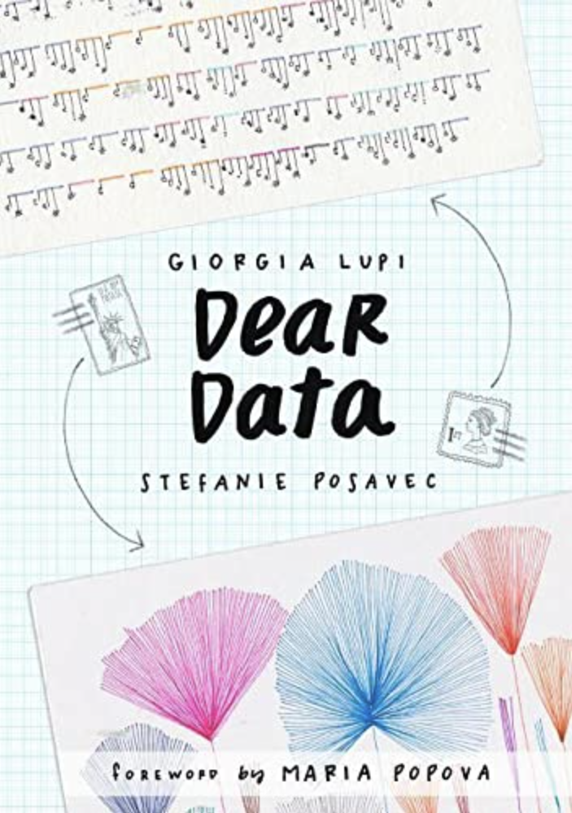
Dear Data: Visual Strategies for Developing Stories
Anything can be measured, objects to experiences and beyond
Full of creative hand-drawn data visualization

Slide 66
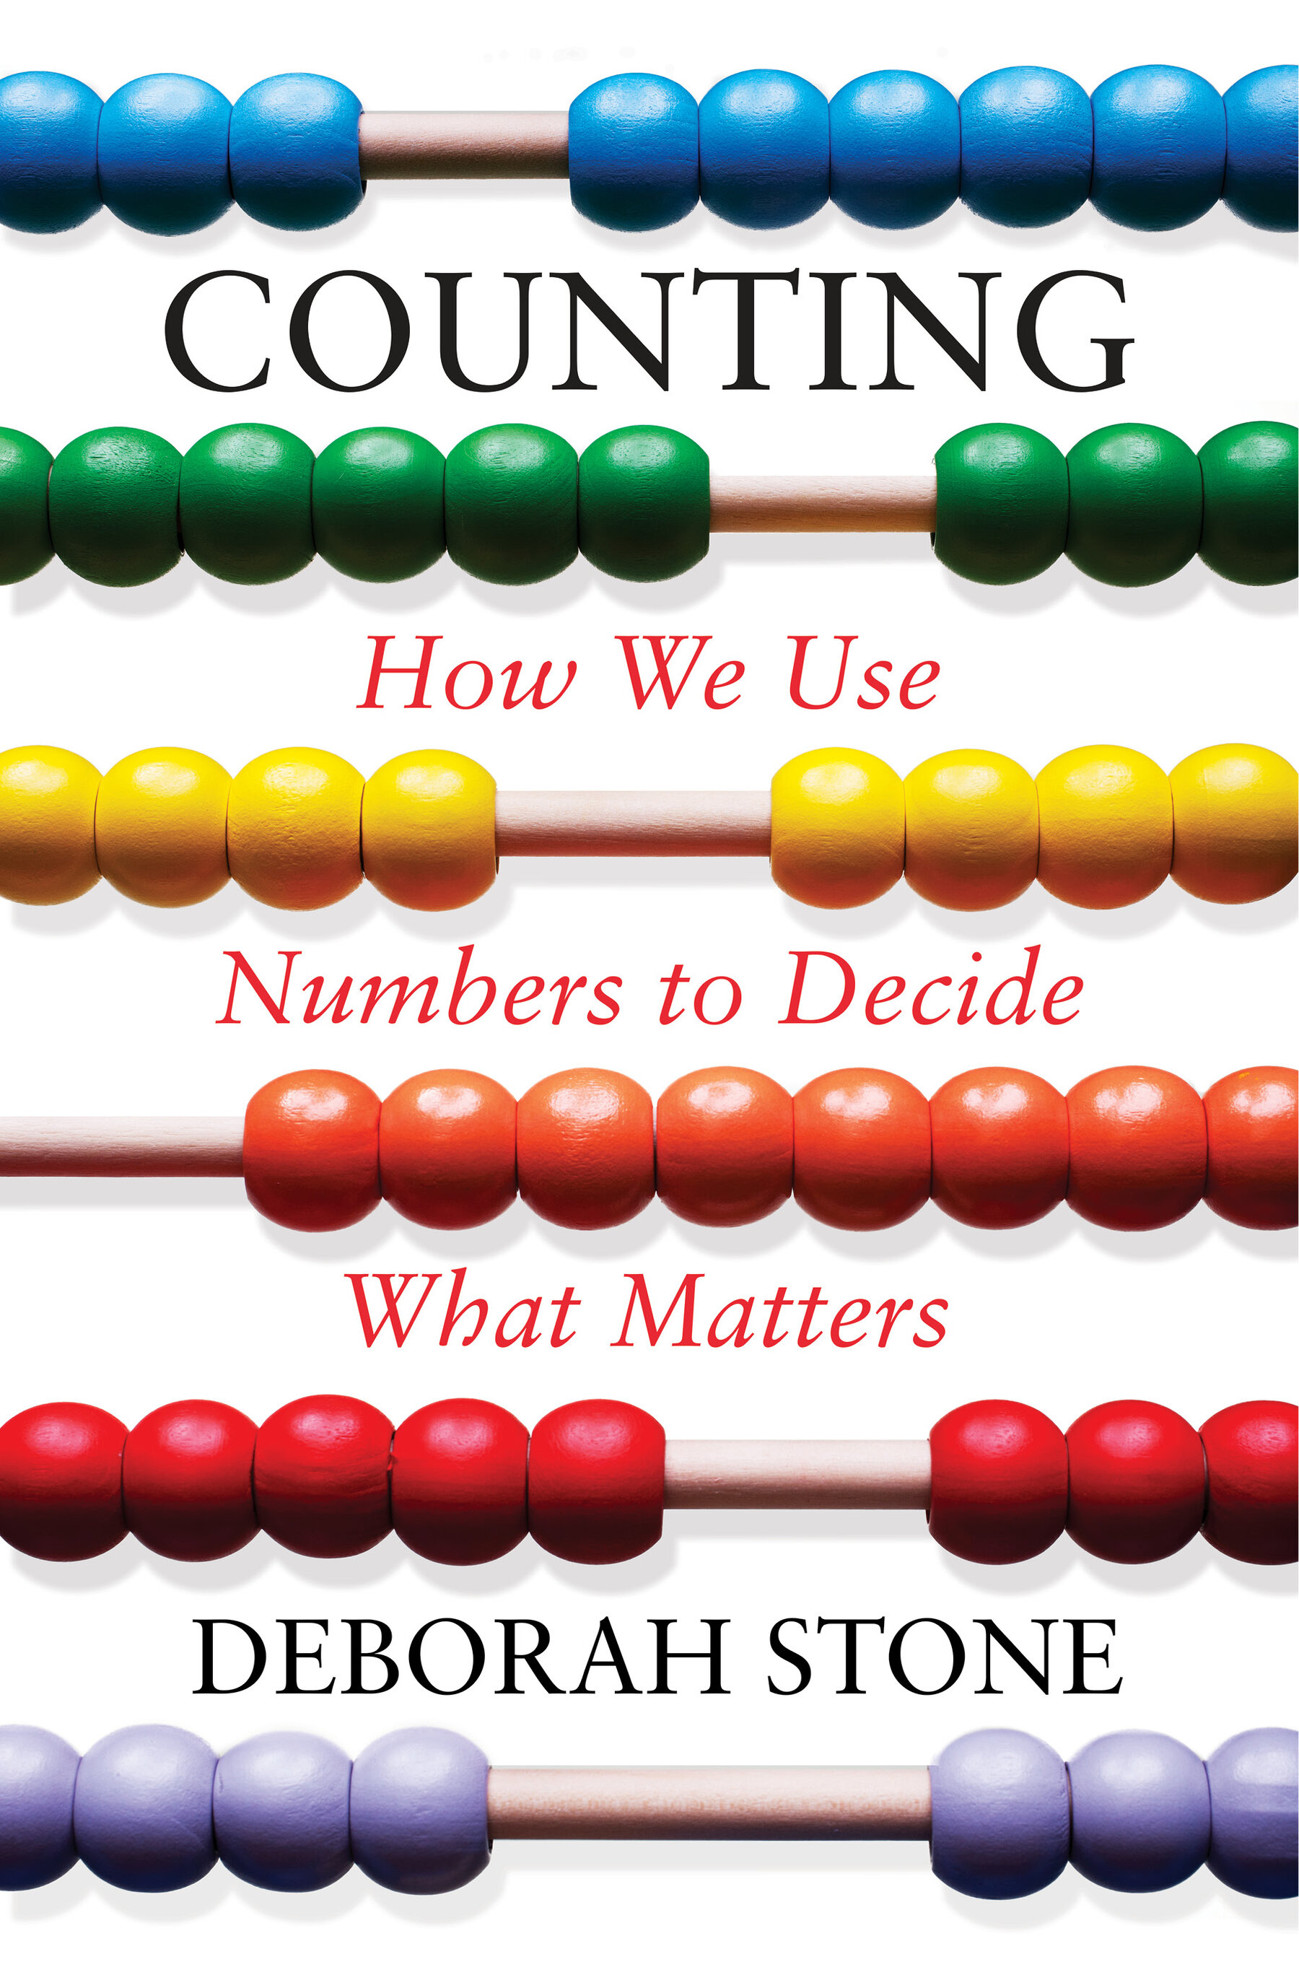
Counting and What Counts
Numbers are not more real than other kinds of data
“Counting is a lot like being a judge. Before we can count up ‘somethings’ we have to decide what counts as a something.” (p. 179)
Finding ways to measure value requires both creativity and integrity

Slide 67
More by Kate McDowell and Collaborators
McDowell, Kate. Book Stories: 20 Years of Library Book Plate Celebrations. College & Research Libraries, January 4, 2023. https://doi.org/10.5860/crl.84.1.49. (open access)
McDowell, K. and Cooke, N. (2022, October). Storytelling and Social Justice: A Pedagogical Imperative. The Library Quarterly. (HTML version free until 1/1/23: https://doi.org/10.1086/721391
McDowell, K. (2021, October 19). Storytelling as information part 1: The S-DIKW framework. Information Matters. https://informationmatters.org/2021/10/storytelling-as-information-part-1-the-s-dikw-framework/ (open access)
_____. (2021, October 19). Storytelling as Information Part 2: Future S-DIKW Research. Information Matters. https://informationmatters.org/2021/10/storytelling-as-information-part-2-future-s-dikw-research/
McDowell, K., & Miller, D. (2021). Great storytelling: Best practices for advancement. Journal of Education Advancement & Marketing, 6(3), 257–267.
McDowell, K. (2020). Storytelling, Young Adults, and Three Paradoxes. In A. Bernier (Ed.), Transforming Young Adult Services, second edition (2nd ed., pp. 93–109). American Library Association-Neal Schuman.
McDowell, K. (2009). Surveying the Field: The Research Model of Women in Librarianship, 1882–1898. The Library Quarterly, 79(3), 279–300.

Slide 68
Image credits
“How Storytelling Affects the Brain” From the infographic "The Science of Storytelling," by OneSpot, https://www.onespot.com/blog/infographic-the-science-of-storytelling/
Caroline Hewins, University of Illinois Archives, The American Library Association Archives, https://archon.library.illinois.edu/ala/index.php?p=digitallibrary/digitalcontent&id=2791
Betsy Hearne, Storytelling from Fireplace to Cyberspace conference, Betsy Hearne
Augusta Baker, New York Public Library, https://www.nypl.org/blog/2021/03/01/nypls-augusta-braxton-baker-fighting-stereotypes-and-developing-diverse-collections
Other photographs from Pixabay, creative commons license
Illustrations by Hilary Pope, graphic designer

Slide 69
Collaborator Acknowledgements
Colleagues Nicole Cooke, Jennifer Burek Pierce, Sara Schwebel, Kyungwon Koh, Jodi Schneider, and Ben Grosser
Xinhui Hu (RA for the DSTL project), co-PI Matt Turk, and the entire 40-person Core Design team and testing team for DSTL
The AIVC team at Illinois and PAHO, including Ian Brooks, Rebecca Kyser, and many more

Slide 70
Workshop
Starts at kl. 11:00

Slide 71
Troubleshooting Library Data Storytelling and Community Misinformation
Workshop kl. 11:00-14:00
(12:15 pause)

Slide 73
I: Introduction II: Story Seeking Data III: Misinformation Interlude IV: Data Becoming Story

Slide 74
Crafting Data Stories
What stories can you craft from data you already have?
Do you have the right data as evidence?
Who are your audiences and what do you know about them?
What’s your story’s narrative structure?

Slide 75
Data Stories for Advocacy
What kinds of motivations and goals do you have for your data stories?
Motivations
justification, benchmark, achievement
Goals
Understand & serve real needs
Build on strengths/address deficits

Slide 76
Narrative Structures
Narrative Structure | Originating Theory | Emotional Impact
Transformation | Campbell, The Hero with a Thousand Faces | Awe at transformation, joy of watching a hero triumph
Continuity | Todorov and Weinstein “Structural Analysis of Narrative” | Stability and resilience despite challenges
Discovery | Roland Barthes S/Z | Mystery, suspense, intrigue, and satisfaction of coming to understanding
Notes:
I draw on my own theoretical knowledge of narrative, and have reframed it for teaching and public use
These theories are used deductively in some of my research
They are also theoretically robust ways of describing common narrative structures that emerge from analysis of organizational narratives
Connective insights that show my humanist foundation even as I bridge to qualitative social sciences

Slide 77
Structure Narratives
Continuity
Transformation
Discovery
Notes:
9:40

Slide 78
Library Data Stories that Reach Audiences
Knowledge levels
Demographics
Attitudes
Positive, negative, mixed, indifferent, polarized

Slide 79
Qualities of Audiences
Knowledge levels
Of organizational context
Of data, in general and in context
Demographic Data
Numbers of people, patrons or students
Languages spoken
Household income levels
Neighborhoods or other geographic factors (colleges within a university)
Age ranges
Cultural groups (ethnic, religious, social, etc.)
Employment (sectors and industries)

Slide 80
Quick Guide to Audience Attitudes
Attitude | Shared reality? | Tone | Tactics
Positive | Yes | Open | Build trust. Don’t take audience sympathy for granted. Make the story easy to retell.
Negative |  | Calm | Focus on persuasion. Restate concerns in positive terms to build common ground. Find compromises, even if disagreements continue. Slow down to de-escalate conflict.
Mixed |  | Open and calm | If some are persuaded, consider the story they need to tell about why.
Indifferent |  | Curious | Start with why it matters for these specific people. Model the interest that you hope to instill. Keep it simple. Ask questions and wait for responses.
Polarized | No | Non-reactive | Stay on message. Do not repeat false information. Consider the value of debate strategically. If the intent is to confuse the voters, avoid debate.

Slide 81
Goals and Motivations
Goals | Motivation: Justification | Motivation: Benchmark | Motivation: Achievement
Understanding real needs | Use evidence of needs to justify resources (investments, time, money). | Use evidence of needs to compare with outside standards or trends. | Demonstrate that needs are understood and next steps to meet needs are clear.
Serving real needs | Design or maintain services based on evidence of needs. | Use evidence of needs met through services to compare with outside standards or trends. | Demonstrate that services are successfully meeting needs.
Build on strengths | Use assessment of strenghts to justify resources that sustain or expand those strengths. | Use evidence of strengths to compare with outside standards or trends and contribute to the larger library community. | Demonstrate that investments to build on strengths are effective and valuable.
Address deficits | Use assessment of deficits to justify resources that can make improvements. | Use evidence of deficits to compare with outside standards or trends and keep up with the larger library community. | Demonstrate that investments to address deficits are effective and valuable.

Slide 82
Storytelling Wisdom and S-DIKW
S-Data Basis of information in story
S-Information Data interpretation with context as story
S-Knowledge Actionable information in story
S-Wisdom Which story to tell when, how, to whom, and more
McDowell, K. (2021). Storytelling wisdom: Story, information, and DIKW. Journal of the Association for Information Science and Technology, 72 (10) (Special Issue: Paradigm Shift in the Field of Information), 1223–1233.
Notes:
QUARTER WAY POINT, 2:45
HERE FOR AWHILE
We need is a modification of this pyramid, this way of understanding fundamental information definitions
Storytelling make a significant adjustment
S-Data—what facts remain constant in this story? Or, ask people, what facts did you learn? What evidence does this story carry?
S-Information—interpretation
S-Knowledge—action, what to do
S-Wisdom—which story to tell,
Why necessary?
Theoretical gaps leave researchers baffled by (mis)information dynamics. We have not theorized important everyday information practices.
Online communication mirrors classic storytelling dynamics, and the framework has explanatory power.
Storytelling is a basic and overlooked way that information is shared and reshaped collectively.
Others have seen this work as necessary too
Citations to this work from many different fields so far,
Safety evaluation
Older adults and health information
Misinformation scholarship
Cultural heritage informatics
Intangible cultural heritage
AI research
Online deliberation platforms
Assessment of knowledge exchange

Slide 83
Story needs character(s) and plot
Main character is what the audience will follow
Plot is the sequence of events or discoveries
Act I: Initial situation
Act II: Problem
Act III: Steps taken and solution (or not)
Lo Duca, Angelica and Kate McDowell. “Using the S-DIKW Framework to Transform Data Visualization into Data Storytelling” (under review)

Slide 84
II: Story seeking data

Slide 85
Case Study: Story Without Data
Automatic invoicing of school teachers classroom use borrowing for lost/damaged books
What data are relevant?
____________________

Slide 86
Case Study: Story Without Data
School teachers borrowing books for classroom use
Teachers often borrow hundreds of books at once, and we did 20000 loans to institutions/schools last year.
Schools are facing hard cuts. Schools have school libraries, which probably are underfinanced.
Book replacement costs real money.
Should the library should automatically invoice schools/barnhagekindergartens for lost/damaged books?
Previously done on a manual basis (time consuming)
Probably (no exact data) lost a lot of money, invoiced very few
Last year, introduced automatic invoicing to save time and money, and to treat everyone equally
This may be damaging the relationship between the library and the schools
Concern that loans will go down because teachers are afraid of the cost if they lose or damage books.
“This decision concerns budgeting, goals, feelings, digitalization of processes, a new and old practice, and our main mission, as stimulation reading for children is the most important thing we do!”
What data are relevant?
____________________

Slide 87
S-Data: Main Character
Visual representation of facts relevant to something people care about, which becomes the main character
Visually identify a problem (Act II)
What values do we bring to the process of interpreting the data to identify a main character?

Slide 88
S-Information: Situation
information, describing the initial situation before the problem occurs (Act I)
Adding context, for example
Commentary: a textual description of the data, or the context around data, such as events, past situations or conditions
Annotation: a short text focused on a specific data point or set of data points
Symbol: a visual element, such as a circle, an arrow or a line, that helps the audience focus the attention
Image: a picture, an illustration, or a photo that helps the audience give a face to the people behind the data.
Context helps to specify the character and anchor the opening of the plot by evoking curiosity to investigate.
Whose perspective(s) inform the description of context?

Slide 89
Information to convey | Description | Suggested Charts
A single piece of information | A single number representing critical information | - Big Number (BAN) - Donut Chart - 100% Stacked Bar Chart - Waffle Chart
Parts of a whole | The components contributing to the entirety of a system, object, or concept. The sum of all components must be 100% | - Pie Chart - 100% Stacked Bar Chart - Multiple Waffle Chart - Donut Chart
Comparison among entities | The similarities and differences between multiple entities to establish relationships and distinctions | - Bar Chart - Column Chart - Slope Graph - Dumbbell Chart - Table
Trend | The behavior of an entity over the time | - Line Chart - Small Multiple Line Chart - Stacked Area Chart - Stacked Column Chart
Outcomes of a survey or a questionnaire | Answers to questions contained in a survey or a questionnaire | - Stacked Bar Chart - Column Chart - Multiple Bar Charts
Distribution | Spread of values across a dataset, indicating how frequently different values occur | - Histogram - Pyramid - Box Plot
Relationship | Association, connection, or correlation between different entities to identify patterns, trends, and dependencies | - Scatterplot - Bubble Chart - Heatmap
Spatial information | The behavior of an entity over the space | - Choropleth Map - Dot Density Map - Proportional Symbol Map - Heatmap
Flow | Represent a process | - Sankey - Chord

Slide 90
S-Knowledge: Plot
With a defined initial situation and data character, the plot now develops to discover
meaning at the level of knowledge of the problem,
the enigma or mystery and disclosure of what happens, and
whether or not the data character solves the problem.
In a presentation, these steps occur sequentially; in a chart, these steps are designed to be followed visually.
These representations together create a full picture of what to know, understand, learn, and/or what to do based on this data story.

Slide 91
Potential Actions Based on Knowledge
Category | Description | Purpose | Example
Ask for support | Ask the audience to support the story in some way | Leverage the audience’s competencies to solve the problems highlighted in the story | A text inviting the audience to participate in a survey
Provide different options | Provide the audience with potential alternatives to proceed | Help the audience's decision-making process | A list of possible alternative next directionssteps: A, B, C
Free interact Freelyion | Leave the audience the possibility to freely interact with the story | Let the audience analyze the data and draw conclusions | An interactive chart or dashboard
Learn more | Encourage the audience to delve deeper into the topic or insights presented in the data story | Direct the audience to additional resources, articles, studies, or references for a more comprehensive understanding | A link to an in-depth analysis report
Propose a plan | Propose a plan outlining the sequence of actions to be taken next. | Let the audience continue working on the story after its end | A list of possible sequential next steps
Shareing | Encourage the audience to share the data story, for example, on their social networks. | Leverage the audience's networks, foster discussions, and increase visibility to amplify the reach of the data story | AUse social media post buttons to sharinge the story

Slide 92
S-Knowledge Summary
the visual and textual elements to add to the story at this stage are:
Commentary, annotation, or additional charts stating the main problem and the solution
Proposed next steps
Pointer to outside resources, such as a link, which reinforces the proposed next steps.

Slide 93
S-Wisdom: Tailoring Story to Audience
Editing by selecting actionable insights for a specific audience
Includes a call to action

Slide 94
Types of Audience
Audience Type | Requirements | What to represent
General Public | Understand data | An appealing overview of insights
Executives | High-level overview of data trends to aid strategic decision-making | Highlight critical metrics and trends influencing business outcomes
Professionals | Detailed insights to understand the phenomenon behind data | Add numbers, statistics, and helpful information to understand insights deeply and communicate them effectively

Slide 95
Audience Knowledge and Goal
Audience | Knowledge Before the story | Goals or strategies After the story
public | lower knowledge levels | more variation of attitudes, but the goal is to persuade for democratic support
executives | high knowledge levels but may lack a detailed understanding of data | decision-making power and how they can be persuaded but also retell the story to others to justify decisions
professionals | high knowledge level, most detailed understanding of data | persuade executives as decision-makers, but they do not need to persuade the public

Slide 96
Back to Case Study
Would a data storytelling approach clearly explain the situation?
Could a different approach to character, plot, or audience lead us to novel solutions?
Does analysis of possible data stories explain why different audiences hold very different points of view?
What values do we bring to the interpretation of the data?
Other thoughts?

Slide 97
Pause/Break
Kaffe, te, etc.

Slide 98
III: Misinformation Interlude

Slide 99
Interlude: Library-Related Misinformation
A case study based on a true story

Slide 100
Library Renovation Misinformation
Library renovation is slow in the US
40% of library buildings have not been renovated since 2000 or earlier
Library board asked to vote on renovation plans.
Mayor secretly cut blueprints by 25%.
Mayor threatened to fire library director if cuts were revealed.
Word got out. Officials demanded to see the original plans, with the original square footage. Original renovation was funded and completed.
Notes:
Over twenty years ago, in a small town in the Midwest, there was a library board tasked with approving plans for a long-awaited building expansion. Building renovations should be a routine story for libraries, but in fact recent data show that 40% of library buildings have not been renovated since 2000 or earlier (PLA https://www.ala.org/pla/sites/ala.org.pla/files/content/data/PLA_Services_Survey_Report_2023.pdf p. 1). In this case, the building renovation plans looked complete, and the board was almost ready to vote and send the plans up to city council. But there was a catch. In a secret meeting, the mayor demanded that the library director change the building plans, reducing the square footage of the planned expansion by almost 25%. The library director was told to tell no one, not even the board who would be voting, or else he would be fired. Large amounts of data, like highly detailed blueprints, can be overwhelming, and the mayor was counting on no one noticing the difference. Fortunately, library board members noticed, and word got back to the city council that the plans had been altered without a public process. Officials demanded to see the original plans, with the original square footage. Stakeholders at all levels are obligated, for the good of public and institutional resources, to ask detailed questions about proposals for major renovations. Thanks to motivated public officials and a budget that could handle the expansion, the originally planned renovations were completed. That building stands today, serving a busy community of library lovers.

Slide 101
Mis-Dis-Mal-information
Wardle, Claire. “Understanding Information Disorder.” First Draft, September 22, 2020.
https://firstdraftnews.org/long-form-article/understanding-information-disorder/

Slide 102
Mis-Dis-Mal-information Case Study
The mayor created disinformation about the library renovation plans to try to save the city money.
This became misinformation when it was unwittingly shared by library board members.
The mayor planned to spread malinformation when he threatened to fire the library director if the director revealed the truth. Fortunately, it did not come to that.
The misinformation was corrected, the source of the disinformation was revealed, the malinformation did not spread, and the mayor was not re-elected.

Slide 103
Storytelling and/as Misinformation
Storytelling dynamics and narrative structures for three cases of Covid-19 viral misinformation
McDowell, K. (2024). “Storytelling and/as Misinformation” in Everyday MIsinformation. Cambridge University Press. (in press).
Notes:
ALSO HERE FOR AWHILE Coosa River, Wetumpka, AL
Painting from 1847
https://digital.archives.alabama.gov/digital/collection/photo/id/4449
Alabama Department of Archives and History
Introduction as Story
two historical stories of community experiences related to health and medicine. The first story comes from my family. My mother heard a story from her grandmother about being a young mother herself during the 1918 influenza epidemic, when the whole household came down with the flu. Her parents (my great-great-grandparents) left food on the porch and visited through an open window, using much the same “social distancing” practices in Wetumpka, Alabama in 1918 as in the COVID-19 pandemic. The wisdom of these practices left an impression, and she recognized them immediately when they were called into use globally once again in spring of 2020. Continuity of stories in families can provide a kind of storytelling wisdom that accompanies the stories we inherit. (McDowell 2021)
Also in Alabama, fourteen years later and 51 miles away in Tuskegee, the U.S. Public Health Service launched the Tuskegee Syphillis study in 1932. The history of this study involves racism, torture, and genocidal practices against Black men who were unknowingly subjects of experimentation with untreated syphilis infections. For qualitative researchers, this history is repeated at every basic Institutional Review Board (IRB) training. This unethical study is one of the main reasons for the 1974 National Research Act, which requires “voluntary informed consent” from all human research subjects. (Centers for Disease Control and Prevention 2021)
Families who experienced the pain, suffering, and in many cases the death of their loved ones later learned that they had gone untreated because of deception, as a “scientific” experiment. Here as well, information was inherited in the form of storytelling wisdom. Communities that have been subjected to this and other kinds of systemic persecution are reasonably skeptical of new health interventions. When medicine enacts genocide, it does terrible damage at the level of public trust, with impacts for generations to come, and this is one story in a larger history of federally supported medical racism.
And the resistance of communities impacted should be seen not as an information problem, but as a historically and storytelling-informed wisdom.
Why are stories distorted? Academic and cultural heritage institutions bear much responsibility
The stories of indigenous lives in the Americas have been difficult to tell because of these and other limiting academic beliefs. In her article establishing the “importance of felt experiences as community knowledges,” Million writes:
“The mainstream white society read Native stories through thick pathology narratives. Yet the same stories collectively witnessed the social violence that was and is colonialism's heart. Individually or collectively, these stories were hard to ‘tell.’ They were neither emotionally easy nor communally acceptable. […]
To ‘tell’ called for a reevaluation of reservation and reserve beliefs about what was appropriate to say about your own family, your community” (Million 2009 p. 56).
Million, Dian. “Felt Theory: An Indigenous Feminist Approach to Affect and History.” Wicazo Sa Review 24, no. 2 (2009): 53–76.
Epistemicide, which ideas are killed and how that impacts which stories are told and what information is recorded
The Alabama Department of Archives & History said in a statement in 2020 that for much of the 20th century it promoted a view of history that favored the Confederacy and failed to document the lives and contributions of Black Alabamians.
https://www.al.com/news/2020/06/archives-department-acknowledges-role-in-distorting-alabamas-racial-history.html
--Beth Patin at Syracuse

Slide 104
Misinformation S-DIKW Framework
Bad S-Data: Evoking cultural cues that imply factuality for data that is false
Bad S-Information: False data with context that misinforms in story
Bad S-Knowledge: Stories based on false information that lead to ineffective or harmful actions
Bad S-Wisdom: Reactivity that leads to retelling misinformation as story without checking sources in ways that amplify harm
McDowell, K. (2023). Storytelling Dynamics and Misinformation: The Bad S-DIKW Framework. Information Matters. https://informationmatters.org/2023/04/storytelling-dynamics-and-misinformation-the-bad-s-dikw-framework/
Notes:
Third iteration, based on https://asistdl.onlinelibrary.wiley.com/doi/10.1002/asi.24466
How can a person teach information literacy, data literacy, in this kind of environment?

Slide 105
Analyzing Misinformation
Using storytelling concepts and narrative structures to understand misinformation content and sharing

Slide 106
IV: Data Becoming Story

Slide 107
Case Study: Data Without Story
Fornyelser/Renewals (p. 8)
Arrangement/Programming (p. 9)
Which dataset/visualization should we choose?
What topics are important, now or soon?
Which of datasets are interrelated?

Slide 108
Crafting Data Stories
What stories can you craft from data you already have?
Do you have the right data as evidence?
Who are your audiences and what do you know about them?
What’s your story’s narrative structure?

Slide 109
Data Stories for Advocacy
What kinds of motivations and goals do you have for your data stories?
Motivations
justification, benchmark, achievement
Goals
Understand & serve real needs
Build on strengths/address deficits

Slide 110
Library Data Stories that Reach Audiences
Knowledge levels
Demographics
Attitudes
Positive, negative, mixed, indifferent, polarized

Slide 111
Qualities of Audiences
Knowledge levels
Of organizational context
Of data, in general and in context
Demographic Data
Numbers of people, patrons or students
Languages spoken
Household income levels
Neighborhoods or other geographic factors (colleges within a university)
Age ranges
Cultural groups (ethnic, religious, social, etc.)
Employment (sectors and industries)

Slide 112
Quick Guide to Audience Attitudes
Attitude | Shared reality? | Tone | Tactics
Positive | Yes | Open | Build trust. Don’t take audience sympathy for granted. Make the story easy to retell.
Negative |  | Calm | Focus on persuasion. Restate concerns in positive terms to build common ground. Find compromises, even if disagreements continue. Slow down to de-escalate conflict.
Mixed |  | Open and calm | If some are persuaded, consider the story they need to tell about why.
Indifferent |  | Curious | Start with why it matters for these specific people. Model the interest that you hope to instill. Keep it simple. Ask questions and wait for responses.
Polarized | No | Non-reactive | Stay on message. Do not repeat false information. Consider the value of debate strategically. If the intent is to confuse the voters, avoid debate.

Slide 113
Structure Narratives
Continuity
Transformation
Discovery
Notes:
9:40

Slide 114
Narrative Structures
Narrative Structure | Originating Theory | Emotional Impact
Transformation | Campbell, The Hero with a Thousand Faces | Awe at transformation, joy of watching a hero triumph
Continuity | Todorov and Weinstein “Structural Analysis of Narrative” | Stability and resilience despite challenges
Discovery | Roland Barthes S/Z | Mystery, suspense, intrigue, and satisfaction of coming to understanding
Notes:
I draw on my own theoretical knowledge of narrative, and have reframed it for teaching and public use
These theories are used deductively in some of my research
They are also theoretically robust ways of describing common narrative structures that emerge from analysis of organizational narratives
Connective insights that show my humanist foundation even as I bridge to qualitative social sciences

Slide 115
Notes:
Beginning, middle, end, yes, but a list has these too
What makes story different is the intertwining of information and emotion, and middles are hard
Big campaign to expand the library taxing district. Smaller than school district, so uneven access. Some kids could have cards, some could not.
“Demonstration district” gave everyone in the school district temporary access to working library cards for a limited time
Publicized this offer: farmer’s market, grocery stores, school open houses, skating rink. Everywhere!
Could not lobby for the change to district, could only explain the temporary offer and give information that this would be on the ballot. Difficult!
Ultimately, ballot measure failed, but the demonstration increased awareness so that kids outside of the library taxing district could come to the library and use resources even without a library card.

Slide 116
Notes:
Rising action
increasing information and emotional tension. What sequence can do this?
“Demonstration district” gave everyone in the school district temporary access to the library for a limited time
Publicized this offer: farmer’s market, school open houses, skating rink. Everywhere!
Could not lobby for the change to district, could only explain the temporary offer and give information that this would be on the ballot. Difficult!

Slide 117
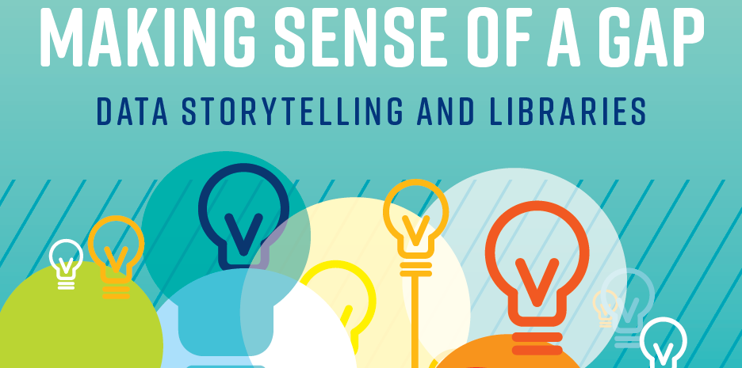
Notes:
Imagine benchmarking your library’s metrics against some similar
libraries in the region. What do you do when you find a big gap, and
your library is behind? How do you start to mobilize the resources to
improve? Powerful data tools exist to compare one library with
another, but tools alone can’t tell you how to advocate for change.
Data storytelling can turn a gap into an advocacy opportunity.

Slide 118
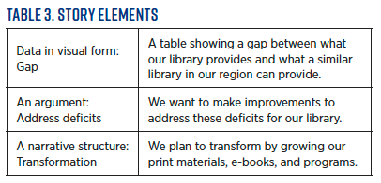
Showing the story in data

Slide 119
Story plan
McDowell, K. (2023). Making Sense of a Gap: Data Storytelling and Libraries. Public Libraries Magazine, 62(6), 28–35.

Slide 120
Cases | Insights from Triangle | Insights from Narrative Structure
Library Data Storytelling Insights
Notes:
Medicine Misuse: Desperation and Ivermectin
could have been true, but the data weren’t fully collected yet
“What they’re not telling you” rhetoric to enlist “truth-tellers”
Transformation: “truth-telling” actually propagating misinformation
Discovery: revealing something everyday with unexpected and hidden uses
Exploiting Vaccine Hesitancy: Faked Magnetism
Video “evidence” that vaccinations caused bodily magnetism
Conspiracy tellers and audiences locked into interrelated stories with ever-narrowing window for contrary evidence
Continuity: resist change no matter the circumstances
Aftermath of Medical Racism: Vaccine Questioning
Inherited information resulting from traumatic medical racism
Distrust between public health authorities and BIPOC audiences
Two narrative structures at odds
Transformation narrative about heroic family members who survived federally funded medical torture
Discovery narrative about invention and value of vaccines in a pandemic
Language of “questioning” vs. “hesitancy”

Slide 121
Cases | Insights from Triangle | Insights from Narrative Structure
Medicine Misuse: Desperation and Ivermectin | Teller allies with audience against “them” and “what they’re not telling you” “Secret” revealed to audience, aura of mystery | Transformation story, teller as “hero” revealing “truth” discovery narrative, revealing something everyday with hidden uses
Exploiting Vaccine Hesitancy: Faked Magnetism | Teller uses shock based on trickery to activate audience emotionally to resist If audience trusts teller, then likelihood of retelling increases | Continuity story, in that the underlying message is to focus on maintaining the status quo despite disruption
Aftermath of Medical Racism: Vaccine Questioning | Inherited information, teller and audience are insiders together as families who survived Governmental medical officials expect trust because of expertise and believe that more information is the answer | Transformation structure makes those survived despite terrible obstacles heroes Public health officials hope to tell a discovery narrative about the invention and value of vaccines
Storytelling Insights
Notes:
Medicine Misuse: Desperation and Ivermectin
could have been true, but the data weren’t fully collected yet
“What they’re not telling you” rhetoric to enlist “truth-tellers”
Transformation: “truth-telling” actually propagating misinformation
Discovery: revealing something everyday with unexpected and hidden uses
Exploiting Vaccine Hesitancy: Faked Magnetism
Video “evidence” that vaccinations caused bodily magnetism
Conspiracy tellers and audiences locked into interrelated stories with ever-narrowing window for contrary evidence
Continuity: resist change no matter the circumstances
Aftermath of Medical Racism: Vaccine Questioning
Inherited information resulting from traumatic medical racism
Distrust between public health authorities and BIPOC audiences
Two narrative structures at odds
Transformation narrative about heroic family members who survived federally funded medical torture
Discovery narrative about invention and value of vaccines in a pandemic
Language of “questioning” vs. “hesitancy”

Slide 122
Cases | Insights from Triangle | Insights from Narrative Structure
MisinformationStorytelling Insights
Notes:
Medicine Misuse: Desperation and Ivermectin
could have been true, but the data weren’t fully collected yet
“What they’re not telling you” rhetoric to enlist “truth-tellers”
Transformation: “truth-telling” actually propagating misinformation
Discovery: revealing something everyday with unexpected and hidden uses
Exploiting Vaccine Hesitancy: Faked Magnetism
Video “evidence” that vaccinations caused bodily magnetism
Conspiracy tellers and audiences locked into interrelated stories with ever-narrowing window for contrary evidence
Continuity: resist change no matter the circumstances
Aftermath of Medical Racism: Vaccine Questioning
Inherited information resulting from traumatic medical racism
Distrust between public health authorities and BIPOC audiences
Two narrative structures at odds
Transformation narrative about heroic family members who survived federally funded medical torture
Discovery narrative about invention and value of vaccines in a pandemic
Language of “questioning” vs. “hesitancy”

Slide 123
Addressing Polarized Audiences
Identifying the problem
Determining what to do about the problem
Determining when to try to persuade and when to avoid debate
Staying on message

