Slide 1
Connecting to Your Best Stuff
Elevating Resources in Primo VE
CARLI Discovery Primo VE Committee
June 11, 2024 | 11 am - 12 pm

Slide 2
Overview

Slide 3
Use Primo VE functionality to help Library users "connect to the good stuff" in your catalog
Resource Recommender
Search Ranking
Showcase

Slide 4
Specific, individual items
Specific, sets of items

Slide 5
Resource Recommender

Slide 6
Resource Recommender
“The Resource Recommender service enables you to recommend….resources based on searchable tags that you configure in Alma…”
-ExLibris Knowledge Center

Slide 7
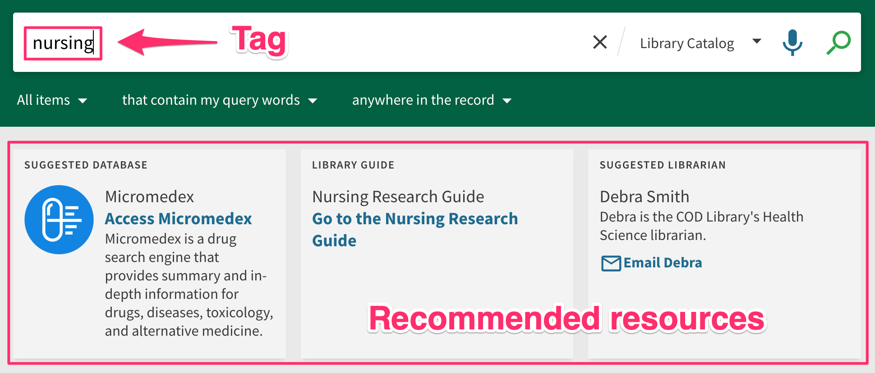

Slide 8
Resource Recommender
These resources can include:
Databases (Or other electronic resources)
Library guides
Websites
Custom resources
Library contacts (Liaison contact information, etc.)
Library information (Hours, locations, etc.)
Banners/alerts

Slide 9
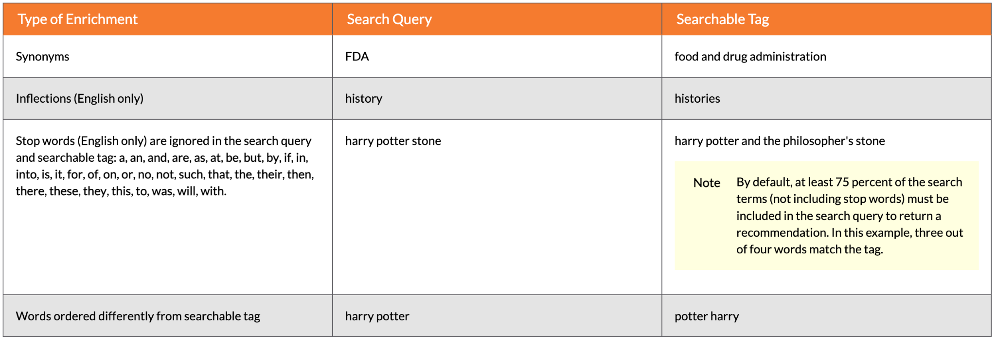
Search queries don’t always have to match the tag exactly:
To change the required amount of search term matching, modify the following parameter:
Configuration > Discovery > Other > Customer Settings -> resource_recommender_tags_min_coverage

Slide 10
Scenarios
Resources with multiple/confusing access points
Premium resources
Underutilized resources
Specific curriculum resources
Access instructions
Lateral resources (Research guides, contact info.)

Slide 11
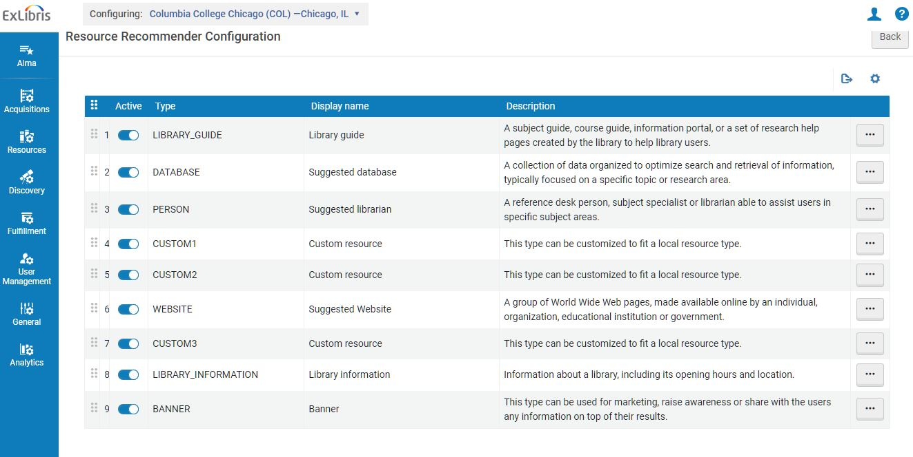
Configuration
Configuration menu > Discovery > Other > Resource Recommender Configuration

Slide 12
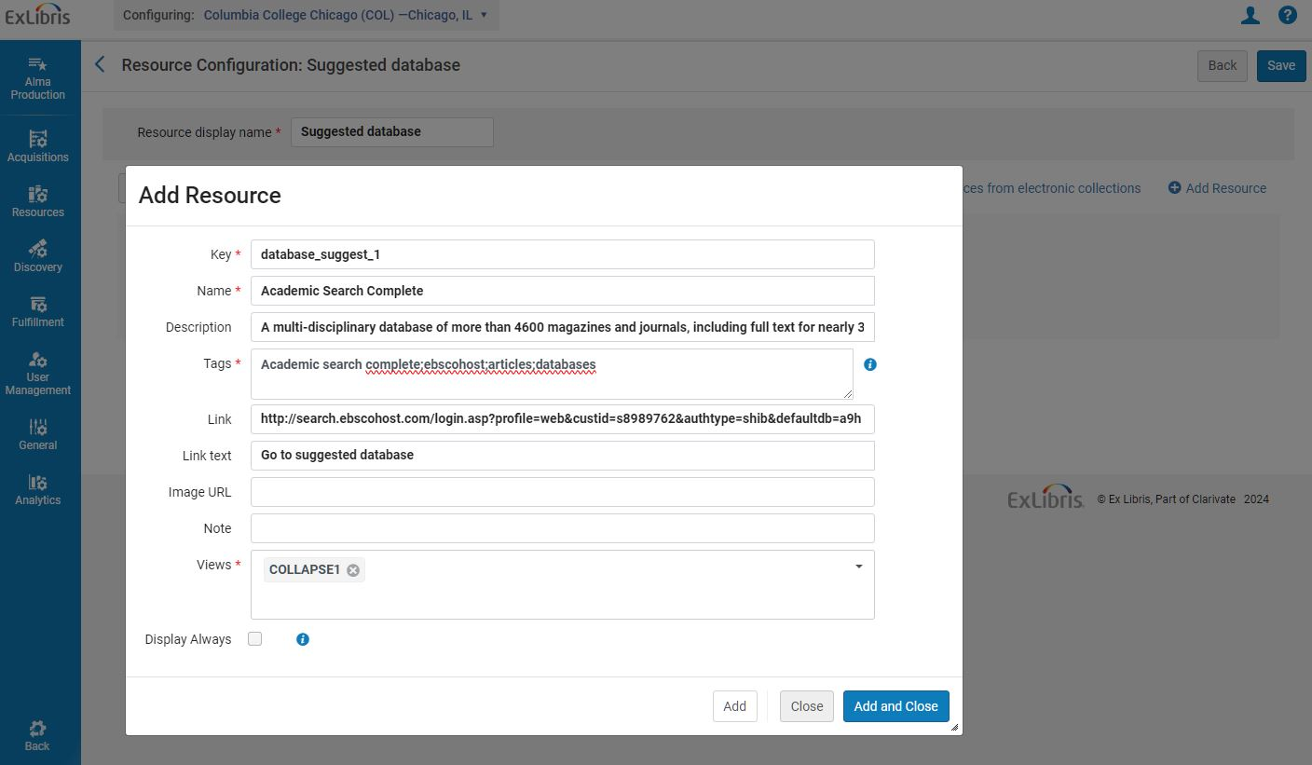
Example 1: Adding a Suggested Database

Slide 13
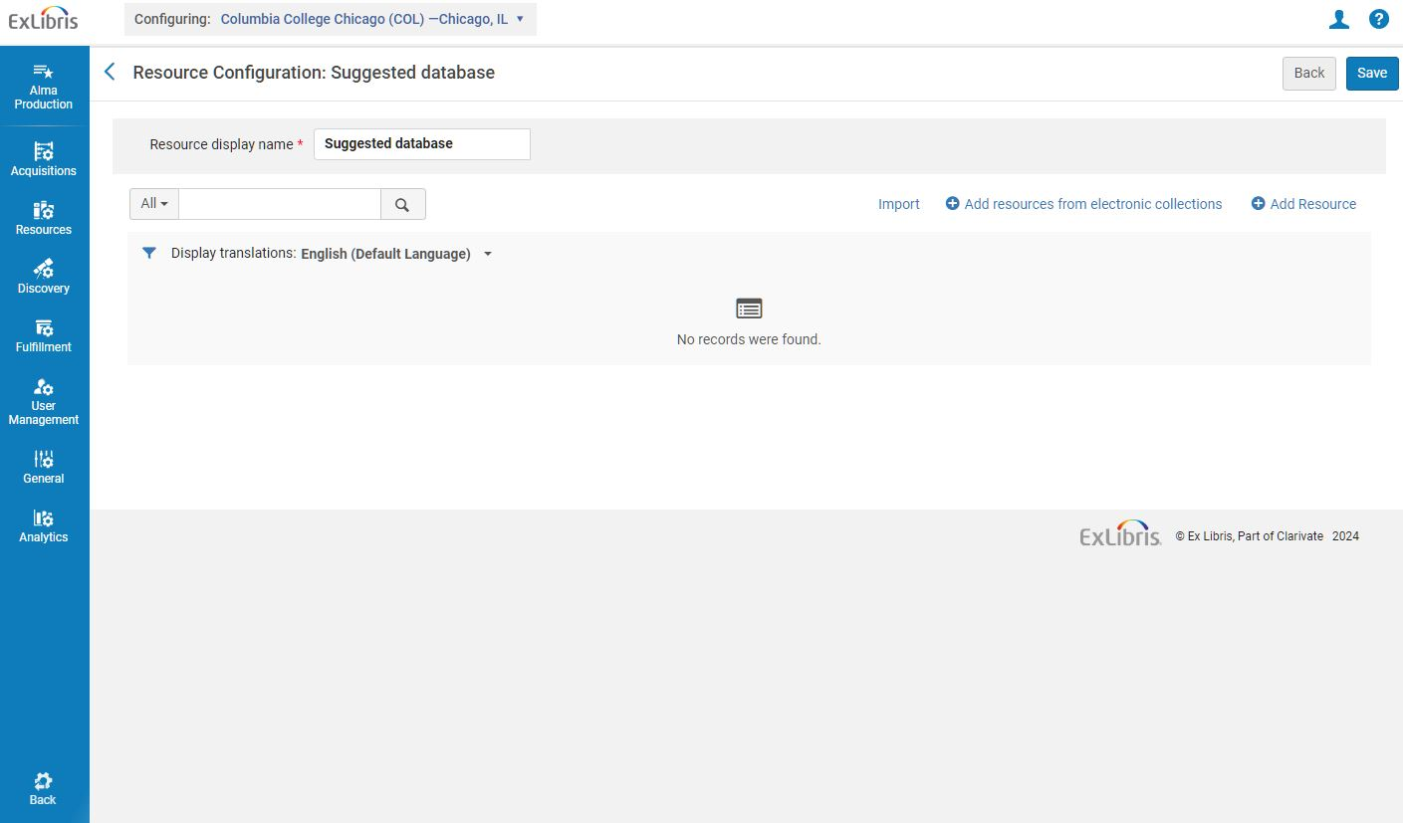
Example 1: Adding a Suggested Database

Slide 14
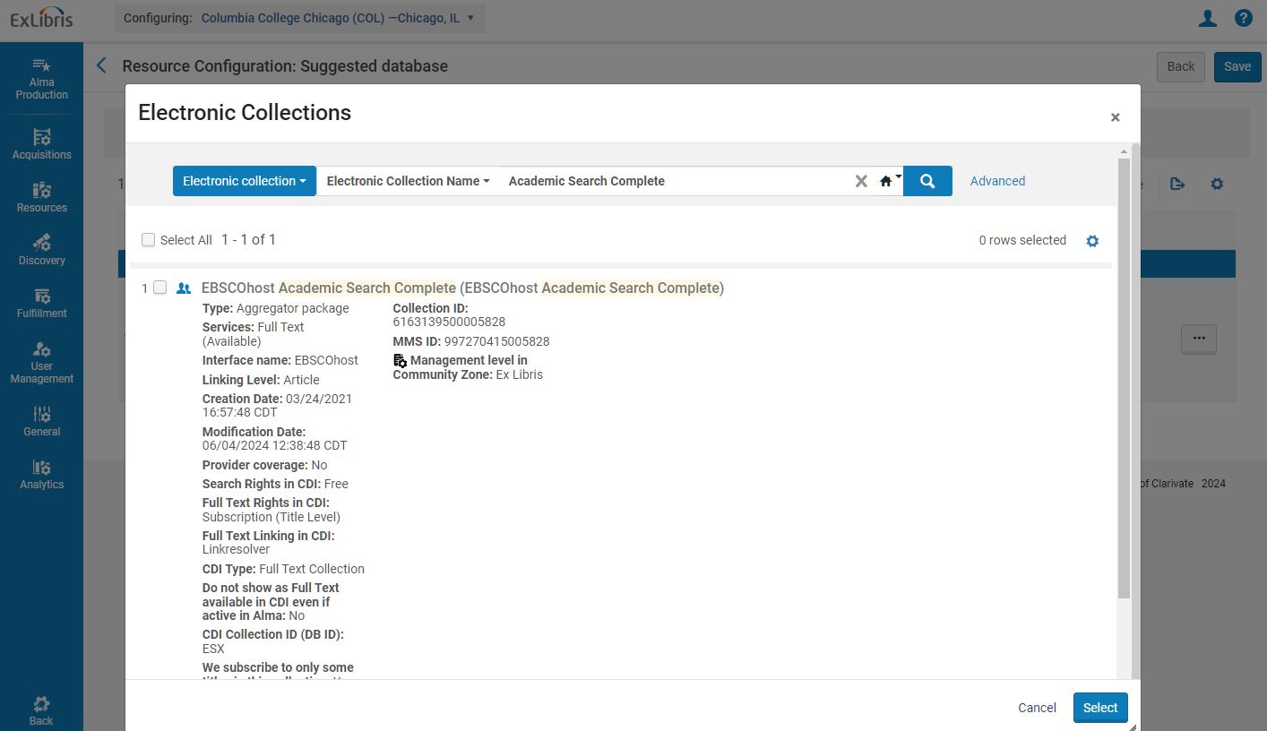
Example 1: Adding a Suggested Database

Slide 15
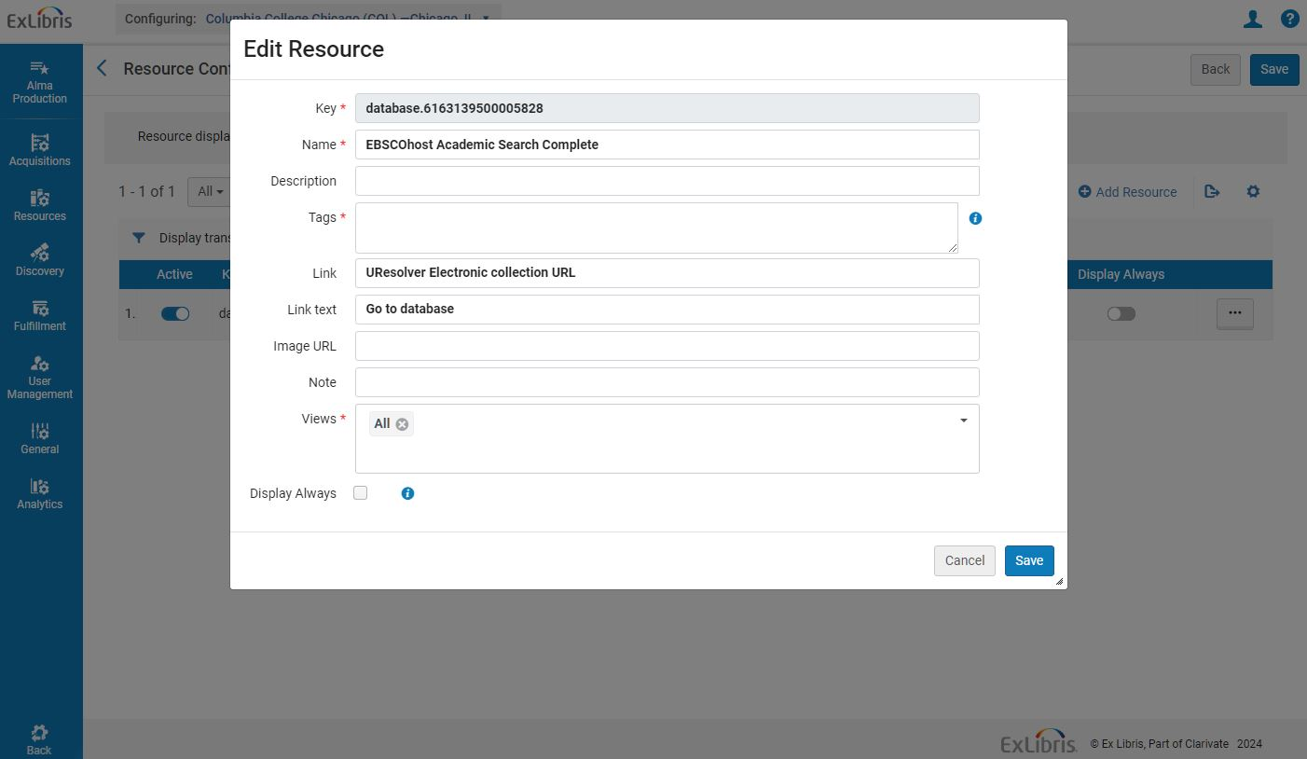
Example 1: Adding a Suggested Database
Electronic collections -> Edit collection -> Additional -> Level URL

Slide 16
Example 2: Importing Suggested Resources with a Spreadsheet
Spreadsheet example available here: https://knowledge.exlibrisgroup.com/@api/deki/files/68837/Database_List.xlsx?revision=3

Slide 17
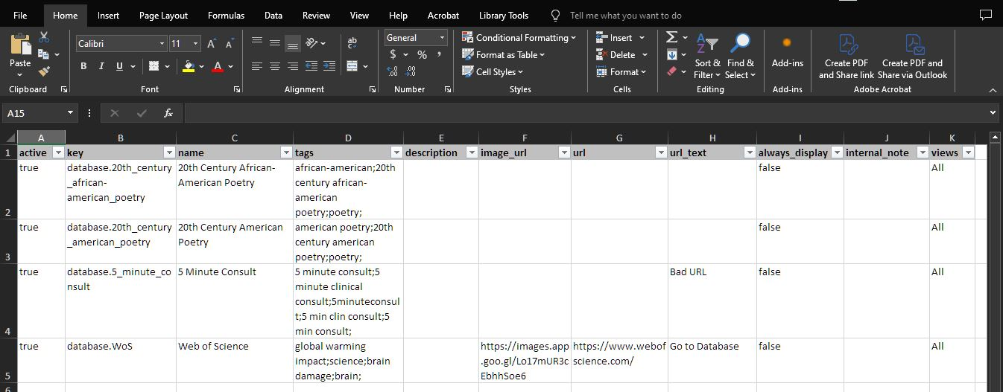
Example 2: Importing Suggested Resources with a Spreadsheet

Slide 18
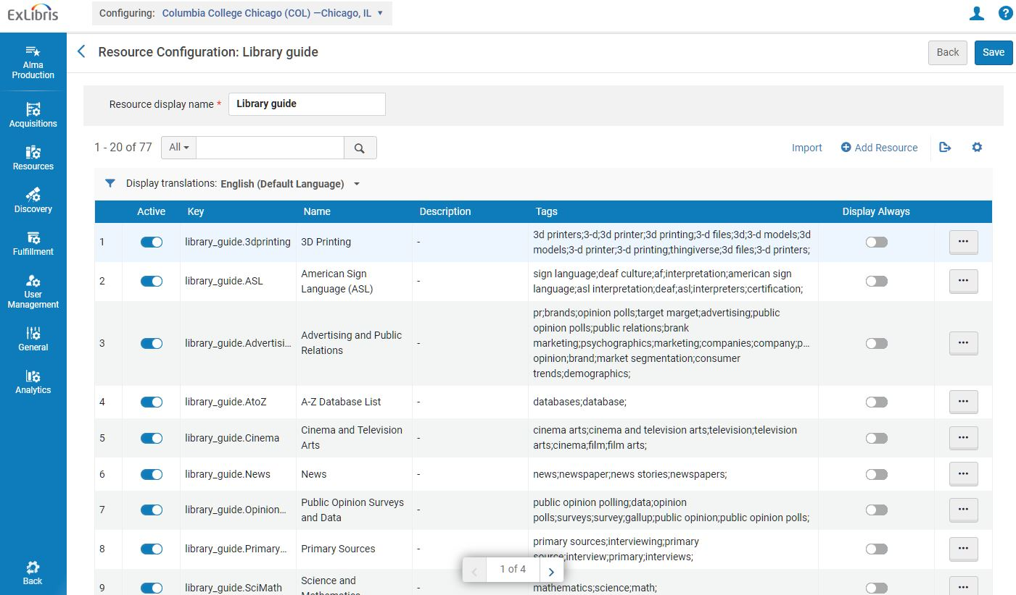
Example 2: Importing Suggested Resources with a Spreadsheet

Slide 19
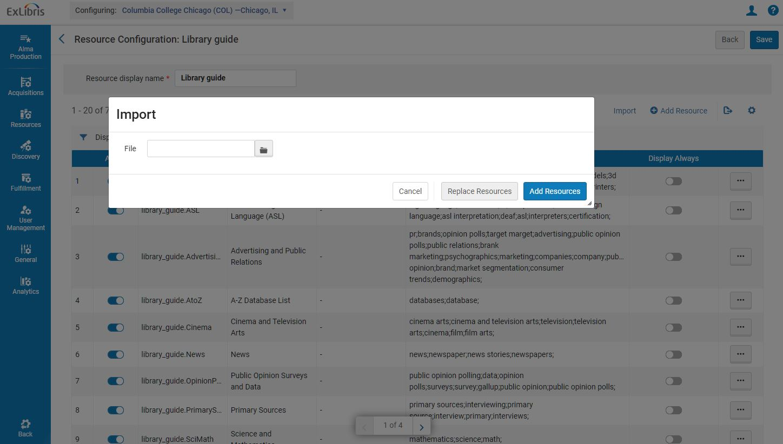
Example 2: Importing Suggested Resources with a Spreadsheet
Add Resources: Adds recommendations to the existing list of recommendations for this resource type.
Replace Resources: Replace all recommendations for this resource type.

Slide 20
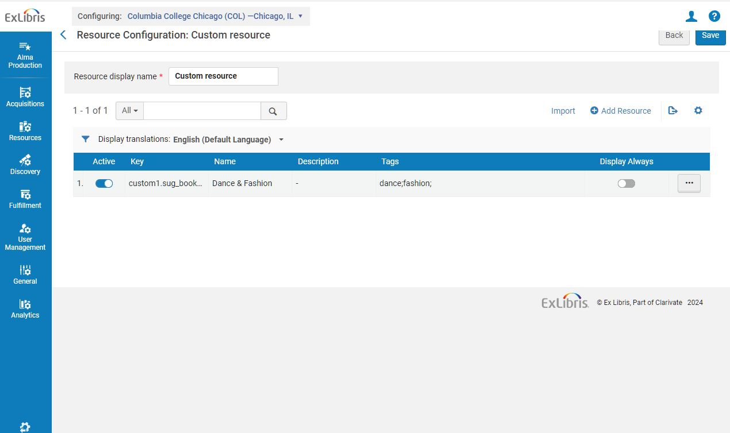
Example 3: Adding a Suggested Custom Resource

Slide 21
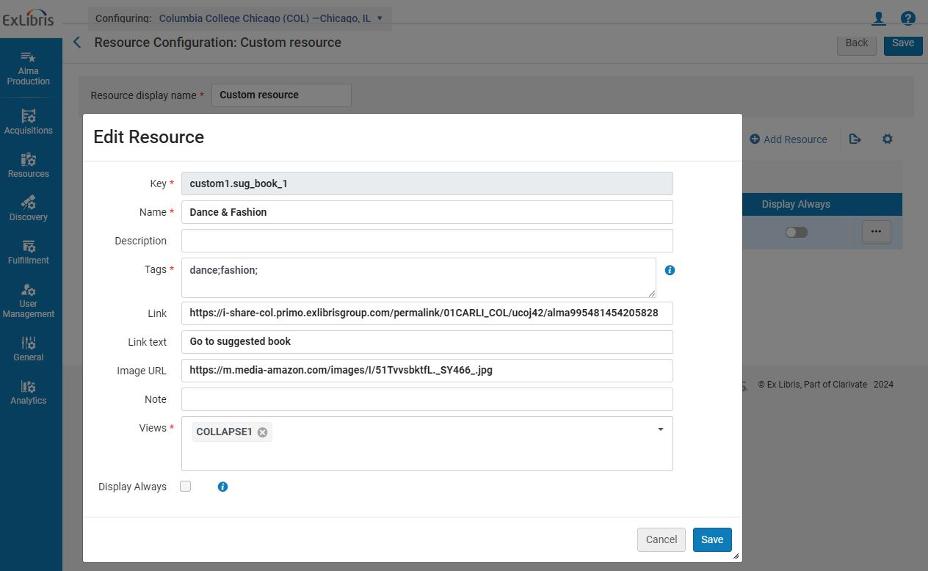
Example 3: Adding a Suggested Custom Resource

Slide 22
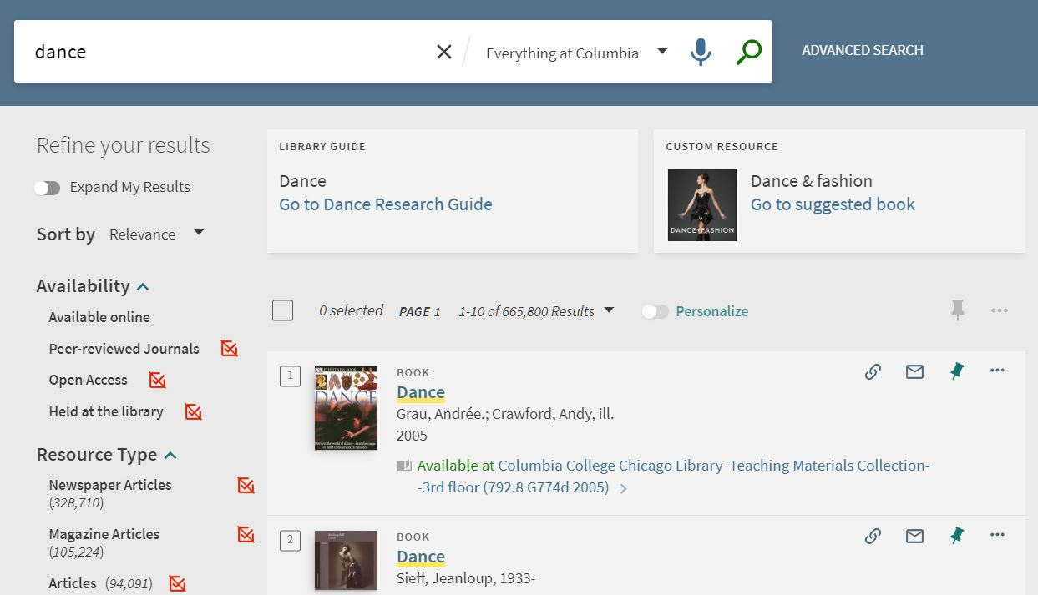
Example 3: Adding a Suggested Custom Resource
Labels can also be changed in configuration:
Configuration -> Discovery -> Display Configuration -> Labels
Edit “Resource Recommender Codes” in the table

Slide 23
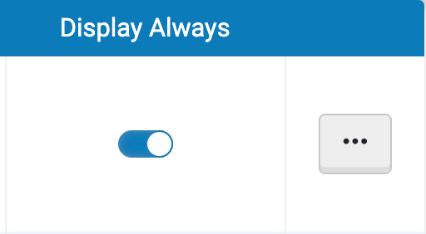
Global notifications
Outages
Emergency notifications?

Slide 24
Considerations
Information overload
Too many resources for a single tag
Overly wordy descriptions
Use thumbnails
Manageability/sustainability
Faculty/staff input
Suggested resources
Tag review

Slide 25
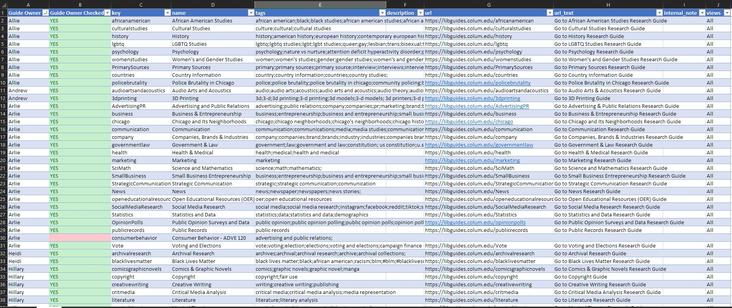
Staff Input
Spreadsheet used by Columbia College library liaisons to review suggested guides and enter tags

Slide 26
Resources
Resource Recommender (ExLibris documentation)
https://t.ly/IKvmU
Resource Recommender (CARLI/SIU Presentation)
https://www.carli.illinois.edu/sites/files/files/20220512_Resource_Recommender_Thompson.pdf

Slide 27
Ranking Configuration
Notes:
Why we started investigating ranking configuration at IWU
Goal: Wanted our local records to appear higher in Everything rankings
Frustrations about items owned by our library being buried; too many ILL requests for ebooks/books that were available in I-Share
Other ways to achieve this, but I was interested in exploring ranking as a possible solution
Collected examples from colleagues
Your use cases may look different; goals you want to achieve will be different
Not going to talk so much about the exact changes we made, but how we went about it
Please contact me if you want to talk about the exact changes!
Initial research/CARLI help: Needed to identify which ranking configuration settings would help achieve my goal
Listserv research, reviewed documentation from ExLibris & CARLI
Initially started looking at Ranking Configuration > Institution Boosting
CARLI pointed me to Boosting Records in Blended Profiles (thanks, Annie!)
Explain difference between two?
Where I made changes
Demo or show screenshots of where to find Institution Boosting & Boosting Records in Blended Profiles
Note that there are other settings you could test depending on your goal
How I tested
Institution Boosting: Sandbox
Tested in sandbox with FRBR groupings turned on (like our institution), similar sized institution
Boosting Records in Blended Profiles: Created test search profile slot
Walk through steps?
Small increments
One change at a time
Document everything!
Starting point, changes in settings, changing in rankings, questions, observations
Different documentation styles
Some people use bare bones documenting (i.e. not title, just local vs. CDI record, for example), some use screenshots, I use a table and record as much info as possible (easiest for me to identify the changes in rank)
Briefly show examples?
Find what works for you & what will help meet your goals
Test many different examples
Helps identify implications you may not have considered
Other Tips
Collect a wide variety of examples/test cases
Change search after modifying a boost
Change capital letter so the search will be recalculated (listserv tip) or use incognito browser
No magic numbers for boosting
Collect feedback from colleagues after making changes in production
Chart of scopes/profiles/slots

Slide 28
Getting Started
Identify local goals
Collect examples from colleagues
Your use cases and goals will look different!
Overview of how we went about the changes

Slide 29
Initial Research
Listservs, CARLI Support, documentation from ExLibris & CARLI
Identified two areas to explore:
Institution Boosting:
Changes the weight of local IZ records in search results
Boosting Records in Blended Profiles:
Blended profiles contain multiple search engines (i.e. CDI, local records, etc.)
Increases relevance from a particular source in blended profile
Local records seems to include IZ & NZ

Slide 30
Institution Boosting
Configuration > Discovery > Search Configuration > Ranking Configuration > Institution Boosting
Also Fields Boosting, Date Boosting, Resource Type Boosting

Slide 31
Boosting Records in Blended Profiles
Configuration > Discovery > Search Configuration > Search Profiles
Click 3-dot Edit menu next to selected Search Profile, then Configure Blending

Slide 32
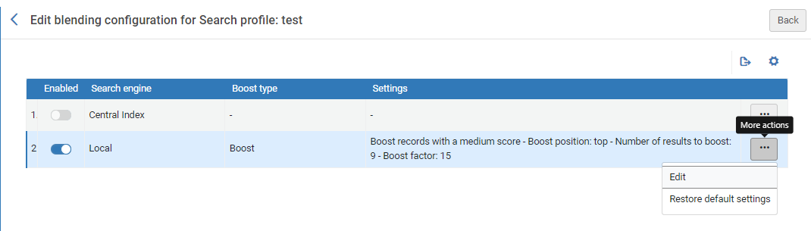
Boosting Records in Blended Profiles
3. Click 3-dot menu next to search engine to configure, then Edit

Slide 33
Testing
Used sandbox for Institution Boosting tests
No changes to production environment
Can’t test exact use cases
Sought sandbox institution with similar FRBR settings
Created test search profile slot for Boosting Records in Blended Profiles

Slide 34
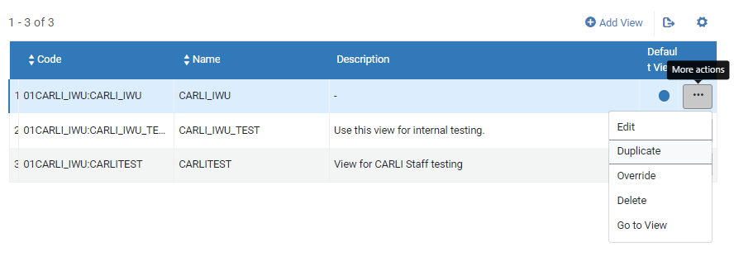
Testing: Create a Test Search Profile Slot
Part 1: Create a test view
1. Configuration > Discovery > Display Configuration > Configure Views
2. Click the 3-dot menu next to production view, then Duplicate

Slide 35
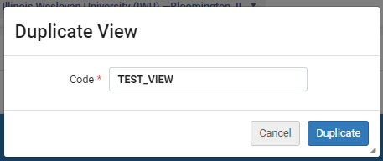
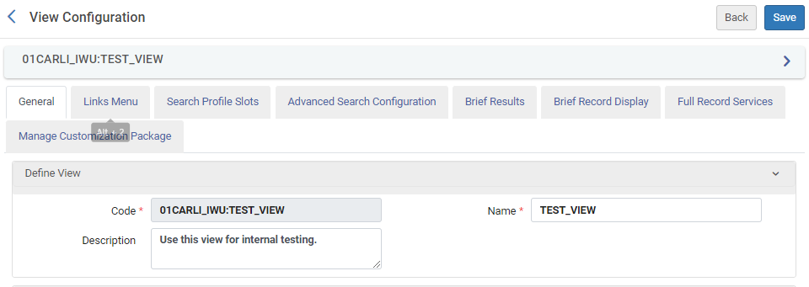
Testing: Create a Test Search Profile Slot
Part 1: Create a test view
3. Add a Code (no spaces), then click Duplicate
4. Click 3-dot menu next to the newly created view then Edit to add/edit the description

Slide 36
Testing: Create a Test Search Profile Slot
Part 2: Create the test search profile 1. Configuration > Discovery > Search Profiles > Add a Search Profile
2. Assign Code, Display Name, Description

Slide 37
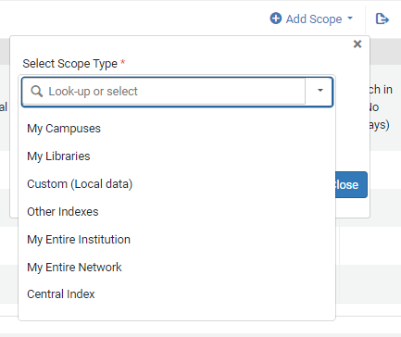
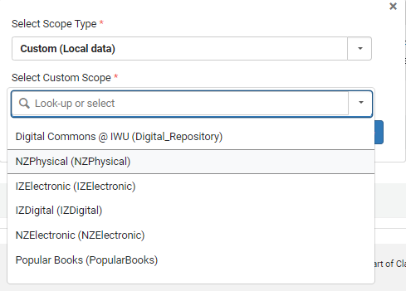
Testing: Create a Test Search Profile Slot
Part 2: Create the test search profile 3. Add Scope(s) to the test profile (replicate the production profile you want to change)
4. Click Save

Slide 38
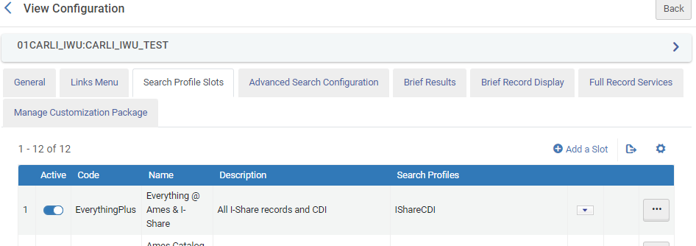
Testing: Create a Test Search Profile Slot
Part 3: Add the test search profile slot to your test view
Configuration > Discovery > Display Configuration > Configure Views
Click the 3-dot menu next to your test view, then Edit
Go to the the Search Profile Slots tab
Click Add a Slot

Slide 39
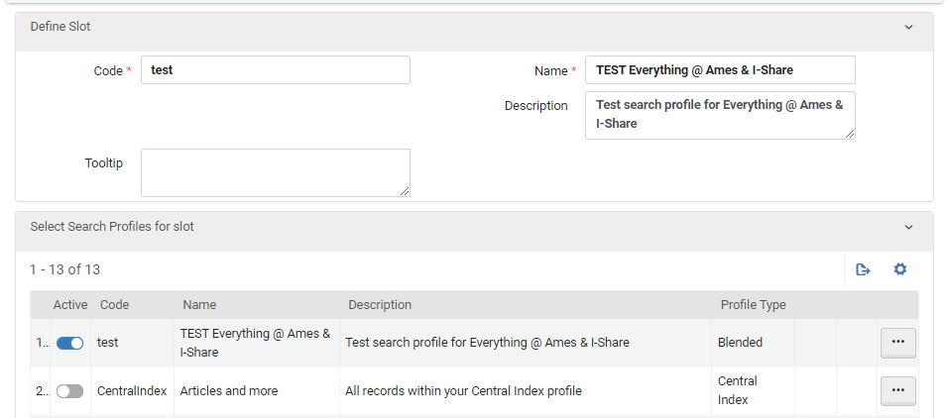
Testing: Create a Test Search Profile Slot
Part 3: Add the test search profile slot to your test view
5. Assign the slot a Code, Name, and Description, then toggle on your test search profile
6. Click Save

Slide 40
Testing
Change only one thing at a time (it is tempting to do more!)
Make changes in small increments
“Be the documentation you want to see”
Screenshots, starting point, changes in settings, changes in rankings, questions, observations
Test several different examples

Slide 41
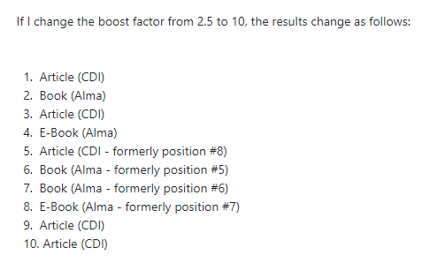

Slide 42
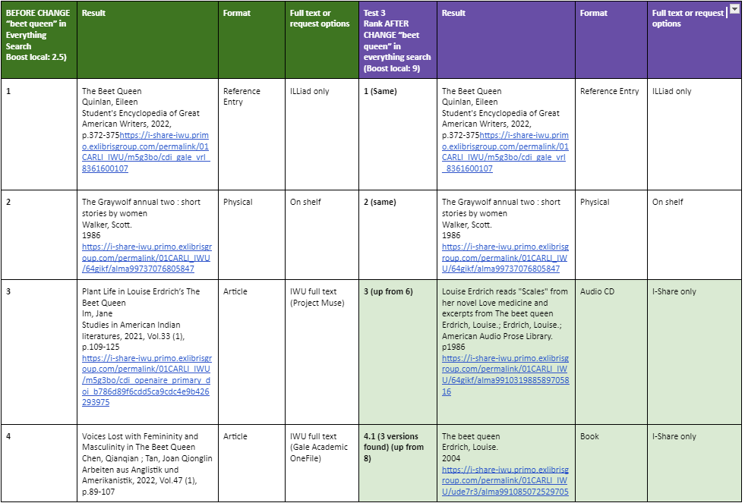

Slide 43
Other Tips
Collect a variety of examples/test cases before testing
No magic numbers for boosting
Listserv tip: Change a capital letter in search terms so the search will be recalculated
Collect feedback from colleagues after making changes in production
Contact me at lspradli@iwu.edu if you want to learn more about our particular testing and changes!

Slide 44
Resources
CARLI Primo VE Search Ranking Configuration
https://www.carli.illinois.edu/products-services/i-share/discovery-interface/ranking_configuration
Configuring the Ranking of Search Results in Primo VE
https://t.ly/pMjUb
CARLI Primo VE Boosting Records in Blended Search Profiles https://www.carli.illinois.edu/products-services/i-share/discovery-interface/blended_search_profiles
ExLibris Boosting Records in Blended Search Profiles https://knowledge.exlibrisgroup.com/Primo/Product_Documentation/020Primo_VE/Primo_VE_(English)/040Search_Configurations/010Configuring_Search_Profiles_for_Primo_VE#Boosting_Records_in_Blended_Search_Profiles
Notes:
ExLibris listservs: https://exlibrisusers.org/postorius/lists/
CARLI email lists: https://www.carli.illinois.edu/email-lists
-CARLI Primo VE Boosting Records in Blended Search Profiles: https://www.carli.illinois.edu/products-services/i-share/discovery-interface/blended_search_profiles
-CARLI Primo VE Search Ranking Configuration: https://www.carli.illinois.edu/products-services/i-share/discovery-interface/ranking_configuration
ExLibris Adding a Search Profile: https://knowledge.exlibrisgroup.com/Primo/Product_Documentation/020Primo_VE/Primo_VE_(English)/040Search_Configurations/010Configuring_Search_Profiles_for_Primo_VE#Adding_a_Search_Profile
-ExLibris Boosting Records in Blended Search Profiles: https://knowledge.exlibrisgroup.com/Primo/Product_Documentation/020Primo_VE/Primo_VE_(English)/040Search_Configurations/010Configuring_Search_Profiles_for_Primo_VE#Boosting_Records_in_Blended_Search_Profiles
- ExLibris Configuring the Ranking of Search Results in Primo VE: https://knowledge.exlibrisgroup.com/Primo/Product_Documentation/020Primo_VE/Primo_VE_(English)/040Search_Configurations/Configuring_the_Ranking_of_Search_Results_in_Primo_VE

Slide 45
Resources
ExLibris Adding a Search Profile https://knowledge.exlibrisgroup.com/Primo/Product_Documentation/020Primo_VE/Primo_VE_(English)/040Search_Configurations/010Configuring_Search_Profiles_for_Primo_VE#Adding_a_Search_Profile
CARLI Email Lists https://www.carli.illinois.edu/email-lists
ExLibris Listservs https://exlibrisusers.org/postorius/lists/
Notes:
-ExLibris listservs: https://exlibrisusers.org/postorius/lists/
-CARLI email lists: https://www.carli.illinois.edu/email-lists
-CARLI Primo VE Boosting Records in Blended Search Profiles: https://www.carli.illinois.edu/products-services/i-share/discovery-interface/blended_search_profiles
-CARLI Primo VE Search Ranking Configuration: https://www.carli.illinois.edu/products-services/i-share/discovery-interface/ranking_configuration
-ExLibris Adding a Search Profile: https://knowledge.exlibrisgroup.com/Primo/Product_Documentation/020Primo_VE/Primo_VE_(English)/040Search_Configurations/010Configuring_Search_Profiles_for_Primo_VE#Adding_a_Search_Profile
-ExLibris Boosting Records in Blended Search Profiles: https://knowledge.exlibrisgroup.com/Primo/Product_Documentation/020Primo_VE/Primo_VE_(English)/040Search_Configurations/010Configuring_Search_Profiles_for_Primo_VE#Boosting_Records_in_Blended_Search_Profiles
- ExLibris Configuring the Ranking of Search Results in Primo VE: https://knowledge.exlibrisgroup.com/Primo/Product_Documentation/020Primo_VE/Primo_VE_(English)/040Search_Configurations/Configuring_the_Ranking_of_Search_Results_in_Primo_VE

Slide 46
Primo Showcase

Slide 47
Showcase
Allows you to create a visual representation of a set of any Primo VE search results
This visual representation is in the form of a browsable carousel of cover images
This representation can be embedded in any webpage

Slide 48
Showcase
Example 1
Example 2

Slide 49
Uses
Showcase titles on specific subjects
Showcase new titles
Showcase items sets are dynamically generated

Slide 50
Implementation/Configuration
Part 1 (One time)
Upload/host JavaScript code to your server
Allow your domain to embed a Discovery Showcase widget
Invoke the JS file on your website

Slide 51
Implementation/Configuration
Part 2 (Each embedded instance)
Customize to widget code
Embed the widget code in your page
<search-carousel titleText="{title}" titleLink="{link}" defaultThumbnailURL="{default_thumbnail_url}" searchURL="{primo_search_query}"></search-carousel>

Slide 52
Implementation/Configuration
Part 2 (Each embedded instance)
<search-carousel titleText="New Artificial Intelligence Books" titleLink="https://t.ly/VdJg-" defaultThumbnailURL="https://example.com/cover-image.png" searchurl="https://i-share-cod.primo.exlibrisgroup.com/primaws/rest/external/pnxs?acTriggered=false&blendFacetsSeparately=false&citationTrailFilterByAvailability=true&disableCache=false&getMore=0&inst=01CARLI_COD&isCDSearch=false&lang=en&limit=10&mode=basic&multiFacets=facet_newrecords,include,90+days+back&newspapersActive=false&newspapersSearch=false&offset=0&otbRanking=false&pcAvailability=true&q=any,contains,artificial+intelligence&qExclude=&qInclude=&rapido=false&refEntryActive=false&rtaLinks=true&scope=MyInstitution&searchInFulltextUserSelection=true&skipDelivery=Y&sort=rank&tab=LibraryCatalog&vid=01CARLI_COD:CARLI_COD"></search-carousel>

Slide 53
searchurl
Do any search in Primo VE
Get the PNX API search URL
Use your browsers “inspect” function
Make a small alteration to the API search URL
Change: primaws/rest/pub/pnxs
To: primaws/rest/external/pnxs

Slide 54
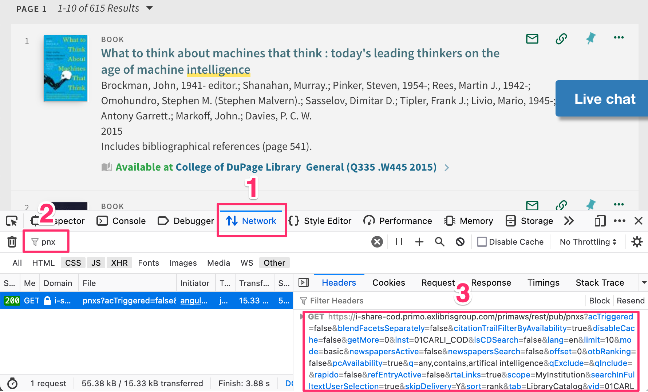
searchurl

Slide 55
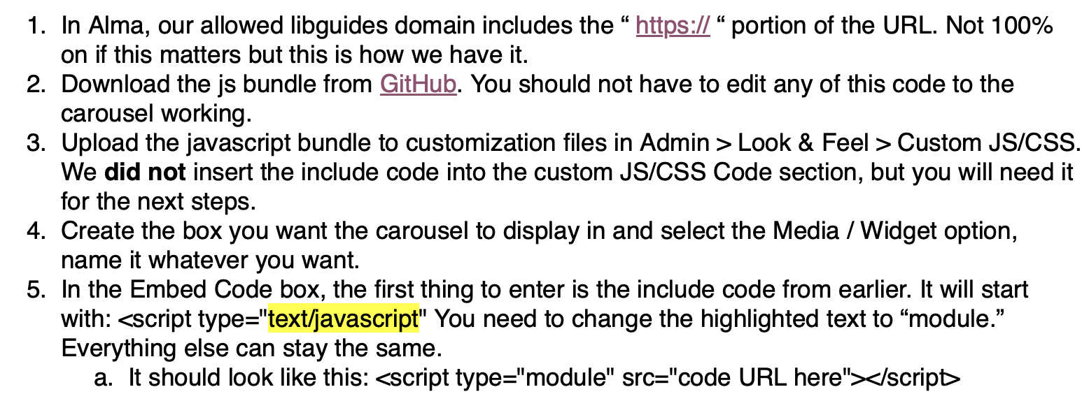
Implementation/Configuration
Gffg dkjfg
Steve Oberg (Wheaton College) via Primo@exlibrisusers.org listserv

Slide 56
Considerations
Requires some technical expertise to implement
Not really “plug and play” for content creators
Limited number items (20 item max)
Accessibility concerns
Customizing bibliographic display is additional process
(https://github.com/rdeiser/Discovery-Showcase-demo.git)
Slow load time
Accuracy of “Recently Added” filter?
More convenient alternatives (LibGuide galleries?)

Slide 57
Resources
Primo Showcase (ExLibris Announcement)
Primo showcase – How to Embed (ExLibris Developers Network)
https://developers.exlibrisgroup.com/blog/primo-showcase-how-to-embed/

Slide 58
Ex Libris Idea Exchange
Vote! All I-Share library employees can create an Idea Exchange account to submit and vote on ideas!
Register Now
Go to: ideas.exlibrisgroup.com (or use the QR code above)
Select a forum, e.g. Primo
In the upper right box, select “sign in” and “create an account”
Verify your email
Start voting!
Let’s Cooperate!
If we coordinate our votes, we can raise the profile of consortial issues like these:
go.illinois.edu/allow-exclusion-of-IZ
go.illinois.edu/allow-add-from-NZ
go.illinois.edu/default-has-activity
Other issues you want to promote? Get in touch!

