Slide 1
I-Share Alma Primo VE Office hours will start shortly
Welcome!
Office Hours will start at 2pm and run until 3pm. Please mute your microphone.
This session will be recorded and made available on the CARLI website.
Notes:
<Turn on captioning.>
<Click Record.>
Hello and welcome to the May 2024 Alma Primo VE Office Hours!

Slide 2
May Alma/Primo VE Release Update
Alma/Primo VE Open Office Hours
05/09/2024

Slide 3
Today’s Agenda
Upcoming Events and Announcements
Alma May Release Updates
Primo VE May Release Updates
Notes:
But first, let’s look at Today’s Agenda. We will be sharing upcoming events and announcements.

Slide 4
Upcoming events
CARLI Calendar
https://www.carli.illinois.edu/calendar/2024-05
CARLI NEWS AND REGULAR PROGRAMMING
Wednesday, May 22 – New Directors’ Institute
Thursday, May 23 – Technical Services Q&A: Annual Acquisitions Activities
Monday, May 27 – CARLI Office Closed for Memorial Day
OPEN EDUCATIONAL RESOURCES (OER)
Friday, May 10, 17, & 24 – Virtual Course: Understanding and Promoting Open Educational Resources
Wednesday, May 15, 22, 29 – OER Grants Weekly Office Hour
Thursday, May 23 – Florida OER Summit: Innovations and Trends
HIGHLIGHTED PROGRAMS
Friday, May 10 – Weeding and Shifting Series: Panel Presentations and Discussions
Thursday, May 16 – EBSCOHost’s new user interface for Public Services Staff
Wednesday, May 29 – Alma: Overview of Alma Anonymization
Notes:
Here are a few CARLI calendar events listed, you can also access the CARLI calendar from the link being provided in chat.

Slide 5
About Release Note Updates Highlights Sessions
We encourage library staff to review the Release Notes.
CARLI Staff review the Alma and Primo VE release notes for new features that we want I-Share libraries to be aware of:
New features that may help your workflows
New features that may change your workflows
Fixes to the software
Items not covered during our sessions:
May not apply in our consortial environment
Are minor updates that don’t warrant mentioning
Or are updates we don’t recommend taking advantage of
Notes:
Links to the release notes:
https://knowledge.exlibrisgroup.com/Alma/Release_Notes/2024
https://knowledge.exlibrisgroup.com/Primo/Release_Notes/002Primo_VE/2024

Slide 6
Alma May release update

Slide 7
Alma – Automatic Upload Electronic Holdings Updates
Autoholdings now available for the following:
JSTOR Books
Project Muse – Gratis/Free Journal Content
Update to Taylor & Francis Autoholdings:
Is now based on Unique ID
When a multi-match on ISBN/ISSN occurs, a portfolio will need to be activated manually ONE TIME. Subsequent autoholdings jobs WILL NOT remove these manual activations.
Notes:
(Marisa)
There are some updates to automatic upload of electronic holdings or autoholdings for short. Autoholdings are now available for JSTOR Books and Project Muse Free Journal Content.
The Taylor & Francis autoholdings have been transitioned from ISSN or ISBN matching to unique key matching with the autoholdings job to decrease instances of multi-matches with ISSNs and ISBNs.
Previously, when a multi-match on an ISBN or ISSN occurred, the portfolio would need to be manually activated as a one-time activation.
There are plans to create more unique key matching for other autoholdings jobs in upcoming releases. Stay tuned!

Slide 8
Alma – Advanced Searching
You can now do advanced searching on General Notes in Alma.
For Electronic collection searches:
“Notes tab – General Notes (Electronic Collection)”
“Notes tab – General Notes (Service)”
For Electronic portfolio searches:
“Notes tab – General Notes”
Notes:
(Marisa)
You can now do advanced searches for general notes in Electronic Collections in the collection level, service level, and portfolio level. The names of these search options all begin with “Notes tab.”

Slide 9
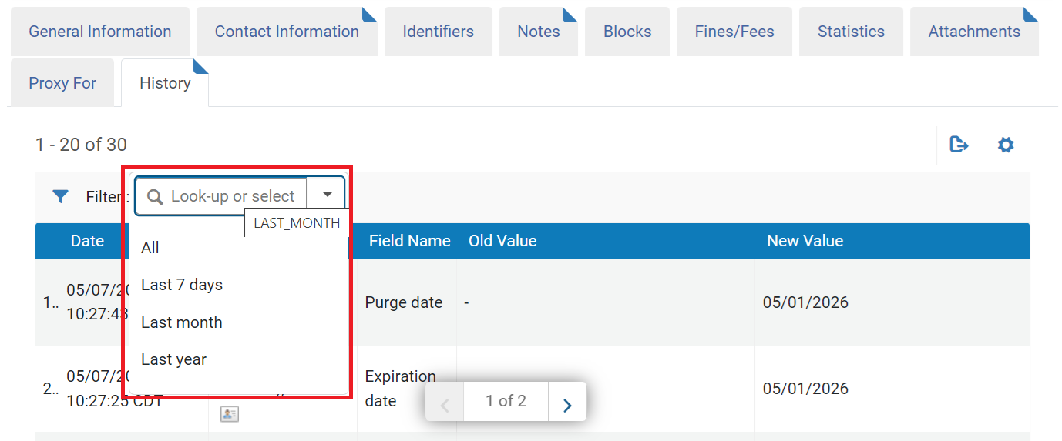
Alma- Fulfillment
Filtering for History in User Details
Figure: Screenshot showing a sample user record history tab, with the Filter values highlighted.
New filter on the user record History tab
May default your view to “Last month”
Notes:
(Debbie)
Hello! Moving into some Alma Fulfillment updates in the May release- there is a new filter on the User Record’s History tab.
The default for the filter seems to be to show the activity for the last month, which is something to be aware of when reviewing a user’s record history.

Slide 10
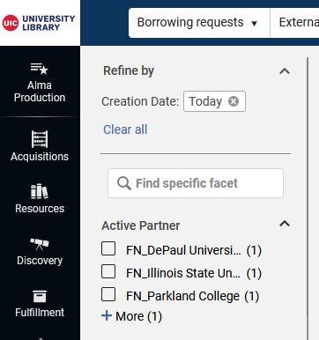
Alma - Fulfillment
Changes to Fulfillment>
Resource Sharing>
Borrowing Requests Facets
Applied facets listed at top of Facets pane
Ability to search facets
Figure: Screenshot of the Alma Fulfillment> Resource Sharing> Borrowing Requests area, showing the Facet Search and Applied Facets list.
Notes:
(Debbie)
The Fulfillment> Resource Sharing> Borrowing requests area has had some functionality added to the Facets pane.
Now, any applied facets are listed together at the top of the pane.
You are also able to use the search box to look for a specific facet.

Slide 11
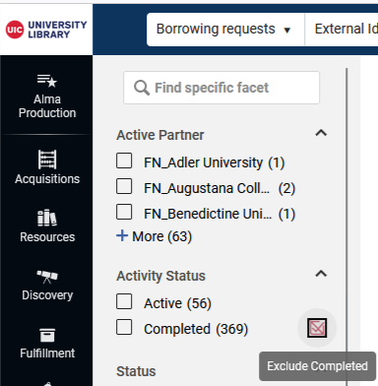
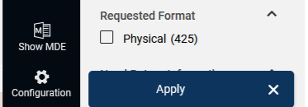
Alma- Fulfillment
Changes to Fulfillment> Resource Sharing> Borrowing Requests Facets
Ability to exclude results using the checkbox to the right of the facet option
Must click “Apply” button for facet to take effect
Figure: The Alma Fulfillment> Resource Sharing> Borrowing Requests area, highlighting the “Apply [facet]” button
Figure: The Alma Fulfillment> Resource Sharing> Borrowing Requests area, highlighting the “Exclude Completed” option
Notes:
(Debbie) Additionally, you can now select the “exclude” checkbox that appears when you hover to the right of the facet option to remove those results from the faceted search.
To apply any facets to the results display, you now must select the “Apply” button at the bottom of the facets list.

Slide 12
Alma- Fulfillment
Auto Renewal after Due Date
Note: All of the “Fulfillment Jobs Configuration” settings in each library’s Alma Configuration settings have consortial standards and are managed by the CARLI Office staff.
May Release Notes explain new functionality to run the job “Daily within range without repeating notification”; CARLI Staff will discuss this new setting option with the CARLI Resource Sharing Committee.
Notes:
(Debbie)
Before we talk about this potential update to the Courtesy notices/Automatic Renewal functionality in Alma, remember that All of the “Fulfillment Jobs Configuration” settings in each library’s Alma Configuration settings have consortial standards and are managed by the CARLI Office staff.
The May Release notes explain new functionality in May for the ability to run the job “Daily within range without repeating notification”; CARLI Staff will discuss this new setting option with the CARLI Resource Sharing Committee.
-------------
Backgroud info- not read in narrative but available for Q & A: Ex Libris added configuration so that, “The courtesy notice is sent only once, X days before the due date, where X is the number of days specified in Days before due date. However, the loan is still included in the job after this date until Y days after the due date as specified in Days after due date. Thus, if the block is removed in the specified range, an automatic renewal will take place if the requirements are met for it.”
Example: If the Days before due date parameter is set to 7, the Days after due date parameter is set to 3, and the loan cannot be renewed because the item was requested, a reminder is sent to the patron 7 days before the due date. After this, no additional courtesy notices are sent. However, if the block is removed before 3 days after the due date, the job attempts to implement an automatic renewal.

Slide 13
Login in Multiple Tabs in Browser
Screen capture of two Alma instances open side by side
Notes:
(Adrienne) You can now work in two of the same Alma IZs in the same browser if you have the same login. Note that you do not want to work on the same record at the same time because you can get unexpected results. But if you are doing different things, it works.

Slide 14
Scheduling jobs to Run later
A screen capture of the scheduling widget for jobs in Alma
A screen capture of a scheduled job in Alma
Notes:
(Adrienne) You can now schedule jobs to run at a later time. To do so, select Once in the Schedule the Job to Run Regularly with These Parameters pane. A date box opens up. Click the Calendar icon to set the date and time. Note that the job might not run exactly when you specify. I ran a test job that actually ran 45 minutes later because other jobs were in the queue.

Slide 15
Alphabetical sorting of facets
Items are now sorted within each facet in alphabetical order.
Screen capture of facets in Alma
Notes:
(Adrienne)

Slide 16
Changes to the Manage Sets interface
You can view a list of your sets in a table view and can toggle the sets’ status to active and inactive.
Select Actions > Customize to view the various forms of customization.
The bottom screen capture shows Records Customization.
A screen capture of the table view in Manage Sets in Alma
A screen capture of the Records Customization in Manage Sets in Alma
Notes:
(Adrienne) The types of customization are Sections Customization, Records Customization, Table Customization, and Facets Customization. Sections Customization allows you to select the order and visibility of record sections when you select a set in the table. Records Customization allows you to select which types of data will be in which columns. Table Customization allows you to choose which columns should be in the table view. Facets Customization allows you to choose the order and visibility of the facets.

Slide 17
Springshare Integration
You can import Springshare gate counts and reference data for use in Alma Analytics.
Detailed instructions: https://knowledge.exlibrisgroup.com/Alma/Product_Documentation/010Alma_Online_Help_(English)/080Analytics/010Introduction/The_Basics_of_Working_with_Analytics/Springshare_Integration
Screen capture of the new Springshare dimensions in the External Vendor Data subject area of Alma Analytics
Notes:
(Adrienne)

Slide 18
More Analytics Updates
New Design Analytics roles were added that are limited to specific subject areas in Acquisitions, Fulfillment, and Resources. To enable these roles, set the support_partial_analytics_designer parameter (Configuration > Analytics > General Configuration > Other Settings) to true.
The Public Access Model field was added to the E-Inventory > Electronic Collection and E-Inventory > Portfolio Details for Consortia Members > Electronic Collection.
Screen capture of the new Analytics roles in Alma.
Notes:
(Adrienne) The access model describes the resource availability for simultaneous use.

Slide 19
Editing a Community Zone Record
Community Zone records identified in editor header
Image below shows a magenta box stating Community Record
MDE may also alert users when saving changes that could affect community
Image of the record header and initial fields of a MARC record in the Alma metadata editor that comes from the Community Zone. A new magenta “Community Record” tag calls out this record as a community record.
Notes:
Ted
Before this release, when editing institution or network zone records in the metadata editor, one would have to look for clues that the record might be a community zone bibliographic record. Some records might only appear as “view only” with no other indication. This release does away with the subtlety by including a bright magenta tag on the editing header with the text Community Record. The release notes also mention that the editor may alert users when making changes that those updates could affect other community users.

Slide 20
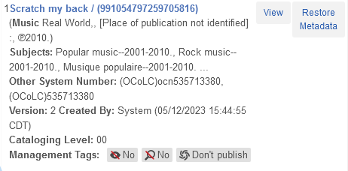
Record Versions Enhanced
Record version history includes management tags
Useful when troubleshooting data sync and publishing
Below image shows that the previous version had no bibliographic suppression, no search suppression, and no publishing to data sync.
Image shows a summary of the previous record version for the Compact Disc Scratch My Back. The new management tags show no bibliographic suppression, no suppression from Z39.50 searching, and Don’t publish to the OCLC data sync.
Notes:
Ted
As someone who looks at the record history when troubleshooting cataloging questions, I’m thrilled by this next enhancement. Record versions now include details of what management tag settings were in the prior versions. This should be especially helpful when reviewing issues related to the OCLC data sync, but also may help with discovery in Primo VE.
In our example here, we see that the last version before the current one had management tags for No bibliographic suppression, no suppression from Z39.50 searching, and was set to Don’t publish to the OCLC data sync. With this history now available, we can help answer questions about what should have happened when.
By the way, the record *is* currently set to publish to OCLC.

Slide 21
MDE Call Number Browse
Browse Shelf List enhanced to index full call number
Search and Browse > Browse Shelf Listing
Depends on position of cursor in a specific bib or holding tag
In image below, cursor is in the 852 field of the holding record.
Note: Holding call number (852$h $i) contains your call number
Image of the Alma metadata editor view with a holding record on the left and the browse shelf listing box on the right.
Notes:
Ted
This next one seemed like a brief update, but the release notes undersell what’s happening. Ex Libris is improving call number indexing to cover both the classification portion and work or cutter number portions. Whereas before, the indexing covered subfield a of bibliographic call number fields, or 852 subfield h, now subfields b and I will be indexed for browsing and searching as well.
The more practical details of this update appear in one of the ways the call number browse may be used. In the metadata editor, the cataloger may position the cursor within a bibliographic or holding tag for a call number, then go to Search and Browse, the Browse Shelf Listing. Alma will copy the full call number of the field into the search box. However, the browse will be limited to your assigned call numbers, that is to say, the call numbers found in holding records.

Slide 22
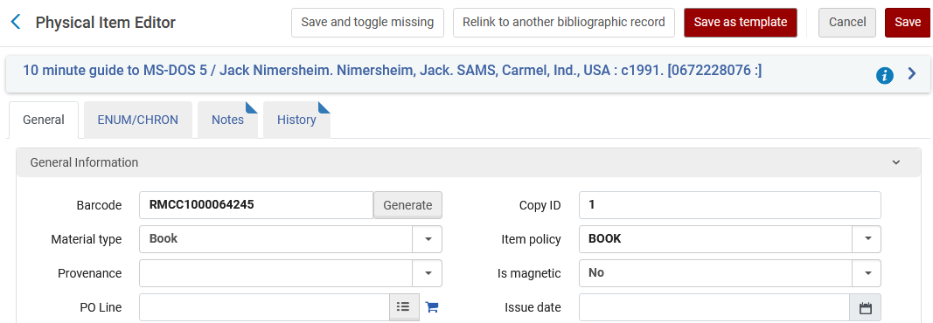
Physical Item Templates
Create an item template from an existing item
Use Save as Template button (highlighted below) to store the template.
Image showing the top section of the physical item editor with the Save as Template button highlighted by the mouse cursor.
Notes:
Ted
Now we come to an update that we’ve been asked about since 2020. Alma now lets you create templates for physical items, enabling you to speed up item creation for commonly applied settings. If your institution already uses PO line templates, you’ll recognize how this works.
Start by reviewing and/or editing the details of the item that need to be part of the template. This could include details like copy, item policy, material type, cost, and notes. Then click Save as Template at the top.

Slide 23
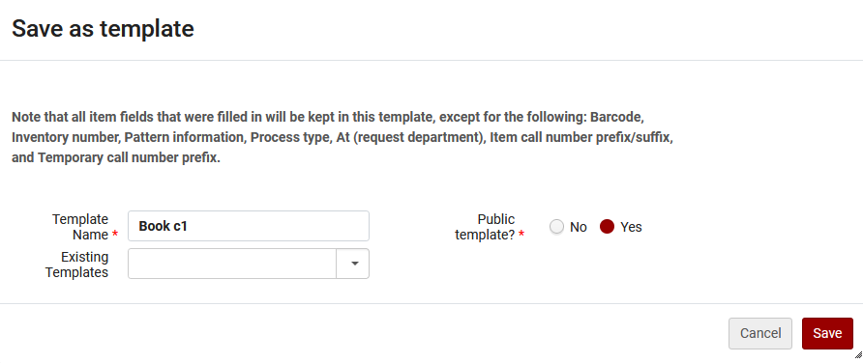
Physical Item Templates
Create a template by adding a name
Public template = usable by anyone at institution
See below, creation of a public template “Book c1”
Image of the Save as template dialog, prompting for a new template name and whether the template is public or not. A note will appear that states which fields will not be retained in the template.
Notes:
Ted
Next, Alma presents the save as template dialog, where you define a new template, or update an existing template. You may also define a template as public, meaning it’s available for everyone at your institution, or not public, which means your account only. A note also appears on the template screen to let you know that not every field is retained in the template. Some details, like barcode, inventory number, and process type, are left blank to be set by the user or the system later.
Save the template to use later. You’ll have to save the record separately from the template.

Slide 24
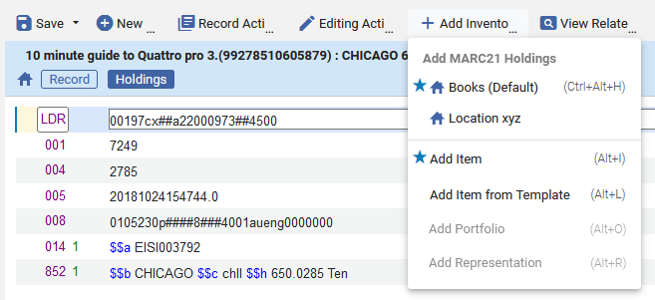
Physical Item Templates
Add Item from Template available from items list and MDE
Image of actions available for the list of items screen, including Add Item from Template on the right
Image of the Alma metadata editor with a holding record in the editor and the add inventory menu expanded. The Add Item from Template option is active, and shows the shortcut Alt+L.
Notes:
Ted
To use a template, you may select Add Item from Template on the list of items screen, which is sometimes tricky to reach, or from the metadata editor Add Inventory menu while editing a holding record.
To see more of this in action, I recommend the Alma Highlights video on item templates. <https://youtu.be/_Fs-AhJCrxA>

Slide 25
BIBFRAME & Linked Open Data
BIBFRAME records now supported by the Alma platform
BIBFRAME records may be used in existing searches and workflows
Importing and editing BIBFRAME records will be different
BIBFRAME support is off by default in each IZ
Possible exploration by CARLI later in the year
Linked Open Data enrichment configuration
Select vocabularies and linking field ($0 or $1)
Use with Alma Refine, metadata editor, or other tools
Vocabs: Homosaurus, Getty, WikiData, ORCID, Geonames
Notes:
Ted
One of several intriguing and intimidating updates in this release is the announcement of support for BIBFRAME. This support incorporates the abilities to search for and use records that were created in BIBFRAME rather than MARC, MODS, or other metadata schema. Records themselves may be applied in existing Alma workflows, such as inventory management, acquisitions, and fulfillment, since Alma will treat the BIBFRAME record as any other bibliographic record.
Services related to importing, editing, and publishing BIBFRAME records appear to require some different practices than libraries have used for MARC. As the metadata editor is not a BIBFRAME editor, cataloging will likely require the use of APIs and the Sinopia editor.
Ex Libris’ support announcement pertains to the platform as a whole, but Ex Libris is not activating support automatically in any institution. This is useful, in that CARLI may need to examine how this might affect the network zone. We’ll want to identify what we might need to know to support libraries as well.
For additional information about this enhancement, see the link posted in chat: <https://knowledge.exlibrisgroup.com/Alma/Product_Documentation/010Alma_Online_Help_(English)/Metadata_Management/005Introduction_to_Metadata_Management/BIBFRAME_Support>
Another area that will need more than a few minutes of review is linked open data as a way to enrich authorities. In the current release, Ex Libris has added the ability to configure linking from a bibliographic heading to a linked data source, such as the virtual international authority file (VIAF) or Homosaurus. A cataloger may specify which linking term to use, either $0 or $1. More information is at the link posted in chat. <https://knowledge.exlibrisgroup.com/Alma/Product_Documentation/010Alma_Online_Help_(English)/Metadata_Management/210Metadata_Management_Configuration/Linked_Data_Enrichment_Configuration#widget-files>
Ex Libris mentions in the release notes that some institutions have been using “Alma Refine,” one of Alma’s cloud apps to assist in this enhancement process to this point. While that tool isn’t new to this release, it isn’t as well known to CARLI staff as Open Refine. <https://developers.exlibrisgroup.com/appcenter/alma-refine/>. One new aspect to the cloud app is the addition of the Homosaurus vocabulary as one of several that may be targeted to help improve headings linking.
Like BIBFRAME, this is something CARLI and one or more committees may need to examine in the future.

Slide 26
Resource Management Teasers
Browse authority headings list displays if heading is “local”
Search resources includes standard number (e.g., 024, 028)
Full call number, including $b, added to search indexes
Applies indexing improvements to All Titles and other searches
MARC21 Profile updated with new MARC tags and subfields
Notes:
Ted
This release included a plethora of smaller but meaningful updates to resource management tools already in use. Here is a quick rundown of these updates.
The browse authority headings interface in the metadata editor will now display if a heading found is linked to a local authority record. This may be useful for DEIA efforts by CARLI or at institution levels.
The search external resources screen in the metadata editor will now include a standard number search box. This will enable searches on standard numbers such as publisher number, universal product code, and music number, that may be entered in MARC tags 024 or 028.
Related to the earlier mention of call number indexing, the full call number will be found in call number search indexes following the semi-annual re-indexing process. As noted earlier, this will make searching bibliographic records by call number more accurate, though remember that the holding record call number is where your institution’s call number should be stored.

Slide 27
Quick Ordering from Amazon
Combines New Order API with a browser plugin, “Order It!”
Some assembly required: integration, browser, testing match settings
Users with Purchasing roles may add the plugin as a bookmark.
Go to Acquisitions menu > Advanced Tools > Order It! Bookmark
Drag to your bookmarks/favorites location.
Search Amazon for selected item, then call bookmark.
Order It! fills in title details.
Excellent use case for PO line templates for the rest of the POL.
More in the Alma Highlights video on Order It!
Notes:
Ted
Something that acquisitions folks have asked about has arrived, that is an integration of sorts between Alma and Amazon. This isn’t quite a true end-to-end integration like one gets with Rialto or the GOBI API, but it does appear to be a time saver.
The new option is a browser plugin, Order It! That gets called from a browser bookmark or favorite. Users with purchasing roles may have access to the plugin, and there is some assembly required, mainly establishing a new order API integration that helps import data into Alma.
Once the integration is set up, an authorized user may search Amazon for potential items. Once an item is found, they may call the bookmark which grabs title information in order to create a PO line and search Alma for a matching record. If no match is found, the API would add the metadata found. The plugin supports the use of PO Line Templates, to fill in POL information that aren’t on the brief Order It! box.
You may view more about this in the Alma Highlights video on Order It! <https://youtu.be/k1zuG2o9F2I>
While configuration and operational details are in the Alma documentation. <https://knowledge.exlibrisgroup.com/Alma/Product_Documentation/010Alma_Online_Help_(English)/020Acquisitions/050Purchasing/Working_with_Vendors_for_PO_Lines/Ordering_from_Amazon_with_the_Order_It!_Plugin>

Slide 28
Acquisitions Teasers
EDI enhancements to include quantity and Access Model
View PO Lines that are Assigned to Others
More alerts on Receive Item pop-up for receiving from POL
MARC21 Profile updated with new MARC tags and subfields
Notes:
Ted
This release included a few more useful improvements to acquisitions functionality.
For institutions that send order data to vendors using electronic data interchange, the EDI interface now supports sending an order quantity other than 1, and also supports Access Model as a note field.
Another improvement to bring the new PO Line task list up to speed, it is now possible to view PO lines that are assigned to others. This was functionality in the old user interface for acquisitions, and the current enhancement restores the ability to view only those PO Lines.
The ability to receive directly from a PO Line is still relatively new. This functionality has been updated to display several alerts related to the POL and item when receiving.

Slide 29
Primo VE May release update

Slide 30
Primo VE – QuickLinks Major Change
Automatically Enabled QuickLinks
QuickLinks option now at Institution level with this change in May 2024. (Was at “View” level)
Alma made “QuickLinks in brief results displays” the _default_ in May 2024
Can opt out of this new Institution level parameter via Alma Configuration > Discovery > Other > Customer Settings > auto_switch_quicklinks
More information on QuickLinks
QuickLinks’ cooperating vendors.
Notes:
(Denise) Alma is changing the default behavior of Primo VE QuickLinks for electronic full text option. (Read slide) They are advocating most libraries use QuickLinks.
Quicklinks in brief results will display by _default_ unless you opt out of the new Institution level parameter by setting
Alma Configuration > Discovery > Other > Customer Settings > auto_switch_quicklinks to false. You may opt in or opt out at any time by adjusting this setting.
>

Slide 31
Primo VE – QuickLinks Examples
A screenshot of Primo VE article results with QuickLinks examples of “Get PDF” and “Read Online” highlighted
Notes:
(Denise) Here’s examples. QuickLinks appear on the brief result displays. Here for example, I looked up football in an “Articles” search slot and you can see this library has QuickLinks enabled. That’s what supplies the “Get PDF” . QuickLinks works with bibliographic data from cooperating publishers & vendors to provide a one-click to full text option. My colleague will put the link to cooperating publishers & vendors in the chat.
Please begin discussing accepting (or not) the new QuickLinks default with your colleagues. Note, the labels “Get PDF” or “Read Online” etc. can be edited.

Slide 32
PRIMO VE
Primo VE – New Linking Template for InfoBase
A screenshot of the linking template name and syntax
More information on Configuring the Central Index Linking Templates
Notes:
(Marisa)
This next Primo VE feature release will apply to those of you who have InfoBase electronic collections that are not Films on Demand collections. There is now a separate linking template for InfoBase collections that are not Films on Demand collections. While this new feature pertains to CDI linking, you may also find the linking syntax a useful reference if you are setting up a local InfoBase collection.

Slide 33
Linked Open Data – discovery of Person Entity
Primo VE can now associate person entities in bibliographic records using LC Names Authority headings through Linked Open Data to provide two new discovery features:
Person entity suggestions at the bottom of Auto Complete in the simple search box
A screenshot of a simple search for George Wash showing how autocomplete suggests Person Entities
Notes:
(Jessica) Primo VE can now associate person entities in bibliographic records using LC Names Authority headings through Linked Open Data to provide two new discovery features!
First is the feature to suggest person entities at the bottom of Auto Complete in the Primo VE Simple Search box. Yes, you must have Auto Complete enabled to take advantage of this new feature.

Slide 34
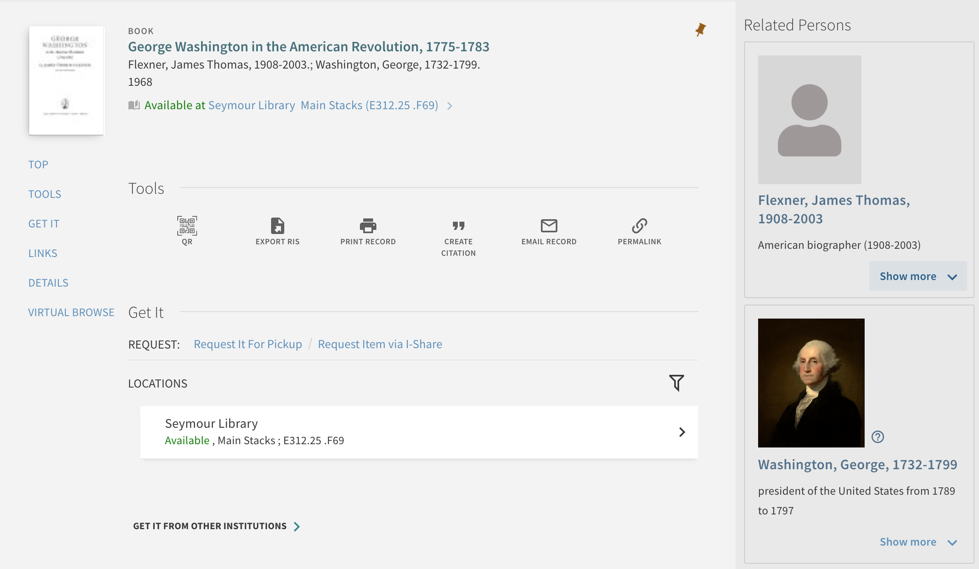
Linked Open Data – discovery of Person Entity
2. Person entity info cards for Related Persons in the Full Record display
A screenshot of the Full Record page in Primo VE showing Related Persons entities
Notes:
(Jessica) A second new feature using the LC Name Authority headings in bib records is the Person Entity Info Cards on the side of a Full Record display.

Slide 35
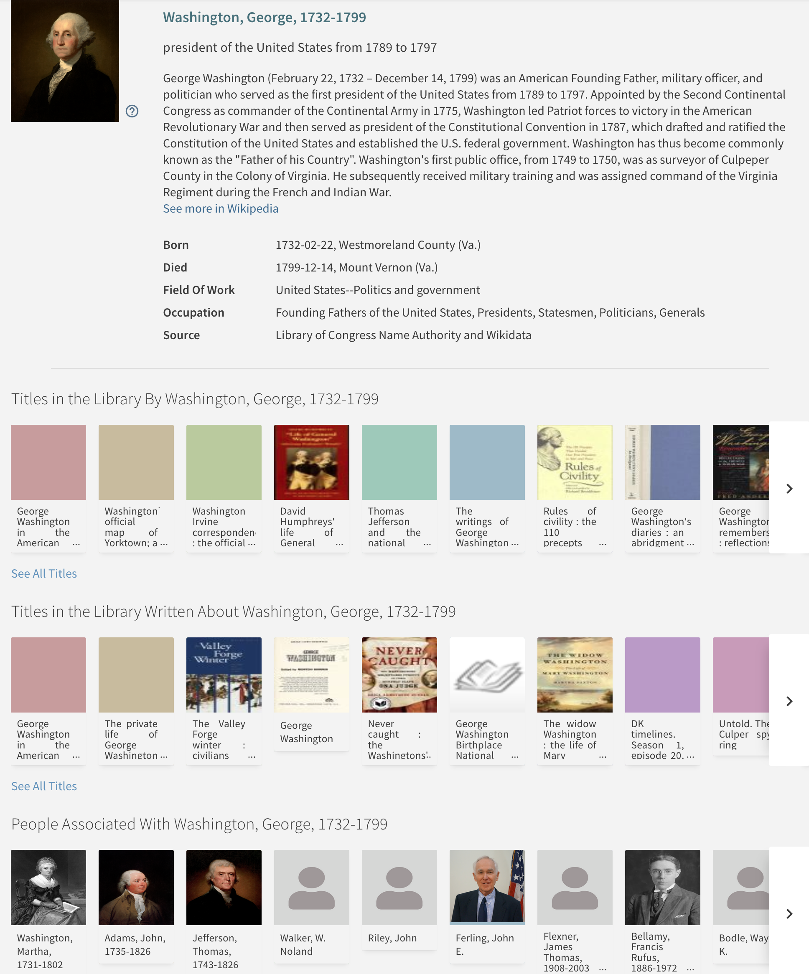
Linked Open Data – discovery of Person EntitY
Both of these options lead to the Person Page with more information enriched from Wikidata, including titles by person and titles about the person, as well as other people associated with that person.
Screenshot of the Full Record display page with Person Entity Linked Open Data
Notes:
(Jessica) Clicking on either new feature will take the user to the new Person Page. The Person Page gives information enriched from Wikidata, including titles by the person and titles about the person, as well as other people often associate with the person.

Slide 36
Linked Open Data – discovery of Person Entity Configuration
These features are not on by default. You can turn each of them on independently, if desired, and it will apply to ALL Primo VE Views:
Configuration > Discovery > Other > Customer Settings
enable_person_entity_info_card – Set this parameter to true to enable the Person Info Card on the Full Display page.
enable_person_entity_autocomplete – Set this parameter to true to enable autocomplete for person entities. (Note that Auto Complete must be Enabled in the View Configuration first.)
You can adjust the labels of the new sections, if desired.
Feature only works with Library of Congress Name Authorities in this iteration.
Notes:
(Jessica) The features are optional. They are disabled by default and can be enabled independently, if desired. Note that the settings in Discovery > Other > Customer Settings do apply to ALL Primo VE Views.
As with most things in Primo VE, you can adjust the labels if you’d like.
At this time, this feature works only with Library of Congress Name Authorities and only in English, but Ex Libris is pursuing other ways of using Linked Open Data in the future.

Slide 37
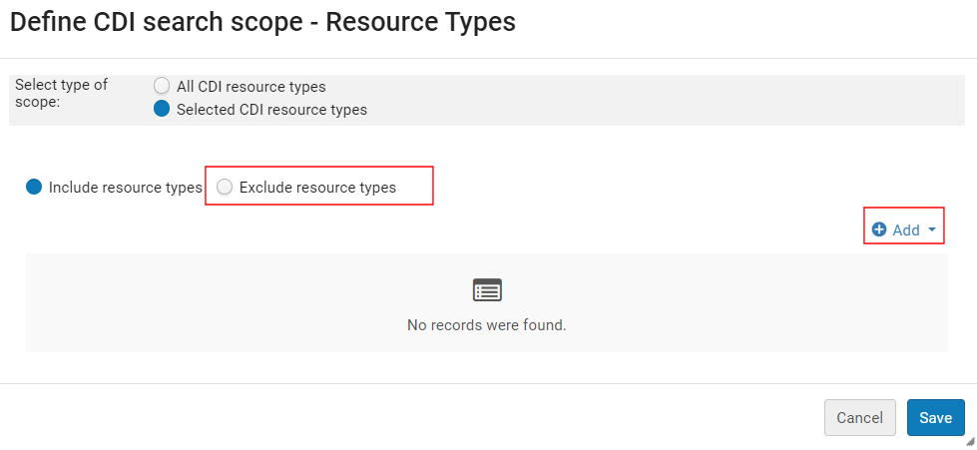
Exclude CDI Resource Types in CDI Scopes
Before May release: could limit CDI search scopes to INCLUDE only records of specific CDI Resource Types (up to five types).
After May release: can instead limit CDI search scopes to EXCLUDE records of specific CDI Resource Types (up to five types).
In Alma Configuration > Discovery > Search Configuration > Search Profiles > Edit the CDI search profile > click the Row Action menu (ellipsis) > Edit Resource Type selection
Screenshot of the CDI search scope Resource Types include/exclude options
Notes:
(Jessica) Before the May 2024 release, you could limit CDI search scopes to INCLUDE only records of specific CDI Resource Types (up to five types).
After the May 2024 release, you can now instead limit CDI search scopes to EXCLUDE records of specific CDI Resource Types (up to five types).
In Alma Configuration > Discovery > Search Configuration > Search Profiles > Edit the CDI search profile > click the Row Action menu (ellipsis) > Edit Resource Type selection
This might be helpful for adjusting custom search scopes to include specialty types like dissertations and theses or to exclude types like book chapters.
CDI Resource Types: https://knowledge.exlibrisgroup.com/Primo/Content_Corner/Central_Discovery_Index/Documentation_and_Training/Documentation_and_Training_(English)/CDI_-_The_Central_Discovery_Index/070Resource_Types_in_CDI

Slide 38
Library Card Options to Allow Users to Opt Out of Receiving Notices
A screenshot of My Library Card showing the undesirable options to opt out of notices.
Please do not enable these options in the patron’s Library Card.
Notes:
(Jessica) Reminder: do not enable My Library Card option for users to opt out of library notices! This was a new feature in the August 2023 release that has more options in the May 2024 release. CARLI and the CARLI Resource Sharing Committee are asking I-Share libraries NOT to enable these as it would allow users to opt OUT of receiving certain circulation-related notices by checking options in their My Library Card. In our shared environment, it is critical that all users are able to receive notices and communications from other I-Share libraries. This feature is disabled by default. Please DO NOT ENABLE IT. Thank you!

Slide 39
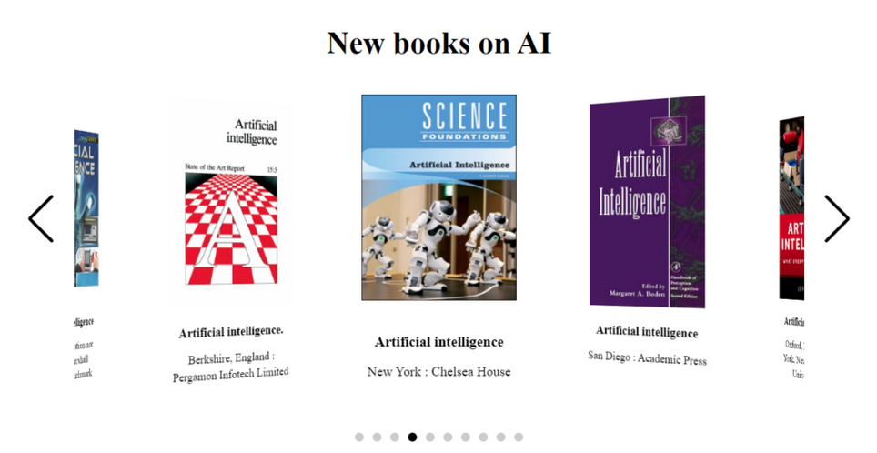
Primo VE Showcase Enhancements
Can now be embedded within Primo VE, not just on external websites.
Number of items has been increased to 20 (from 10).
Now supports local thumbnails.
Ex Libris has made several Accessibility improvements.
CARLI Discovery Primo VE Committee’s June 11, 2024 webinar Connecting to Your Best Stuff: Elevating Resources in Primo VE will discuss the Showcase, Resource Recommender, and Search Ranking. Register now!
An example Primo VE Showcase showing new books on AI
Notes:
(Jessica)
The showcase can now be embedded within Primo VE, not just on external websites.
The number of items has been increased to 20 (from 10).
The Showcase will now display local thumbnails, if present.
Ex Libris has made several Accessibility improvements!
CARLI Discovery Primo VE Committee’s June 11, 2024 webinar Connecting to Your Best Stuff: Elevating Resources in Primo VE will discuss the Showcase, Resource Recommender, and Search Ranking. Register now!
https://www.carli.illinois.edu/connecting-your-best-stuff-elevating-resources-primo-ve

Slide 40
I-Share Alma Primo VE Office hours
Thank you for attending!
Contact CARLI at
support@carli.Illinois.edu
Decoration: A bouquet of brightly colored spring flowers in a glass jar sitting on a gold-colored table. A library card file is in the background, out of focus.
Notes:
Decoration: A bouquet of brightly colored spring flowers in a glass jar sitting on a gold-colored table. A library card file is in the background, out of focus.

