Slide 1
Usage Statistics
Megan Ruenz, Wheaton College Library
CARLI E-Resources Management Committee
April 11, 2025

Slide 2
ERM Committee
Members
+
CARLI Staff
Liaisons
Committee Members:
Jacob Del Rio
Robin Hofstetter
Joanna Kolendo
Elizabeth Nelson
Elizabeth Outler
Jennifer Patterson
Sara Rizzo
Megan Ruenz
Lisa Wallis
CARLI Staff Liaisons:
Yanira Cruz
Ted Schwitnzer
Marisa Tolbert

Slide 3
Today’s Agenda
Introduction to COUNTER Stats
Transition from COUNTER 5 to 5.1
Setting up and using SUSHI in Alma
Alma Analytics
Building Reports
Questions

Slide 4
COUNTER Metrics
COUNTER website: https://www.countermetrics.org/

Slide 5
Transition from COUNTER R5 to R5.1
COUNTER Code of Practice Release 5.1
https://cop5.projectcounter.org/en/5.1/13-transitioning/03-transitioning-from-counter-r5-to-r51.html
COUNTER Friendly Guide to Release 5.1
https://www.countermetrics.org/wp-content/uploads/2024/04/Guide-Changes.pdf
What Has Not Changed:
Reports
Metrics
What Has Changed:
Item used as unit of reporting
Improved definitions of Access Types
Expanded Data Types
Upgraded COUNTER API
Revised JSON schema

Slide 6
Resources for Setting Up SUSHI in Alma
Ex Libris Resources:
SUSHI Vendor List:
https://knowledge.exlibrisgroup.com/Alma/Product_Documentation/010Alma_Online_Help_(English)/020Acquisitions/030Acquisitions_Infrastructure/010Managing_Vendors/SUSHI_Vendor_Lists
Harvesting Usage Statistics Data via Counter/SUSHI Reports in Alma:
https://knowledge.exlibrisgroup.com/Alma/Best_Practices_and_How-Tos/Acquisitions/Best_Practice_Toolkits_for_Acquisitions/Best_Practices%3A_Harvesting_Usage_Statistics_Data_via_Counter%2F%2FSUSHI_Reports
Almas Compliance with COUNTER 5.1:
https://knowledge.exlibrisgroup.com/Alma/Knowledge_Articles/Alma_Compliance_with_COUNTER_5.1
CARLI Resources:
Setting Up and Using SUSHI in ALMA, April 14, 2022
https://youtu.be/EtOX2rpjjco?si=1sOA0AcZ8Fr57W4p
Setting up SUSHI Harvesting in Alma:
https://www.carli.illinois.edu/products-services/i-share/electronic-res-man/setupsushi

Slide 7
Monitoring SUSHI Harvesting in Alma
Vendor Record
Emailed Scheduled Reports
Building reports in Analytics to view
COUNTER usage

Slide 8
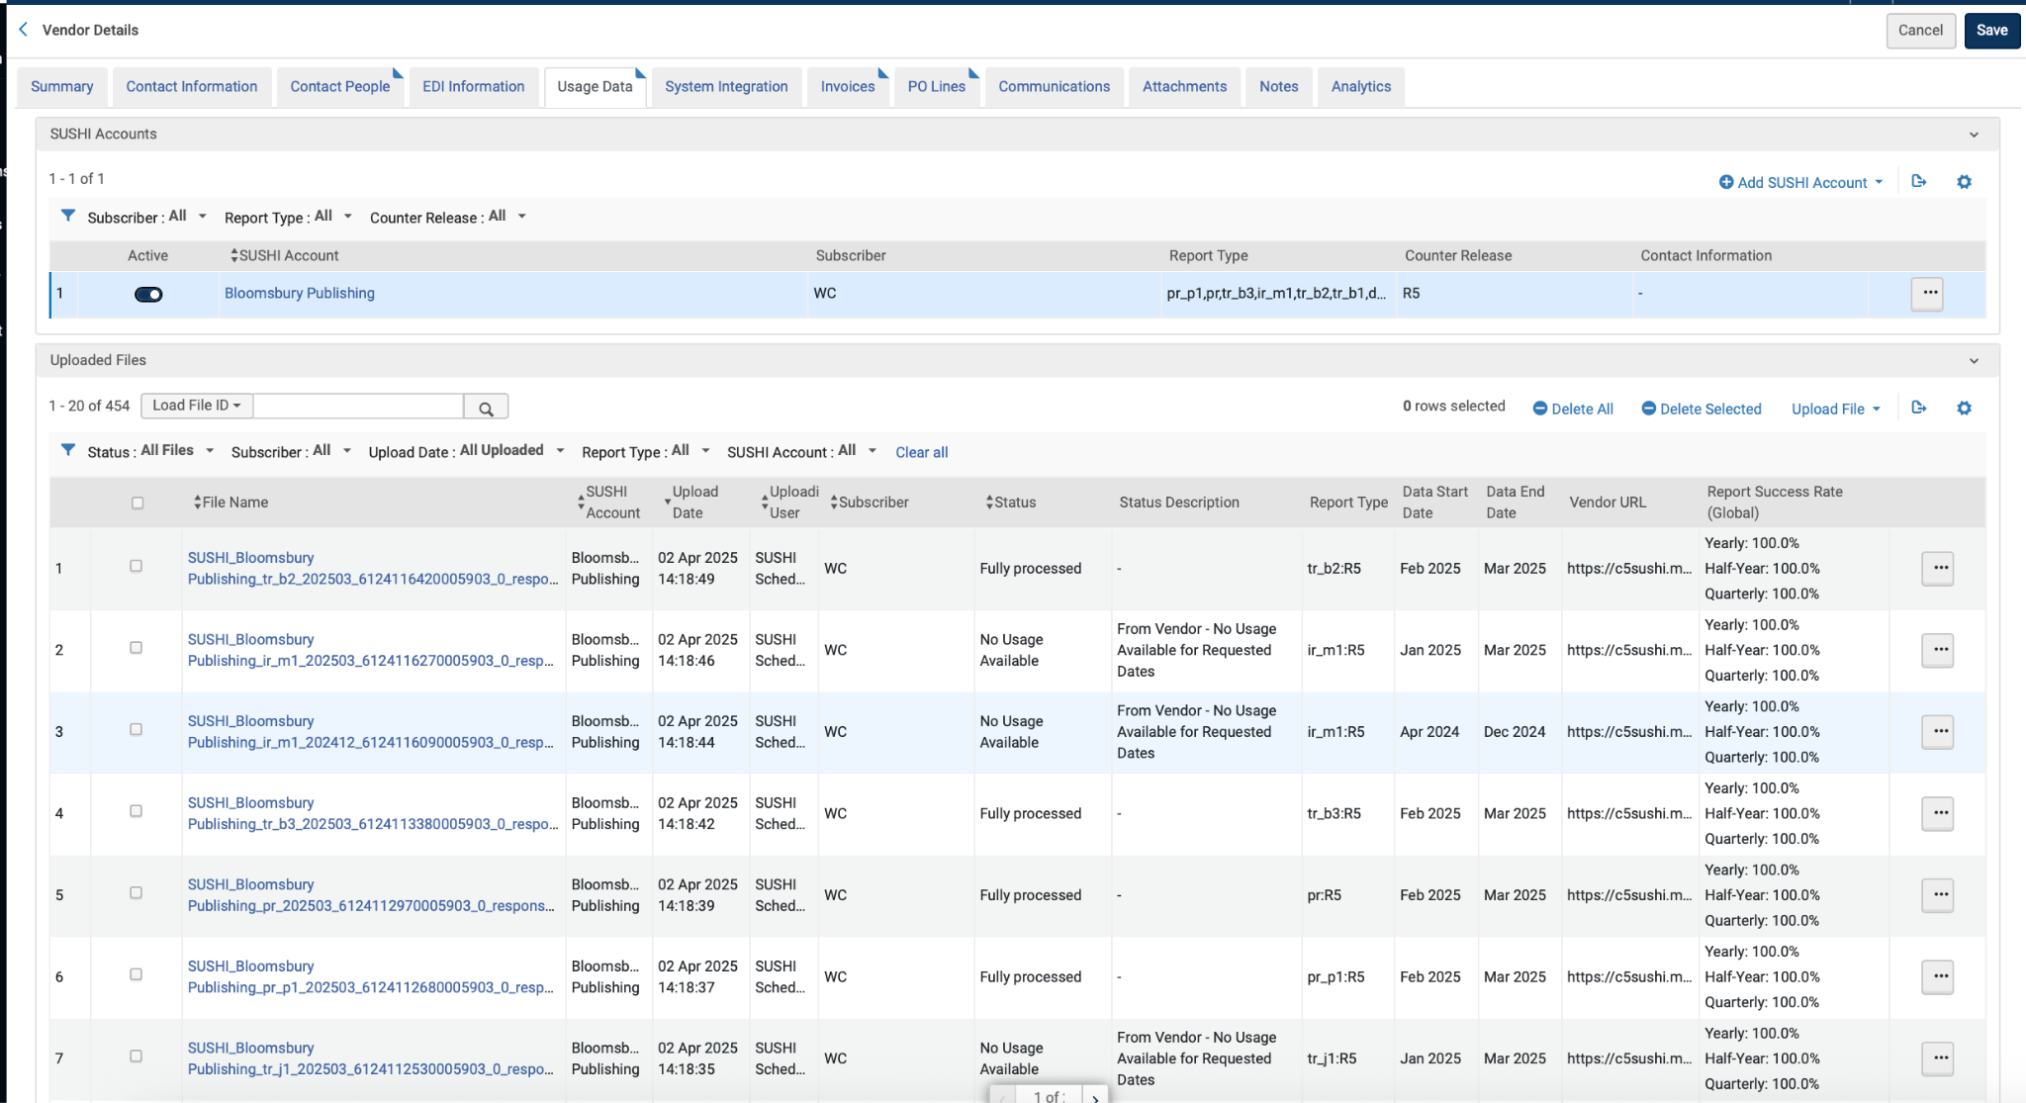
Monitoring SUSHI Harvesting: Alma Vendor Record

Slide 9
Monitoring SUSHI Harvesting: Alma Email Notification
Configuration > Acquisitions > General > Acquisitions Job Configuration
Click “Email Notification”

Slide 10
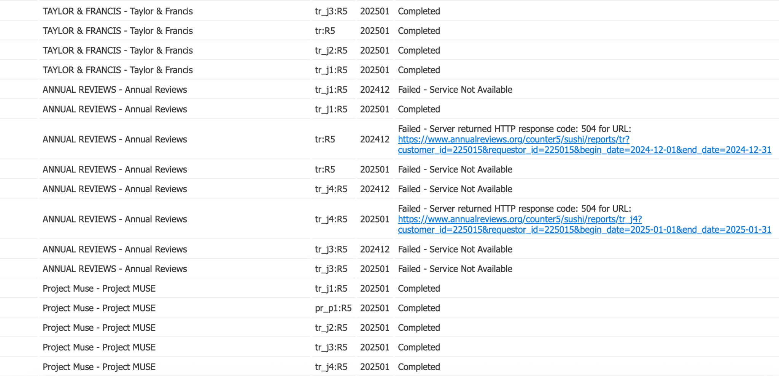
Monitoring SUSHI Harvesting: Alma Email Notification

Slide 11
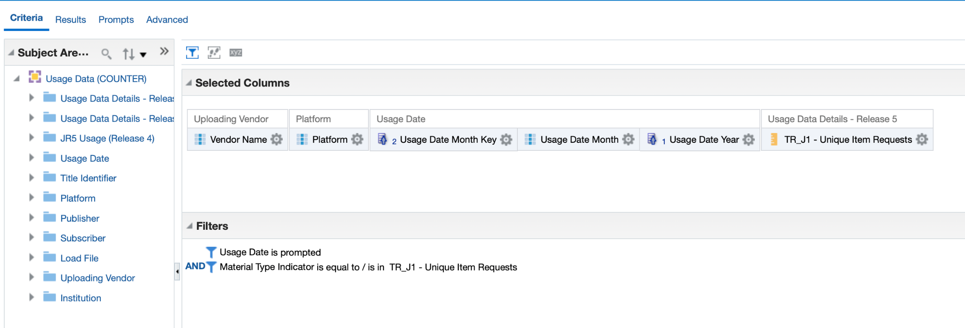
Building COUNTER Reports with Alma Analytics

Slide 12
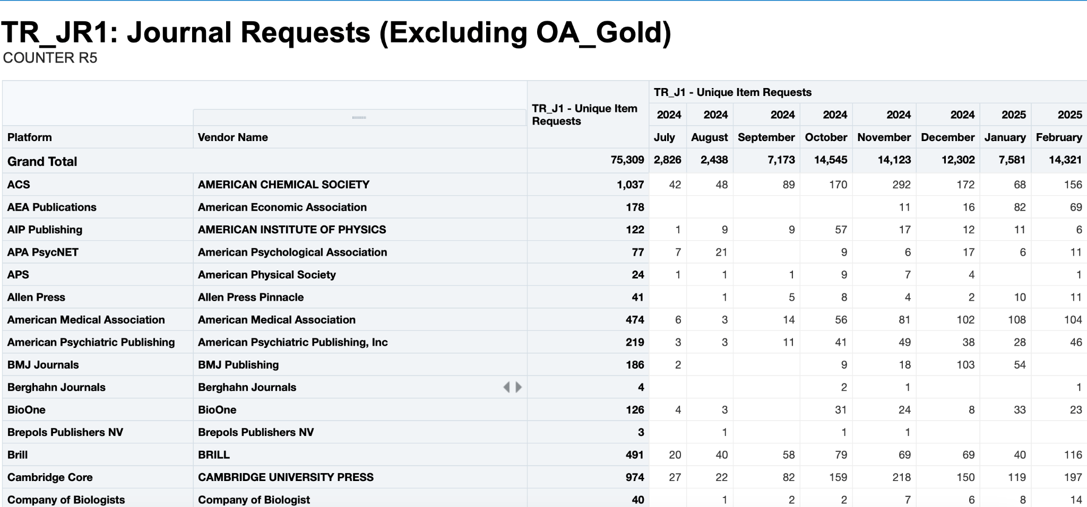
Sample TR_J1 COUNTER Report

Slide 13
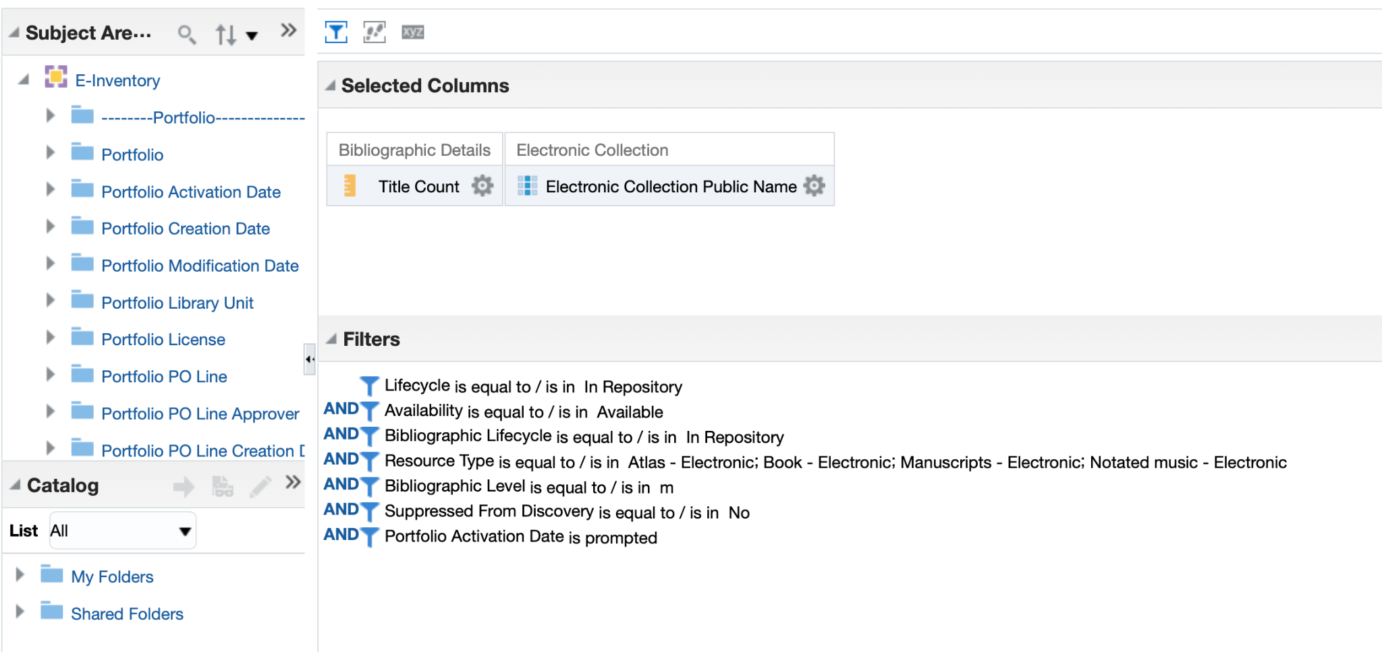
Building ACRL Reports with Alma Analytics

Slide 14
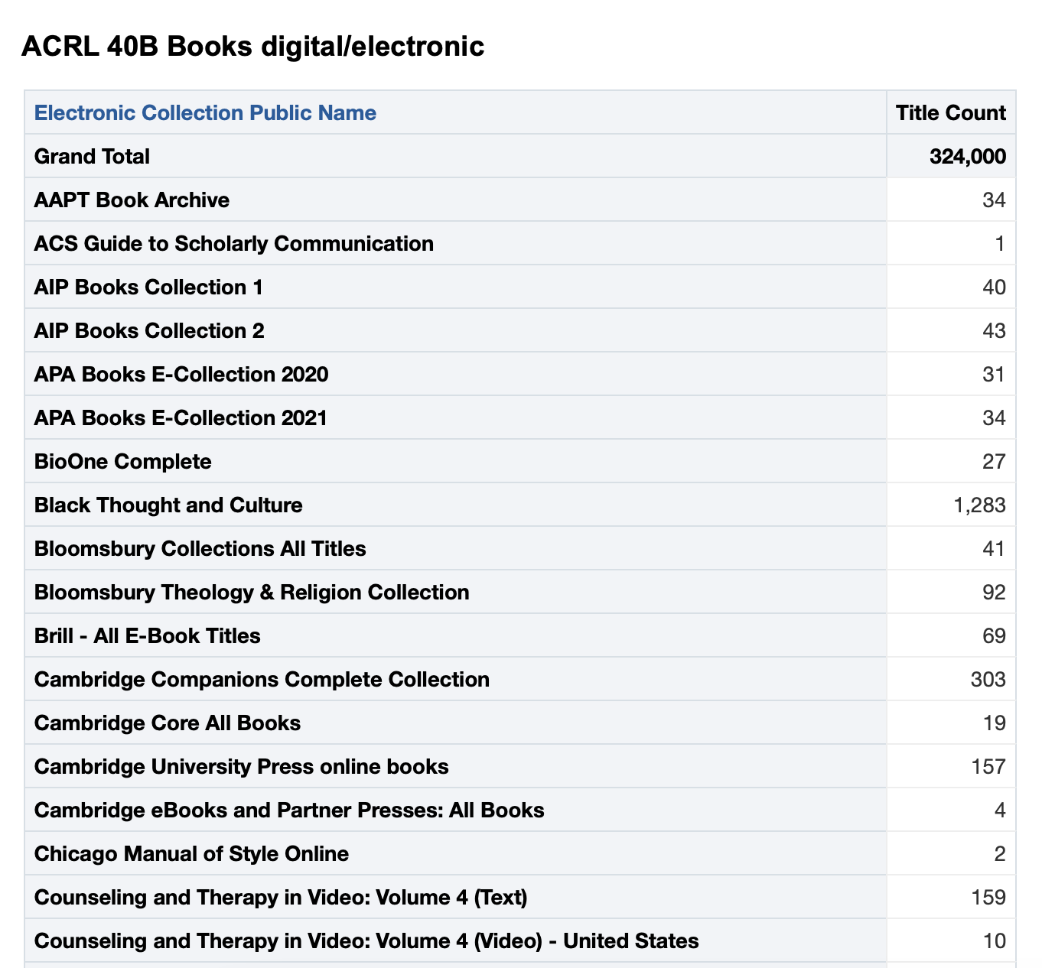
Sample ACRL Report

Slide 15
Alma Analytics Resources
Alma Analytics Webinars Become an Expert
https://knowledge.exlibrisgroup.com/Alma/Training/Webinars/Alma_Analytics%3A_Become_an_Expert?utm_campaign=EM1_Library_Resources_Update_Newsletter_Retention_Feb_AG_Americas_2023&utm_medium=email&utm_source=Eloqua

Slide 16
?
Questions?
megan.ruenz@wheaton.edu

