Slide 1
EBSCOhost Interface Migration:
One library’s experience
Lisa Wallis, NEIU Libraries
CARLI E-Resources Management Committee
February 14, 2025

Slide 2
ERM Committee
Jacob Del Rio
Robin Hofstetter
Joanna Kolendo
Elizabeth Nelson
Elizabeth Outler
Jennifer Patterson
Sara Rizzo
Megan Ruenz
Lisa Wallis
CARLI Staff Liaisons: Ted Schwitzner Marisa Tolbert

Slide 3
Series
March 14 Welcome to eResources
April 11 Usage Statistics: Collection & Reporting

Slide 4
For today
NEIU’s timeline and environment
EBSCO Experience Manager
EBSCOadmin
OCLC Collection Manager
Librarian concerns, outcomes
Questions (& hopefully answers!)

Slide 5
NEIU Libraries’ Timeline
January 2024 | CARLI Interface Preview Vendor Demo Activated preview page Shared preview URL with NEIU librarians Requested EEM account
March 2024 | CARLI EBSCO Experience Manager (EEM) Vendor Demo
April 2024 | CARLI Public Services Librarians Vendor Demo
May 2024 | Launched new interface (after Spring 2024 ended) Notified a few faculty EBSCO power users Included information in weekly Reference Roundup
June 2024 | Incorporated Illinois State Library / CARLI Databases Reconfigured links in OCLC Collection Manager
July 2024 | Monitored EBSCO updates
August 2024 | Communicated with teaching faculty

Slide 6
The NEIU eResources Environment
Alma
Primo VE
OpenAthens
LibGuides
OCLC Collection Manager -> Tipasa
LibraryH3lp

Slide 7
Links
https://search.ebscohost.com/login.aspx?authtype=ip,sso&profie=ehost&defaultdb=xxx
https://research.ebsco.com/c/OPID/search?db=xxx
Add OPID in Alma Linking Parser Parameters (Edit Collection -> View Full Text Service -> Linking)

Slide 8
Introducing EBSCO Experience Manager
https://experience.ebsco.com/

Slide 9
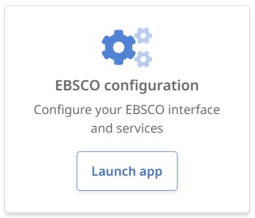
EBSCO configuration

Slide 10
EBSCO Configuration priorities
Global configuration
Changes made here will populate to all EBSCO products on new interface
EBSCOhost, Explora, EDS, Publication Finder
Branding - color and logo

Slide 11
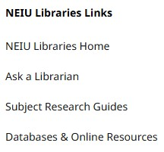
Researcher
Branding
Color and logo
Search box (“Search articles, books, journals & more”)
Navigation
Custom links in sidebar
Product experience
Custom alert banner

Slide 12
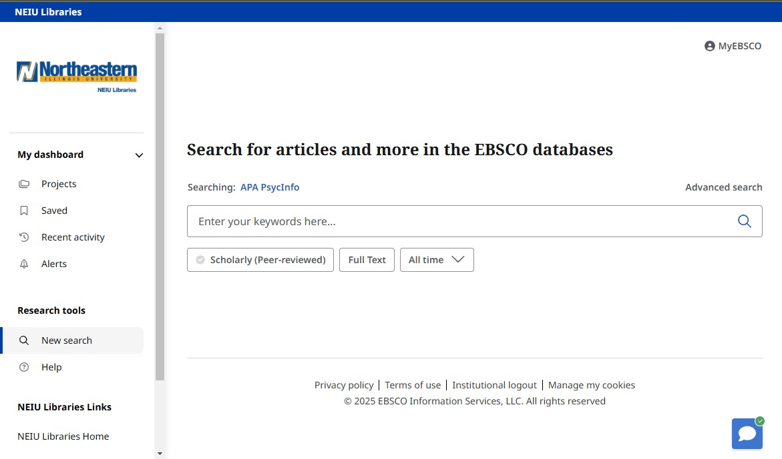
Integrations
Chat
LibraryH3lp
Other possibilities include:
API Links
Cover images
Custom placards
Media placards
Chat
LibraryH3lp
Other possibilities include:
Related resources
Relevant highlights
Relevant spotlights
Supplemental sources

Slide 13
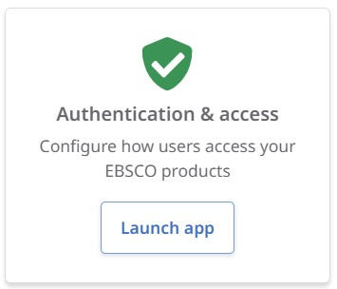
Authentication & access

Slide 14
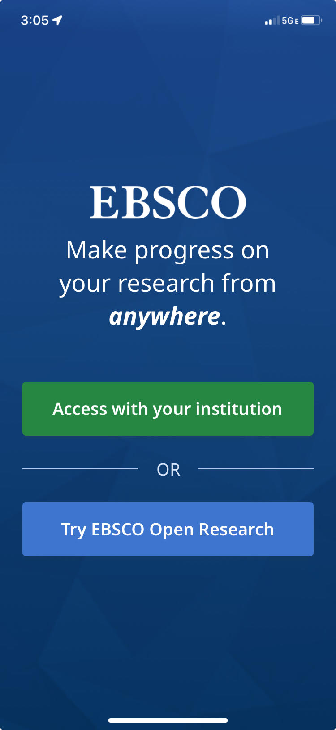
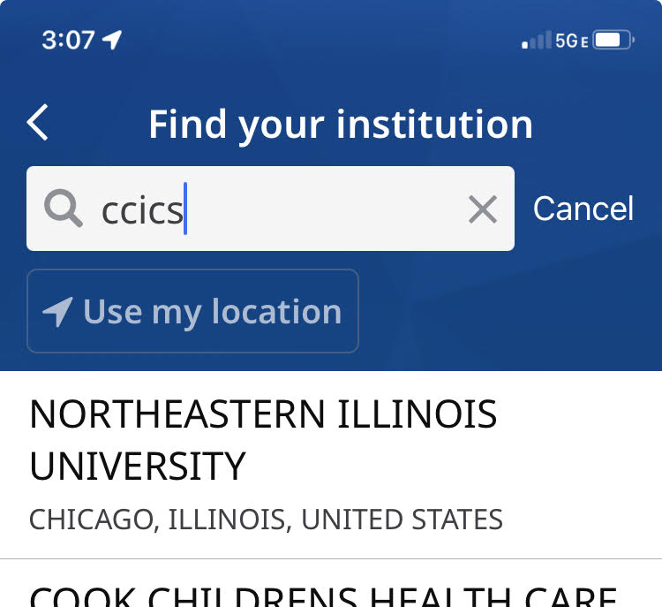
Find My Organization
Name and address
Northeastern Illinois University
Aliases and acronyms
NEIU
CCICS
El Centro
Ronald Williams Library

Slide 15
The importance of EBSCOadmin
https://eadmin.ebscohost.com/

Slide 16
Authentication
Set your Preferred Authentication Order
Required for Find My Organization
Also check “Make this site discoverable in supported applications”
Verify your IP ranges if you continue to offer on-campus immediate access
Contact EBSCO support for additional help, especially if using OpenAthens
No OA redirect prefix needed

Slide 17
Databases tab
EBSCOadmin
“Quick Filters”
Appear under Basic Search
5 available
Full Text
Peer Reviewed
All time
At My Library
Source Type
Reorder
Edit label
EBSCOhost interface

Slide 18
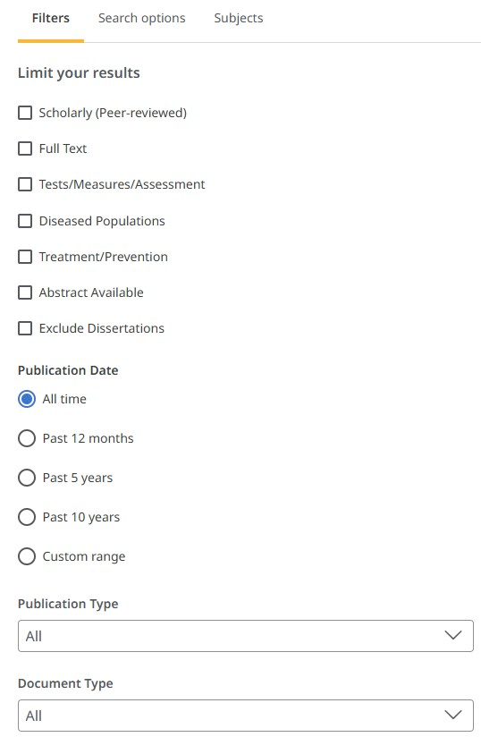
Databases tab
Advanced Search
Too many filters
e.g. PDF Full Text and HTML Full Text
Reorder (mostly)
Checkboxes then
Radio buttons then
Pull-downs/text
Database- and Subject-specific

Slide 19
Don’t forget OCLC Collection Manager

Slide 20
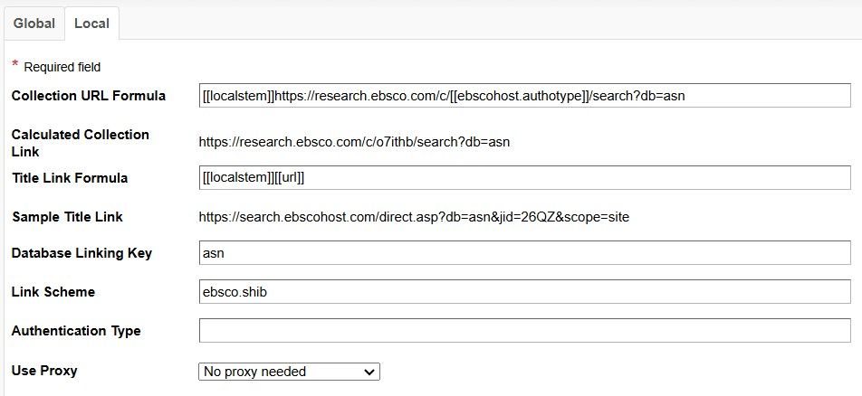
Linking
Enter your OPID in Institution Settings -> Authentication Type
OPID
If using OpenAthens

Slide 21
Librarian Concerns Before Migration
Loss of database-specific functionality
Ability to view applied filters on main screen
Need to update training materials
Emphasis on personal accounts

Slide 22
Librarian Concerns Now
Loss of database-specific functionality
More cumbersome to find
Ability to see applied filters
Requires more clicks
Need to update training materials
Still finding old information
Emphasis on personal accounts
Concerns about privacy, too much screen real estate

Slide 23
Current Observations
“I’m generally used to the new interface.”
“I think the transition went decently.”
“[Students] are fine with the new EBSCOhost interface…The faculty, too, seemed to take the transition in stride.”
“Some students are pleased to be able to utilize user-specific accounts to organize and save their sources.”

Slide 24
Questions?

