Slide 1
Alma: Overview of Alma Anonymization
May 29, 2024
Notes:
(Jessica)
Welcome to this I-Share webinar about Alma Anonymization and the changes coming to our consortial environment. My name is Jessica Gibson, and I’ll be joined today by several of my CARLI colleagues, including, but not limited to, Debbie Campbell, Adrienne Radsvickas, and Martin Kong.

Slide 2
Agenda
Overview of Alma Anonymization
Timeline
Alma Configuration Settings
Considerations for Library Staff
Upcoming Webinars and Training
Notes:
(Jessica)
Our agenda for today’s session includes providing you with an overview of how Anonymization in Alma works, the timeline for implementation, details about the consortial configuration settings for I-Share, considerations that I-Share library staff will need to be aware of, and information about future webinar sessions that we’ll be having to help your library adjust to these changes. Let’s get started.

Slide 3
Overview of Alma Anonymization
Anonymization in Alma removes personal user information from fulfillment transactions (loans, fines/fees, requests) after that information is no longer required for a current transaction and is considered “complete” in the system.
Anonymization in Alma leaves non-patron-identifiable information such as user group and affiliated I-Share institution reportable through Alma Analytics.
Notes:
(Jessica)
Anonymization in Alma removes personal user information from fulfillment transactions--specifically loans, fines/fees, and requests--after that information is no longer required for a current transaction and is considered “complete” in the system.
However, Anonymization in Alma leaves non-patron-identifiable information, such as user group and affiliated I-Share institution, reportable through Alma Analytics for generating statistics, which we know are essential for our member libraries to report to their institutions and other bodies.
Once we turn it on, user loan and request data in Alma will be anonymized after a retention period of seven days; while fine and fee data will be retained for seven years. We’ll get into more details in a moment.
For those of you who have been in an I-Share library since our Voyager days, back before we were using Alma, you may remember that loan and request transactions in Voyager were anonymized immediately, sometimes making it difficult to track down issues!

Slide 4
Overview of Alma Anonymization
Alma supports the anonymization of patron data and fulfillment transactions with a wide range of options.
CARLI staff and the CARLI Resource Sharing Committee have tested and decided upon several consortial policies for I-Share that optimize the privacy of patron data while balancing the needs of library staff to access these data.
These configurations have been approved by the CARLI Governance Board.
Notes:
(Jessica)
In contrast to Voyager, Alma supports the anonymization of patron data and fulfillment transactions with a wide range of options. To determine how best to configure things for I-Share, CARLI staff and the CARLI Resource Sharing Committee have tested and decided upon several consortial policies for I-Share that optimize the privacy of patron data while balancing the needs of library staff to access these data for different purposes. These configurations have been approved by the CARLI Governance Board.
There will be no changes to the day-to-day tasks within Alma such as loaning materials or returning materials, both from a local or I-Share perspective.
There will be changes to Alma Analytics reporting as certain data fields will be anonymized going forward. Two future Webinars and documentation will be provided by to help guide libraries to determine their data needs before and after anonymization is enabled, and to demonstrate how and which fields to modify on existing reports to maintain similar reporting capability as is presently available.

Slide 5
Timeline
CARLI will enable Alma’s anonymization of user data feature for all I-Share libraries on July 29, 2024.
How do we prepare?
Review best practices for handling PII
Consider your institution’s data needs
Review Alma Analytics reports for Anonymization effects
Modify Analysis as needed, or, prepare to export data
Notes:
(Jessica)
CARLI will enable Alma’s anonymization of user data feature for all I-Share libraries on July 29, 2024. CARLI staff will set and maintain these configurations in all I-Share IZs. There is no action required on the part of I-Share libraries to configure Anonymization.
Your library can prepare for these changes in several ways:
By attending CARLI webinars like this session and reviewing CARLI documentation
Review best practices for handling Personally Identifiable Information, or “PII”
Considering your institution’s data needs, and
Reviewing any Alma Analytics reports that your library uses so that you can modify them to adjust for fields that will be anonymized, and/or prepare to export data for analysis outside of Alma.

Slide 6
Upcoming Webinars and Training
Alma How-To: Anonymization and Analytics – Thursday, June 6, 2024, 2:00 PM – 3:00 PM
How to determine if you run a report that relies on data that will be anonymized
How to set up a report to be auto-run/auto-exported
Alma How-To: Reporting and Anonymization – Monday, June 10, 2024, 11:00 AM – 12:00 PM
CARLI staff and Dennis Krieb from Lewis and Clark Community College will discuss using reporting data for institutional purposes (and in light of Anonymization)
Notes:
(Jessica)
Two future webinars are scheduled to help I-Share libraries prepare. Registration is required, and the sessions will be recorded and posted to the CARLI website.
On June 6th we will cover how to determine if an existing report your library uses will be affected by anonymization and how to adjust such reports, and highlight built-in Alma features to configure report results to be auto-run or auto-exported.
On June 10th, CARLI staff and Dennis Krieb, Director of Library Services at Lewis and Clark Community College, will discuss using reported data from Alma for institutional purposes, and how this can be accomplished with Alma Anonymization in place.
Next, let’s dive into some specifics on the consortial configuration settings for anonymization with my colleague, Debbie.

Slide 7
Alma Configurations
CARLI staff will set and maintain these configurations in all I-Share IZs; there is no action required on the part of I-Share libraries to configure Anonymization.
Reminder: I-Share Libraries should NOT make any edits to the Alma Configuration under Fulfillment > General > Fulfillment Jobs Configuration.
These settings are consortially determined and managed by CARLI Office Staff.
Notes:
(Debbie)
Thank you, Jessica!
As we talk about the configuration settings behind the scenes in Alma that will enable the Anonymization process, I’ll start with a reminder that you have hopefully heard me say several times over the years we’ve been on Alma- remember that I-Share library staff should NOT make any edits to the Alma Configurations under the Fulfillment> General> Fulfillment Jobs Configuration.
These settings are consortially determined and managed by CARLI Offices Staff. We need these settings to stay set consistently across the consortium.

Slide 8
Notes:
(Debbie)
Now that I’ve reminded you to not edit these settings, and now that I’m showing you a classic example of my cat’s definition of something else that you can look at, but should not touch, let’s talk about the configuration settings in a little more detail.

Slide 9
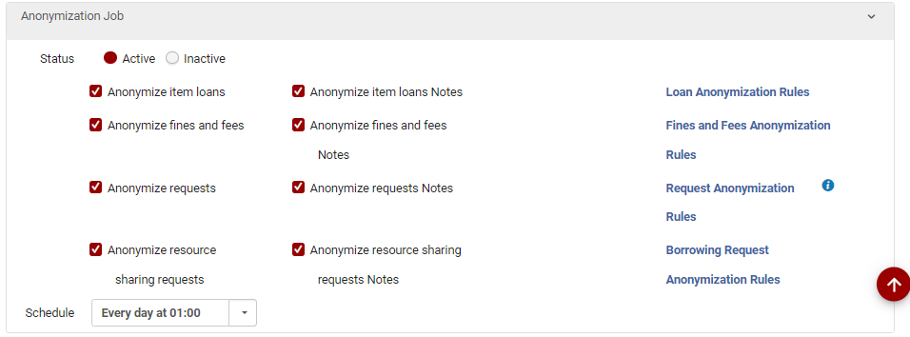
Alma Configurations
Screenshot shows the Alma Configuration for the Anonymization Job, including how the job will be set after July 29, 2024.
Notes:
(Debbie)
The fulfillment job that enables Anonymization in Alma is aptly called the “Anonymization Job.”
When enabled by CARLI staff in July, as a consortium we will be anonymizing: completed loans and loan notes; fines and fees, and fines and fee notes; local requests and local request notes; and finally local I-Share/resource sharing requests, and those associated notes.
The job will be scheduled to run every day at 1:00 am.
Each of these sub-sections of the job points to a set of Rules, linked on the right side of the screenshot. It is these rules that inform Alma which transactions to anonymize.

Slide 10
Alma Configurations
The decision to retain most data for seven days after the transaction ends rather than implementing immediate anonymization allows for the ability to identify problematic transactions (e.g. damage to items, routing/printing errors) and the ability for I-Share libraries to tie patron activities to assessment goals and outcomes when needed.
Except for I-Share libraries using one-way Bursar transfer with Alma, the Anonymization configurations will be standardized across all I-Share IZs for consistency of application and predictability.
Notes:
(Debbie)
As Jessica mentioned, once we enable Anonymization, user loan and request data in Alma will be anonymized after a retention period of seven days after the transaction is completed; while fine and fee data will be retained for seven years once “complete”.
The decision to retain most data for seven days after the transaction ends rather than implementing immediate anonymization, allows for the ability to identify problematic transactions (e.g. damage to items, routing/printing errors) and the ability for I-Share libraries to tie patron activities to assessment goals and outcomes when needed.
The CARLI Resource Sharing Committee and CARLI Office staff thoughtfully discussed Alma Anonymization, so that we can optimize the privacy of patron data while balancing the needs of library staff to access these data for different purposes. The following settings have been approved by the CARLI Governance Board.
Except for I-Share libraries using one-way Bursar transfer with Alma, the Anonymization configurations will be standardized across all I-Share IZs for consistency of application and predictability.

Slide 11
Alma Configurations
Anonymize item loans
Parameter set: Days Since Loan Ended: 7
Anonymize item loans Notes
Parameter set: Days Since Loan Ended: 7
Notes:
(Debbie)
For the Loan-related anonymization settings, both Loan transactions themselves, and the notes associated with the loan transaction will be anonymized seven days after the loan is complete, aka, the item is no longer checked out to the user’s record. These parameters are set in the “Loan Anonymization Rules” for the job, and will apply to transactions made by all user groups-- both local patrons and I-Share patrons.
An example of a Loan Note is when Alma records that the loan was completed by a staff member performing an override to permit the transaction.
Items that are still checked out to the patron, even if they are in a status such as Lost or Claimed Returned, will not be anonymized.

Slide 12
Alma Configurations
Anonymize requests (local)
Parameter set: Days Since Request Ended: 7
Anonymize request Notes (local)
Parameter set: Days Since Request Ended: 7
Anonymize resource sharing requests (I-Share)
Parameter set: Days Since Request Ended: 7
Anonymize resource sharing requests Notes (I-Share)
Parameter set: Days Since Request Ended: 7
Notes:
(Debbie)
Similarly, when either a local request or an I-Share request is complete in Alma, the job will anonymize the transaction seven days after that request is complete.
Examples of a “complete” request include:
the request or hold was cancelled by staff or the patron,
where a lender was not able to be found so the request is not able to be filled,
and where the item that was requested is now on loan to the patron; when the item is on loan to the patron, the request portion of the transaction is “complete” and will be anonymized after 7 days, while the loan that resulted from the request will be anonymized only after the loan portion of the transaction is complete.

Slide 13
Alma Configurations
Anonymize fines and fees
Parameter set: Days Since Fine/Fee Closed: 2,555 (7 years)
For I-Share libraries using one-way bursar transfer only: This setting may differ from consortial standard setting pending individual conversations with those libraries.
Anonymize fines and fees Notes
Parameter set: Days Since Fine/Fee Closed: 2,555 (7 years)
For I-Share libraries using one-way bursar transfer only: this setting may differ from consortial standard setting pending individual conversations with those libraries.
Notes:
(Debbie)
For fines and fees, the amount of time before a completed fine is anonymized is lengthier- 7 years after the fine is marked “complete.”
Complete fines include those that are paid or waived in full, or where one-way bursar transfer has closed the fine in Alma when exporting the fine for transfer to the business office.
A fine or fee that has been anonymized will no longer be listed on the user’s record, since an anonymized fine is no longer associated with the user.
I will now pass this over to Adrienne to discuss some changes to what staff may see when working within Alma.

Slide 14
Considerations for Library Staff
Changes within Alma
Notes:
(Adrienne) In the next few slides, we’ll show you some examples of how anonymization changes the information that you can see in Alma. In general, user-specific information is taken out after seven days have passed after the transaction is complete, except for fines and fees, which are kept for seven years.

Slide 15
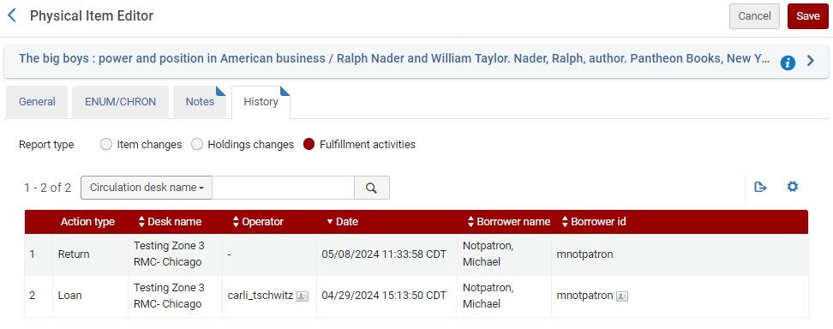
Considerations for Library Staff- Alma Views
Loans- Screenshot before Anonymization
Notes:
(Adrienne) In this “before anonymization” screen shot, you see the borrower name and ID. However, once the loan is discharged, it’s not visible in the user’s record anymore.
Information for the item changes radio button will not change with anonymization because it does not display user information.

Slide 16
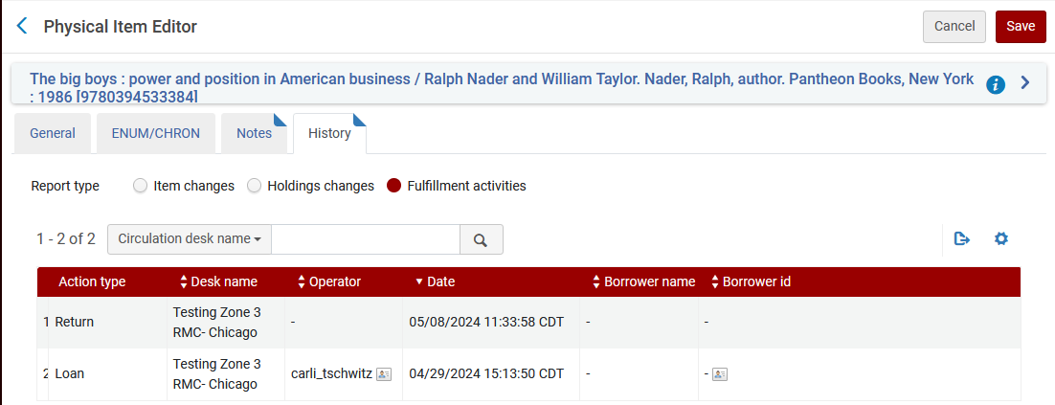
Considerations for Library Staff- Alma Views
Loans- Screenshot after Anonymization
Notes:
(Adrienne) In this “after anonymization” screenshot, the borrower name and ID are blank. When any of these records is anonymized, the link between the relevant record and the borrowing patron is permanently removed from the system—that is, it is not restorable in any way. Consequently, any interface that shows information about the loan borrower will have no history information to display.

Slide 17
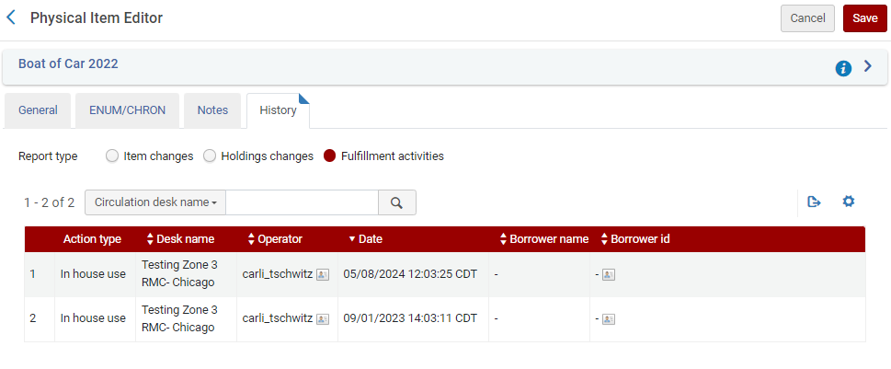
Considerations for Library Staff- Alma Views
Example of an “In house use” transaction
Notes:
(Adrienne) Items that had “in house use” will not have a borrower associated with it, so the borrower will be blank there as well.
Anonymization will not affect these transactions, since they were not associated with a borrower.

Slide 18
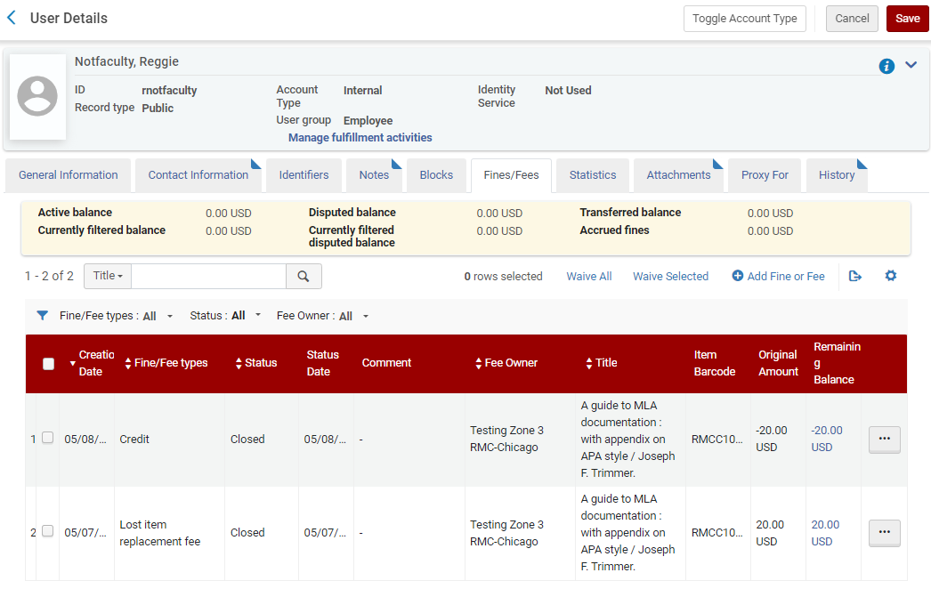
Considerations for Library Staff- Alma Views
Fines/fees- Screenshot before Anonymization
Notes:
(Adrienne) In this screen capture, an old fines transaction is visible.

Slide 19
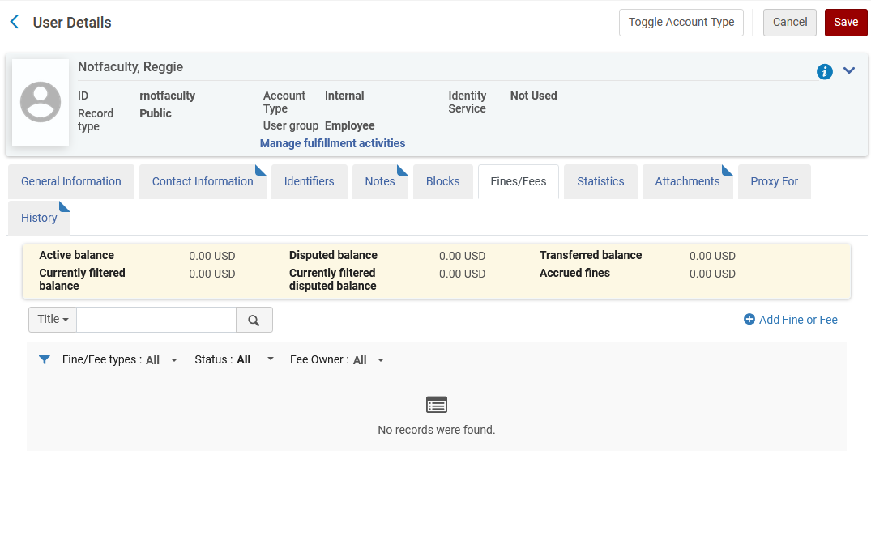
Considerations for Library Staff- Alma Views
Fines/fees- Screenshot after Anonymization
Notes:
(Adrienne)
In the “after” screen capture, the fine is not visible. When a fine/fee record is anonymized, the link between the loan record and the patron is permanently removed from the system—that is, it is not restorable in any way. Consequently, any interface that shows information about the patron owing the fine/fee has no history information to display.

Slide 20
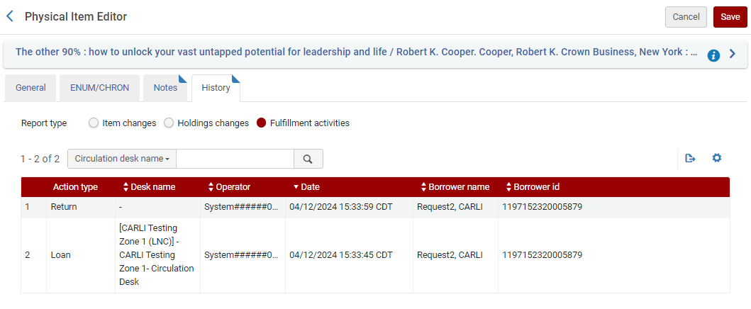
Considerations for Library Staff- Alma Views
Request by a local patron in item history- Screenshot before Anonymization
Notes:
(Adrienne) In this screenshot of a local request before anonymization, the borrower name and ID are visible.

Slide 21
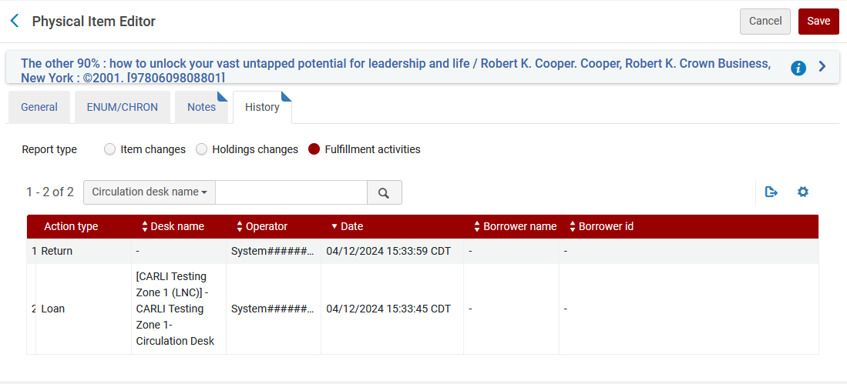
Considerations for Library Staff- Alma Views
Request by a local patron in item history- Screenshot after Anonymization
Notes:
(Adrienne) In this screenshot of the same transaction after anonymization, the borrower name and ID are blank.

Slide 22
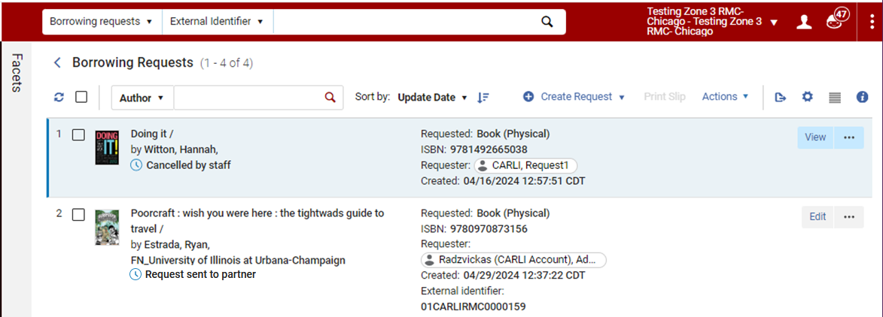
Considerations for Library Staff- Alma Views
I-Share Borrowing Request- Screenshot before Anonymization
Notes:
(Adrienne) In this “before” screenshot of I-Share requests in the Borrowing Requests list, you can see the requester for both these transactions.

Slide 23
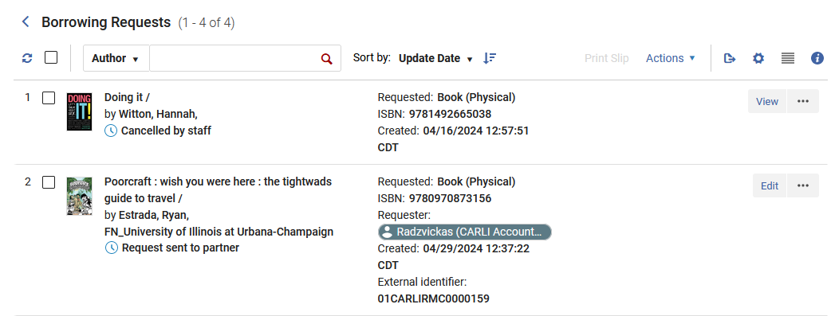
Considerations for Library Staff- Alma Views
I-Share Borrowing Request- Screenshot after Anonymization
Notes:
(Adrienne) In the screenshot, you can see that the requester for “Doing it” is now gone. The borrower for “Poorcraft” is still there because that transaction is not yet complete, while the first one is complete because it was canceled.

Slide 24
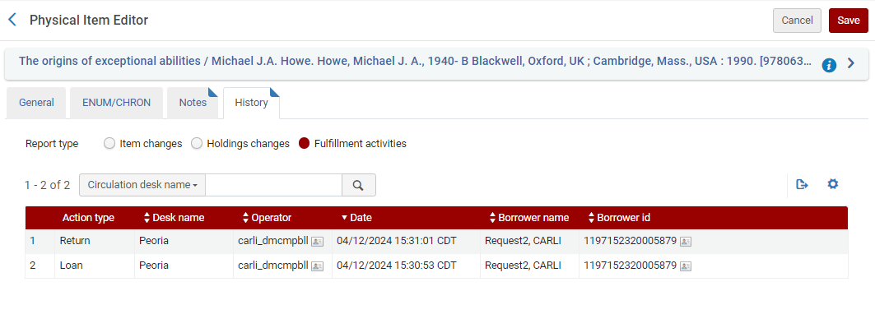
Considerations for Library Staff- Alma Views
Request by an I-Share patron in item history- Screenshot before Anonymization
Notes:
(Adrienne) This is an I-Share request before anonymization in the history for an item: The borrower name and ID are visible.

Slide 25
Considerations for Library Staff- Alma Views
Request by an I-Share patron in item history- Screenshot after Anonymization
Notes:
(Adrienne) After anonymization, the borrower name and ID aren’t visible.

Slide 26
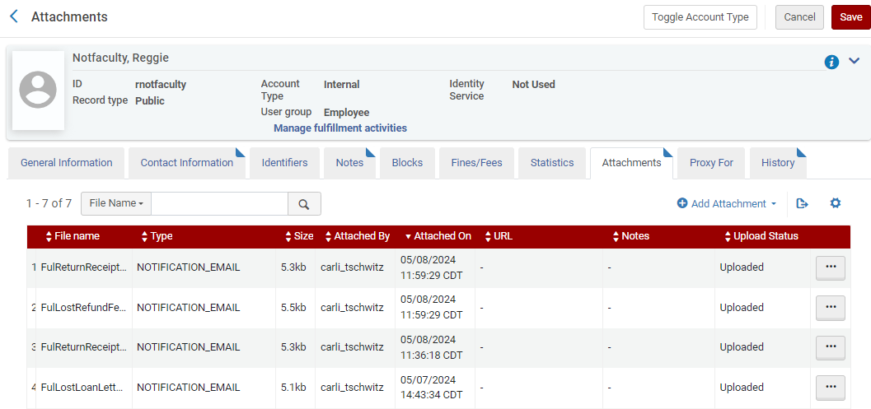
Considerations for Library Staff- Alma Views
Letters retained for 60 days.
Notes:
(Adrienne) Before: Letters are attached to the patron’s account and can be viewed within the Attachments tab. They are retained for 60 days, and are not affected by anonymization.

Slide 27
Considerations for Library Staff- Reporting Changes
Note that some of your local practices regarding the use of fulfillment data may not be known by CARLI staff, therefore you will need to review the following:
Look at your existing Alma Analytics reports that obtain fulfillment data
Think about the fulfillment data that you obtain directly from Alma that will be anonymized going forward.
APIs
Webhooks
Notes:
(Martin)
Here are some of the reporting changes that library staff should take into consideration.
Note that some of your local practices regarding the use of fulfillment data may not be known by CARLI staff, therefore you will need to review the following:
Look at your existing Alma Analytics reports that obtain fulfillment data
Think about the fulfillment data that you obtain directly from Alma that will be anonymized going forward.
APIs
Webhooks

Slide 28
Considerations for Library Staff- Reporting Changes
Forthcoming:
CARLI Webpage with a list of fields affected by Anonymization.
An Ex Libris support ticket was opened by CARLI at the end of March asking for a complete list of fields affected by Alma anonymization. We are currently still waiting for a response.
Notes:
(Martin)
A CARLI webpage is forthcoming that will provide a list of fields in Analytics that are affected by Alma Anonymization.
An Ex Libris support ticket was opened by CARLI at the end of March asking for a complete list of fields affected by Alma anonymization. We are currently still waiting for a response.

Slide 29
Considerations for Library Staff- Reporting Changes
Example #1 of Alma Fulfillment data use:
Damaged laptop that was returned more than 7 days ago but you realized that it is damaged now.
Since anonymization occurs 7 days after the item is returned, the patron’s identifier will no longer be connected to the item that was loaned. Within Alma and/or Alma Analytics, you will not be able to determine who damaged the laptop.
Notes:
(Martin)
This is one example of how Alma fulfillment data may be used at your local institution.
Your institution lends laptops to patrons.
A damaged laptop was returned more than 7 days ago but you realize that it is damaged now.
Since anonymization occurs 7 days after the item is returned, the patron’s identifier will no longer be connected to the item that was loaned. Within Alma and/or Alma Analytics, you will not be able to determine who damaged the laptop.

Slide 30
Considerations for Library Staff- Reporting Changes
Example #2 of Alma Fulfillment data use:
Your library helps the institution gather academic performance data tied to library resource use.
An Alma Analytics Object emails monthly reports of aggregate numbers of items checked out by a patron for reporting purposes.
Since anonymization occurs 7 days after the item is returned, the report could return inaccurate data. The patron’s identifier will no longer be connected to items that were returned more than 7 days ago. Items returned less than 7 days ago will be reported.
Notes:
(Martin)
This is a second example of how Alma fulfillment data may be used at your local institution.
Your library helps the institution gather academic performance data tied to library resource use.
An Alma Analytics Object emails monthly reports of aggregate numbers of items checked out by a patron for reporting purposes.
Since anonymization occurs 7 days after the item is returned, the current report could return inaccurate data. The patron’s identifier will no longer be connected to items that were returned more than 7 days ago. Items returned less than 7 days ago will still be reported.
We are not asking you to change the reports at this moment. We are asking you to think about the processes. Talk with your colleagues and make note of things that you do at your institution that use this Alma / Analytics information that will be anonymized in the future. At future sessions, we will discuss how to change your analytics reports that will be affected and how to create scheduled reports to obtain necessary data before it is anonymized.

Slide 31
Considerations for Library Staff- Reporting Changes
The reports from the I-Share Annual Statistical Package for Alma Data will be updated by CARLI staff
The fiscal year 2023-2024 reports will not be affected by anonymization
CARLI staff will modify the Annual Statistics Package reports as needed to ensure continuity of data in forthcoming fiscal years once anonymization is enabled.
Notes:
(Martin)
The reports from the I-Share Annual Statistical Package for Alma Data will be updated by CARLI staff
The fiscal year 2023-2024 reports will not be affected by anonymization (because anonymization will be enabled after that fiscal year has ended).
CARLI staff will modify the Annual Statistics Package reports as needed to ensure continuity of data in forthcoming fiscal years once anonymization is enabled.

Slide 32
Upcoming Webinars and Training
Alma How-To: Anonymization and Analytics – Thursday, June 6, 2024, 2:00 PM – 3:00 PM
How to determine if you run a report that relies on data that will be anonymized
How to set up a report to be auto-run/auto-exported
Alma How-To: Reporting and Anonymization – Monday, June 10, 2024, 11:00 AM – 12:00 PM
CARLI staff and Dennis Krieb from Lewis and Clark Community College will discuss using reporting data for institutional purposes (and in light of Anonymization)
Notes:
(Martin)
This whole presentation has been an overview of forthcoming Alma anonymization changes.
Here is a reminder that we will have two upcoming in-depth sessions.

Slide 33
Q & A
Notes:
(Martin)

