Slide 1
I-Share Alma Primo VE quarterly update will start shortly
Welcome!
We will start at 1pm and run until 2pm. Please mute your microphone. As time permits, we will respond to questions typed in the chat box, and offline afterwards, as needed.
This session will be recorded and made available on the CARLI website. Slides and references for today are available at
https://www.carli.illinois.edu/alma/primo-ve-quarterly-feature-release-update-0

Slide 2
I-Share quarterly alma primo ve update: February 2025 Feature release February 6, 2025
Notes:
Hello! Welcome to our Quarterly Alma Primo VE Feature Release for February 2025. I’m Jen Masciadrelli at CARLI and along with my CARLI colleagues we’ll discuss some of the new features featured this quarter.

Slide 3
Agenda Office Hours
Agenda – 2/6/2025
Announcements and Reminders
Upcoming events
Today’s Topic: February 2025 Feature Release
Notes:
Jen – a brief agenda – Announcements and Reminders ; upcoming events and today’s topic.

Slide 4
Announcements and reminders
Announcements and Reminders
I-Share Resource Management Training
Tuesdays beginning February 18
Register on CARLI website
ERMC Presents
Hosted by the Electronic Resources Management Committee
February 14, New EBSCOHost UI at Northeastern Illinois U.
CARLI Email Lists
https://www.carli.illinois.edu/email-lists
Notes:
[Ted]
We are offering a new set of Resource Management training. There are eight 90-minute sessions, scheduled Tuesday mornings beginning on February 18. Sessions will be recorded and edited for future release. Each session will stand on its own, though staff who are newer to Alma resource management may benefit from registering for each session.
Links to each session may be found on the Training announcement webpage <https://www.carli.illinois.edu/i-share-resource-management-training> that is being shared in chat.
The Electronic Resources Management Committee is initiating a new series of presentations on various electronic resources topics. The first of these will take place on Friday, February 14 at 1:30 p.m., as Lisa Wallis of Northeastern Illinois University shares her library's experience working with and rolling out the new EBSCOhost user interface. Register on the CARLI website at the link being added to chat. <https://www.carli.illinois.edu/node/9336>
Is this the first you're hearing about this training or this event? If so, then you may not be subscribed to the right email list from CARLI. CARLI lists provide a venue for discussion of topics and announcements of new activities and events. Check out the list of lists at the link on the screen, and sign-up. <https://www.carli.illinois.edu/email-lists>

Slide 5
Announcements and reminders
Granular Analytics Roles Enabled
Setting to enable roles pushed to institutions Jan. 31.
Privacy best practice: limit access to data needed for job
New roles:
Designs Analytics - Acquisition
Designs Analytics - Fulfillment
Designs Analytics - Resources
Designs Analytics - System Usage
Designs Analytics - Users
Notes:
[Ted]
In previous releases over the last year, Ex Libris has introduced several analytics roles that provide more granular reporting access to institution data. This allows institutions the ability to follow privacy best practices, which encourage organizations to govern access to data according to the duties of a user’s job.
The new roles listed here relate provide access to groups of subject areas. For example, a staff member may need analytics access to create catalog clean-up reports, but they may have no interactions with patrons. The Designs Analytics Resources role provides the access to the subject areas needed for managing catalog data.
The existing Designs Analytics role remains available for situations when a staff member requires access to all the Analytics areas. Watch for more information on this shortly.
[Next slide – speaker]

Slide 6
Upcoming events
Upcoming Events
https://www.carli.illinois.edu/calendar
2/11/2025 - PDA Event: Behind the Bulletin: A Look at Reviewing Children’s Literature and Its Role in the Professional Field
2/11/2025 - New Directors Orientation
2/12/2025 - PDA Event: Adobe Express vs. Canva
2/13/2025 - Understanding and Promoting Open Educational Resources: Live Session #1
02/14/2025 - ERMC presents: Migrating to EBSCO UI
3/14/2025 – ERMC presents: Welcome to E-Resources Troubleshooting
4/11/2025 – ERMC presents: Usage Statistics
04/15/2025 - CARLI AI Symposium presented by the Public Services Committee
Notes:
[Name] But first, a few friendly reminders:
You can always check the CARLI calendar for all CARLI events, including those related to Alma and Primo VE.
For the latest news in and around all of CARLI, check out the CARLI newsletter online! The newsletter is published monthly on our website. Here’s the link to the latest!

Slide 7
Alma

Slide 8
New Titles Search User Interface the Default
Feature Rollout Preferences – toggle settings
Notes:
Adrienne
The default for the New Titles search as of the February release is the new user interface. However, you can turn the old interface back on if you desire. Select your user icon in Alma's persistent search bar, select Feature Rollout Preferences, and deactivate the New Titles Search toggle.

Slide 9
Updates to the Physical Holdings User Interface
Running a job in Alma
Notes:
Adrienne
Search results table view
Search configuration - both at the institution level and the personal user level
Performing more actions directly from the search results, including:
Running jobs on selected holdings
Adding and updating itemized holdings sets
A new items section enabling users to perform actions on items directly from the holdings search. Users who want to retain access to the old items list section can enable it through the configuration settings.
A smart link for items provides configurable, one-click access to the items section, the holdings' items list, or an items search by holdings ID.
Suppressing the holdings record.
An enhanced details pane, including the Quick-access component and renaming of the sections for a more intuitive user experience.
Exclude facets
Search labels
Viewing cataloger notes for the holdings record

Slide 10
View Cataloger’s Note in Titles Search
Notes section display in New Titles Search
Notes:
Adrienne
Catalogers can now view notes added to local bibliographic records directly from the search results, without needing to open the Metadata Editor. Catalogers in consortium member institutions can also view notes on Network Zone records.

Slide 11
Repository Search Labels
Search labels
Notes:
Adrienne
Institutions can now add local labels to records. These labels can be used for searching, faceting, and viewing search results.
To maintain control over the number of labels added, only users with Manager or Administrator roles can add labels to records. However, all users can view and search using these labels.
Institutions that wish to grant Operator roles permission to add repository search labels can contact Ex Libris for assistance.

Slide 12
Additional Titles Search Changes
Linked open data and navigation sections have been enabled
You can search for bibliographic records with or without purchase orders and use the Has orders facet to filter search results
You can search by permanent call number without specifying the call number type, except when searching by a call number range.
Single-click links are added for more related entities, alongside the existing orders and requests links.
Notes:
Adrienne
Single-click links are added for more related entities, including courses, licenses, reminders and related records, alongside the existing orders and requests links.
Also, the thumbnail images for records now include images from Syndetics

Slide 13
Leganto: Choose Which Citation Tags to Copy on Rollover
New settings in Integration Profile
Notes:
Adrienne
When the On rollover copy citation tags checkbox is checked, and Select tags is selected from the Course Loader Actions (Configuration > Leganto > LTI > Integration Profiles), tags to include can be selected from the dropdown list. When the job runs, only the selected tags are copied to the duplicated list.

Slide 14
Electronic Resources Updates
AUTOHOLDINGS NEW VENDOR: Sage journals and books are now supported by the Automatic Upload of Electronic Holdings feature.
New Linking Template for Naxos
For documentation, visit “Configuring the Central Index Linking Templates for Primo VE”
Screenshot of Linking Template for Naxos
Notes:
Yanira and Marisa

Slide 15
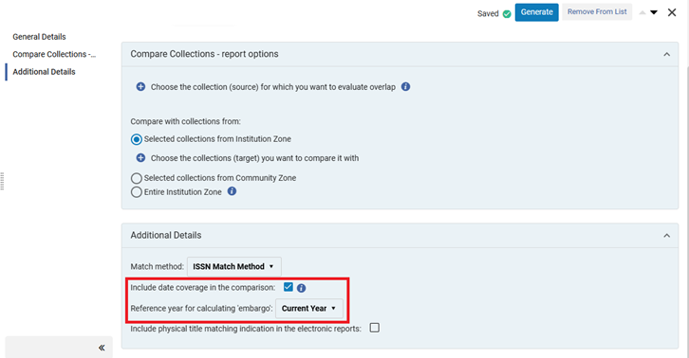
Electronic Resources Updates
Overlap Collection Analysis Now Takes Into Account Embargo Periods
Overlap collection analysis now takes into account embargo periods when coverage comparison is enabled ("Include date coverage in the comparison"). You can also select to calculate the embargo based on a reference year, which can assist in evaluating your future inventory.
For documentation, visit “Working with Overlap and Collection Analysis”
Screenshot of Overlap Analysis date coverage
Notes:
Yanira and Marisa

Slide 16
COUNTER R5.1 Support
COUNTER published Release 5.1 in May 2023, with compliance required by February 28, 2025 (for January 2025 usage)
R5.1 is broadly comparable to R5
Reports have not changed
Metrics have not changed
See What's New in R5.1 for information on changes between R5 and R5.1
Vendors required to support R5 for at least 3 months after implementing R5.1
Do not harvest both R5 and R5.1 reports for the same vendor; this will result in duplicate data.
Monitor vendor rollout of R5.1 through the COUNTER Registry
Notes:
Nicole
Alma now supports COUNTER Release 5.1 reports.
A little bit of background information:
R5.1 was originally published in May 2023, with vendor compliance required for January 2025 usage. Because of the processing timeline for usage data, in practice this means vendors have until the end of February.
If you work with e-resource usage data and weren’t aware of this change – DO NOT PANIC.
R5.1 is broadly comparable to R5. This transition is not like the change from COUNTER R4 to R5.
Most changes are technical in detail and on the side of the publishers processing data
Reports have not changed
Metrics have not changed
There are some meaningful changes between R5 and R5.1, but this isn’t a presentation on COUNTER, so I’ll refer you to COUNTER’s page on “What’s New in R5.1” for more information. (As a side note, the COUNTER website has a ton of great information, especially under the “Education” section).
Vendors are required to continue supporting R5 for at least 3 months after implementing R5.1. Some vendors may choose to continue supporting R5 for longer, but that is not required. That said, that once you begin harvesting R5.1 data for a vendor in Alma, you should no longer harvest R5 data, as this will result in duplication.
You can monitor vendor rollout of R5.1 through the COUNTER Registry.

Slide 17
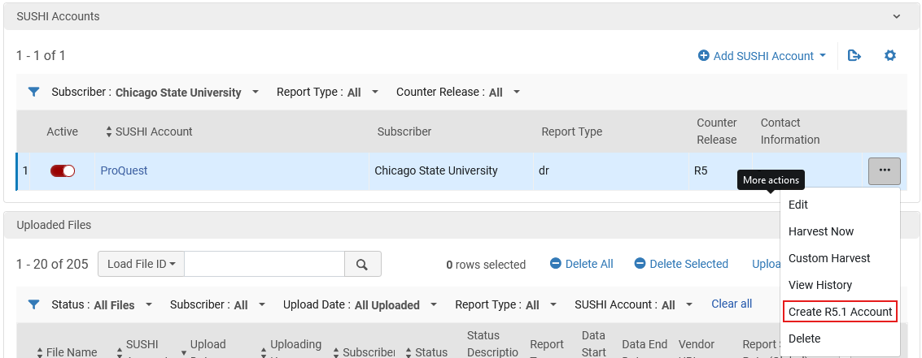
COUNTER R5.1 Support
New SUSHI accounts required
Existing SUSHI accounts: create R5.1 account based on existing account
Deactivate corresponding R5 account(s)
See Workflow for moving SUSHI from R5 to R5.1
Analytics: R5.1 reports will be added to the Release 5 folder
Option to Create R5.1 Account in SUSHI Accounts in Alma
Notes:
Nicole
When you find out a vendor is R5.1 compliant, you’ll need to set up new SUSHI accounts in Alma.
If you already have R5 accounts set up, you can create a 5.1 account based on the existing account. Click the More Actions button, then “Create R5.1 Account.”
Request details (requestor & customer IDs, API keys, etc.) will be copied into the new account. Confirm with the vendor that these are still valid for R5.1 and change as needed. You will need to add the SUSHI account (vendor), new URL, and override URL if necessary.
Once active, new 5.1 accounts will begin harvesting data from the last R5 harvest onwards
After you’ve confirmed the 5.1 account setup, deactivate the R5 account.
For additional information and instructions on moving SUSHI accounts from R5 to R5.1, see Alma’s “Workflow for moving SUSHI from R5 to R5.1”
A quick note about R5.1 reports in Analytics: because R5.1 is so similar to R5, the reports will be added to the current “Usage Data Details – Release 5” folder in Analytics. Reports you’ve created in Analytics will continue to work. Refer to the COUNTER website for information on the specific changes between R5 and R5.1

Slide 18
ALMA
New Manage Patron Services UI- enabled by Default
The new Manage Patron Services UI became the default view.
Until the new UI becomes the only view in May, staff may toggle between the old and new UI as needed.
Directions to toggle:
When logged into Alma, select the “person” symbol in the top toolbar (this is the same symbol you select to sign out of Alma).
From the menu, select “Feature Rollout Preferences.”
Enable or disable the toggle for “New Manage Patron Services: Category Fulfillment” to switch between the current and new UI. The toggle takes effect immediately after being switched.
Notes:
Debbie
With the February 2, 2025 Alma Quarterly Release, the new Manage Patron Services UI will become the default view. https://www.carli.illinois.edu/alma-quarterly-feature-release-february-2025
This means that after the update on Feb. 2, any library staff logging into Alma for fulfillment activities will have the new UI enabled as the default view.
This new UI will become the only view in May 2025.
Until the new UI becomes the only view in May, staff may toggle between the old and new UI as needed.
Directions to toggle are included here on the screen.

Slide 19
ALMA
New Manage Patron Services UI- enabled by Default
Resources to help library staff prepare for the new UI:
CARLI Fulfillment Training upcoming sessions and recordings: https://www.carli.illinois.edu/products-services/i-share/alma/fulfillment/CARLI-Alma-Fulfillment-Training
Ex Libris New Layout documentation for “Managing Patron Services at a Circulation Desk”: https://knowledge.exlibrisgroup.com/Alma/Product_Documentation/010Alma_Online_Help_(English)/030Fulfillment/040Circulation_Desk_Operations/Managing_Patron_Services_at_a_Circulation_Desk_-_New_Layout
Ex Libris PowerPoint highlighting new UI functionality (will prompt download of a PPTX file): https://nam10.safelinks.protection.outlook.com/?url=https%3A%2F%2Fknowledge.exlibrisgroup.com%2F%40api%2Fdeki%2Ffiles%2F170493%2FThe_Manage_Patron_Services_Page_Circulation_Desk.pptx%3Frevision%3D2&data=05|02|Eldad.Yehoshafat%40Clarivate.com|1d6b2485db5c4558a7cb08dc941d9aee|127fa96e00b4429e95f972c2828437a4|0|0|638548102075693837|Unknown|TWFpbGZsb3d8eyJWIjoiMC4wLjAwMDAiLCJQIjoiV2luMzIiLCJBTiI6Ik1haWwiLCJXVCI6Mn0%3D|0|||&sdata=%2B3pjigogbV90iZadk%2BCRBtgbXVqkvB4sniN2FAYaTpQ%3D&reserved=0
Ex Libris New UI known issues: https://knowledge.exlibrisgroup.com/Alma/Product_Documentation/010Alma_Online_Help_(English)/030Fulfillment/040Circulation_Desk_Operations/Managing_Patron_Services_at_a_Circulation_Desk_-_New_Layout?mt-draft=true#Known_Issues
Notes:
Debbie
This slide contains a list of resources to help with transitioning to the new UI. These links were also sent in email to the I-Share Liaisons list, as well as the Public Services Interest Group and the Resource Sharing Interest Group. With those emails, I hope this new UI wasn’t a surprise to anyone on Feb 2nd.

Slide 20
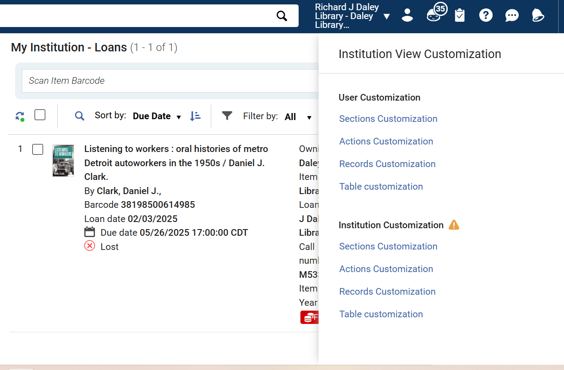
ALMA
New Manage Patron Services UI- enabled by Default
The power of being an admin- “Institution Customization” for table views.
“You are about to customize the default settings for the entire institution.”
Options for customizing an institution view
Notes:
Debbie
If you have admin privileges in Alma, when you select the gear symbol above the tables in Alma that have been updated to use a new UI (so manage patron services, or new titles search), you will see both User Customization and Institution Customization options.
If you edit the Institution Customization settings, you are customizing the default settings for everyone in your institution. The “User Customization” settings are only for your own login.

Slide 21
ALMA
Sound Alerts in New Manage Patron Services UX
The new Manage Patron Services UX can be set up to sound an alert when a block happens at the circ desk.
The sound is not enabled by default; directions to enable from Ex Libris are available: https://youtu.be/42MMzBJ8LMQ
Sound alert icon in barcode scan field
Notes:
Debbie
The new Manage Patron Services UX can be set up to sound an alert when a block-related transaction happens at the circ desk. The video linked on this slide walks through the process to enable the sound for your institution, and then for each circulation desk. Individual staff members can use the sound symbol when performing loans and returns to mute the sound in Alma if desired.

Slide 22
ALMA
Sound Alerts in New Manage Patron Services UX
We are not yet certain all scenarios when the sound is played during loans and returns. For example:
Loans where the override was NOT granted when the user record was retrieved, so each individual loan DOES need the override granted: Yes sound
Loans where the override WAS granted when user record was retrieved, so each individual loan DOES NOT need the override granted: No sound
Returns of lost materials: No sound
Returns of materials loaned by override: No sound
Returns of materials that need to be transited: No sound
We have asked ExL for a comprehensive list of when the sound should be anticipated; we will send an email to I-Share Liaisons once received.
Notes:
Debbie
We are not yet certain all scenarios when the sound is played during loans and returns. We have asked ExL for a comprehensive list of when the sound should be anticipated; we will send an email to I-Share Liaisons once received.

Slide 23
ALMA
Option to Share Operator Name Across the Fulfillment Network
Institutions in a Fulfillment Network can now opt-in to share the name of their operators who have put items of another institution in transit.
The CARLI Office will review this setting with the Resource Sharing Committee and make an I-Share wide decision.
Notes:
Debbie
There is a new setting in Alma Configuration to allow the Institutions in a Fulfillment Network can now opt-in to share the name of their operators who have put items of another institution in transit.
The decision to enable this setting needs to be a consortial decision, so the CARLI Office staff will discuss this setting with the CARLI Resource Sharing Committee to make an I-Share wide decision.

Slide 24
AI Metadata Assistant
Toggle Missing Status added to actions menus for item records
When item is in place, or
When item is not in place and
Process type is one of:
In Process
Missing
Transit
Other process types may require more steps to toggle missing status
Pop-up box for AI Metadata Assistant
Notes:
The AI Metadata Assistant is a tool that aids catalogers with the creation and update of catalog records through a combination of input templates, images of the details of a resource, and an AI trained from MARC record metadata and metadata practices. The input template prompts for a title and other fields such as author and ISBN. The cataloger may upload up to 4 images of the resource, for example images of the title page and title page verso, table of contents, back cover, etc. The assistant uses these details to generate a record description that may be reviewed and modified further. The AI assistant uses a large language model based on MARC data. The model does not learn from new input, and Alma does not retain any of the uploaded images or other data.
Many of you logging into Alma this week will have seen a pop-up announcement that the AI metadata assistant tool is live, Selecting the Take Me There button would navigate a user with the correct admin roles to a configuration screen for an AI Usage Profile. This screen requires the user accept the terms of use for the tool, basically a disclaimer that the tool is provided as is and users are responsible for any records created or modified using the tool. Selecting Yes enables the tool for the institution only, not the network or the community zone.. After enabling the institution, individual users may be assigned the AI Assisted Cataloging role.
Enabling the AI assistant for your institution allows you to modify records that reside in your institution zone only. Access to create or modify network zone data is not yet available, as CARLI staff are still evaluating the tool. There is no ability to modify community zone records.
[Next slide]

Slide 25
Item Records—Mark In-Process as Missing
Toggle Missing Status added to actions menus for item records
When item is in place, or
When item is not in place and
Process type is one of:
In Process
Missing
Transit
Other process types may require more steps to toggle missing status
Toggle Missing Status for Items
Notes:
[Ted]
The process of marking items that are in a “not in place” status has been improved for some process types. For example, an item may have a process type of “Transit” or “In Process,” but staff have already identified that the item is not on the shelf or a cart, and ILDS bags are accounted for. Previously, one could only set a missing status on an item if there was no other status already. Beginning this month, some process types may be replaced with a missing status directly, and a Toggle missing status menu option will appear on the action menu for physical items screens. So far, we’ve seen that the new option will work with items marked In Process or Transit, as well as Missing.
[Next slide]

Slide 26
Item Records—Mark In-Process as Missing
Toggle Missing Status from the More Actions menu
Notes:
[Ted] Pictured here is an item record found on the physical items search screen, which is not yet in the new UI. The item has a Process Type of Transit, and the actions menu includes an option for Toggle Missing Status.
Please note that previous procedures for marking items as missing, such as viewing a request or viewing the list of items screen, are still valid.
[Next slide]

Slide 27
Acquisitions: PO Line Enhancements
Enhanced PO Line Claiming job report
Lists vendors and success or failure in sending claim emails
Automatic update to bibliographic details
Update PO description automatically after a bib change
Opt in with parameter: po_line_description_update_upon_bib_change
Change PO Lines for different inventory and continuity
Display of PO Lines UI
Notes:
{Ted]
In the Acquisitions area, there are a few new improvements. First up, if your institution runs the scheduled PO Line Claiming job, you’ll notice that the job report will now include a list of vendors that the job attempted to email, along with details on whether the messages were sent successfully or not.
A new setting enables the automatic update to the bib description on a PO Line after a bib record change. Alma’s default behavior is to create the bib description on the PO Line using the record attached when the POL is created. This description typically remains unchanged if the POL were closed and updated cataloging occurred after. For example, if the POL were relinked to another bib or if the underlying bib were updated. Ex Libris has introduced a new parameter, po_line_description_update_upon_bib_change, found in the Other Settings configuration table. If set to true, the POL will automatically receive the updated description from the record after it is saved.
[Next slide]

Slide 28
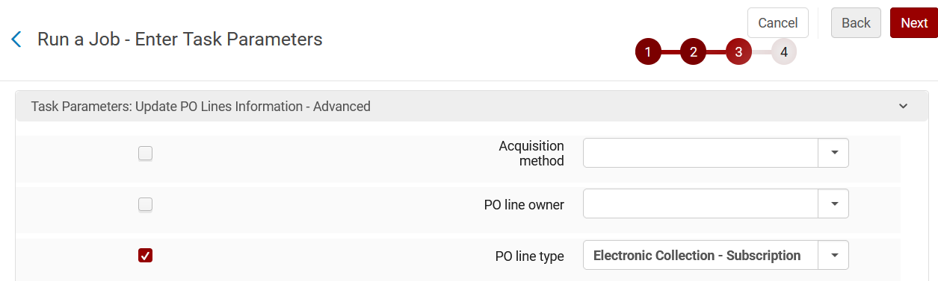
Update PO Lines Information - Advanced
Enhancement allows PO line type changes not previously allowed
Across inventory type: electronic ←→ physical
Across continuity: subscription ←→ one-time
Task parameters for running a job
Notes:
{Ted]
One of the acquisitions jobs has received a significant improvement in this release. The Update PO Lines Information – Advanced job has been a useful tool for updating POLs where some mistakes might have been made. However, changing the PO line type could only be done if the inventory type and continuity were the same. In this release, the job now allows changes across both.
In testing, I was able to change the PO Line type from electronic to physical and physical to electronic, and also from one-time to subscription and vice versa. I was also able to convert a subscription to a standing order, but changing from a standing order to another type may not be allowed.
This could be useful for cleaning up migrated POLs that didn’t come across as desired, as well as fixing Alma-era orders that were entered in a way that wasn’t as practical.
[Next slide]

Slide 29
PO Lines UI Enhancements
Pagination added within a POL
Useful for titles with many ordered items or portfolios
Quick Access menu within a POL
Find any field, section, related tab, or action
Type “.” (period key) to use, or select Quick Access
Additional fields now include recent selections
Acquisition method, Material Type, Currency, Access Provider
Notes:
[Ted]
The PO Lines UI has been enhanced somewhat. First, for large PO lines, that is POLs with a large number of linked items, these lists now include pagination of the list itself, within a PO Line, whenever there are more than 20 rows in the list.
The POL UI also includes a Quick Access menu. This menu provides a list of all available actions, fields, and sections on the POL. For example, if you need to find the MMS ID quickly, or you want to locate the Relink action, this may be useful. The menu includes a recent selections list, so if you’re repeating an action, edit, or lookup on multiple POLs, you’ll find the same item more easily.
The Quick Access menu appears on the POL screen when the POL is displayed full screen, or in half-screen when the screen is wide enough. It may also be opened by typing a period key. This might be something to watch out for. You may not want PO lines on screen when your cat walks across your desk.
Recent selections lists now appear on a few more fields. Previously, the fund and material supplier fields were the main places to see this information. In this release, the acquisition method, material type, currency, access provider, and vendor reference number type are all improved.
[Next slide]

Slide 30
Primo VE

Slide 31
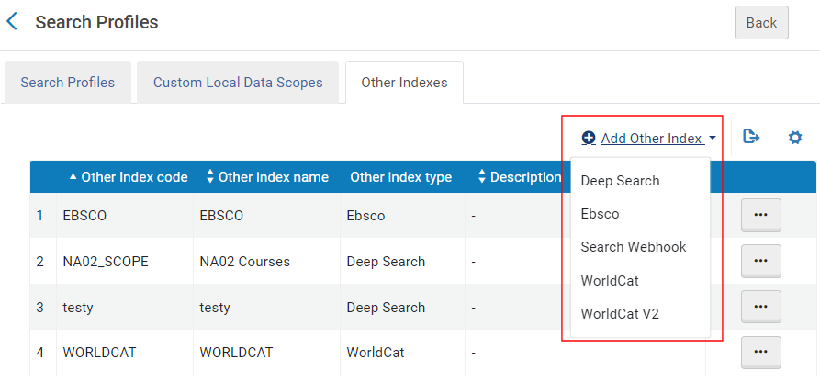
Primo VE
Integrating WorldCat V2 Search API
WorldCat v.1 Search API is nearing its end of life
Replacement WorldCat v.2 Search API index is now available in Alma
Ex Libris documentation: Defining a Scope for a Third-Party Index
OCLC documentation: WorldCat Search API 1.0 transition resources
Search Profiles configuration for Add Other Index
Notes:
Annie
A note for those libraries that use the WorldCat API as a search index.
The WorldCat Search API Version 1 nearing it’s end of life.
A new replacement, WorldCat Version 2, is now available in Alma.
This new version uses a Registration ID that you will need to request from OCLC Customer Service. More information on configuration that can be found at the link on the slide “Defining a Scope for a Third Party Index”.
More information from OCLC about this transition is available at the transition resources link.

Slide 32
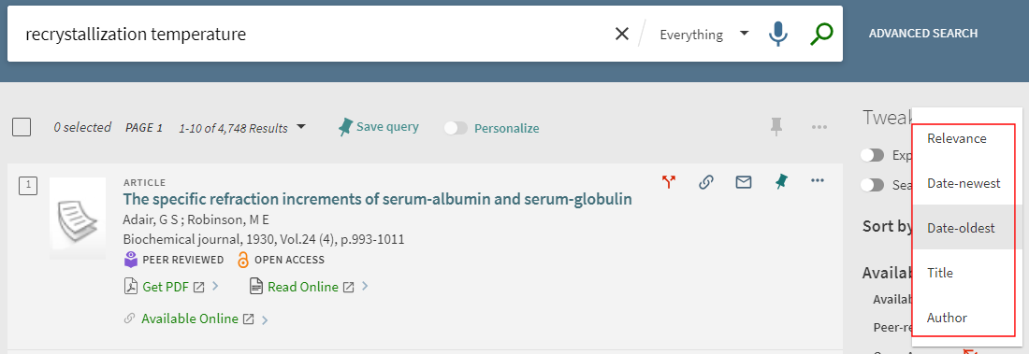
Primo VE
Patron Default Sort
A users' default sort will now be based on their last selected sort type.
Previously, the default sort for advanced and simple searches was Relevance.
For signed-in users, this setting is retained between sessions.
Does not apply to other search types, like Browse or Journal Search.
New default sort settings in Primo VE

Slide 33
Primo research assistant
Primo Research Assistant
Primo Research Assistant is a generative AI-powered tool currently in Beta that can be enabled in your Primo VE instance.
It takes a natural language question from a user and transforms it into a Boolean query that is run on the ExLibris Central Discovery Index (CDI).
It retrieves the 30 top-ranked results, then selects the five top sources that suit the question best, providing a “citation” of the CDI source that was retrieved.

Slide 34
Primo Research Assistant
Ex Libris Documentation:
Getting Started with Primo Research Assistant
How it works, Content Scope, How to enable, How to use it
Video (6 mins.) – a demonstration and explanation of the Research Assistant
CARLI documentation on creating a Test View
CARLI Discovery Primo VE online discussion event Oct. 31, 2024
Notes:
[Jessica]
Ex Libris has provided a Getting Started page with information on How it works, details on the scope of the content being searched by the tool, instructions on how to enable it in a Primo VE View, and how to use it in Primo VE.
Libraries can experiment with the Research Assistant in a Test View without releasing the tool to your users. See CARLI’s documentation for detailed steps on how to set up a Test View
The tools is still in BETA and under active development, so as you might expect, there were several enhancements in the November release.

Slide 35
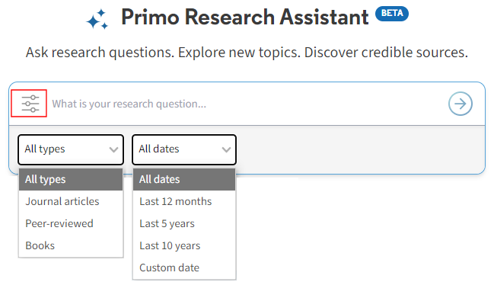
Primo Research Assistant
Refined Search
Users can now refine their searches by resource type (Books, Journal articles, and Peer-reviewed) and date (Last 12 months, Last 5 years, Last 10 years, or a Custom date) by selecting the Refinement icon next to the Search Box to open the refinement options.
Primo Research Assistant filter and menus

Slide 36
Primo Research Assistant
How to Cite Link
Customers can now add a link to a page to provide information regarding Research Assistant—for example, a How to Cite AI-generated Content link. You can configure the link's display text and the link to the page containing the information in the Research Assistant Search Screen Labels code table.
A help button on How to cite AI-generated content

Slide 37
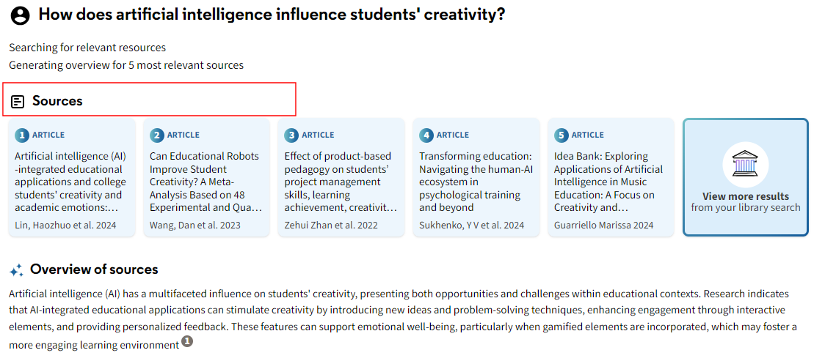
Primo Research Assistant
Reposition Overview and Sources
In the Response, the Source section has moved above the Overview section, enabling users to find materials quickly.
Sources overview

Slide 38
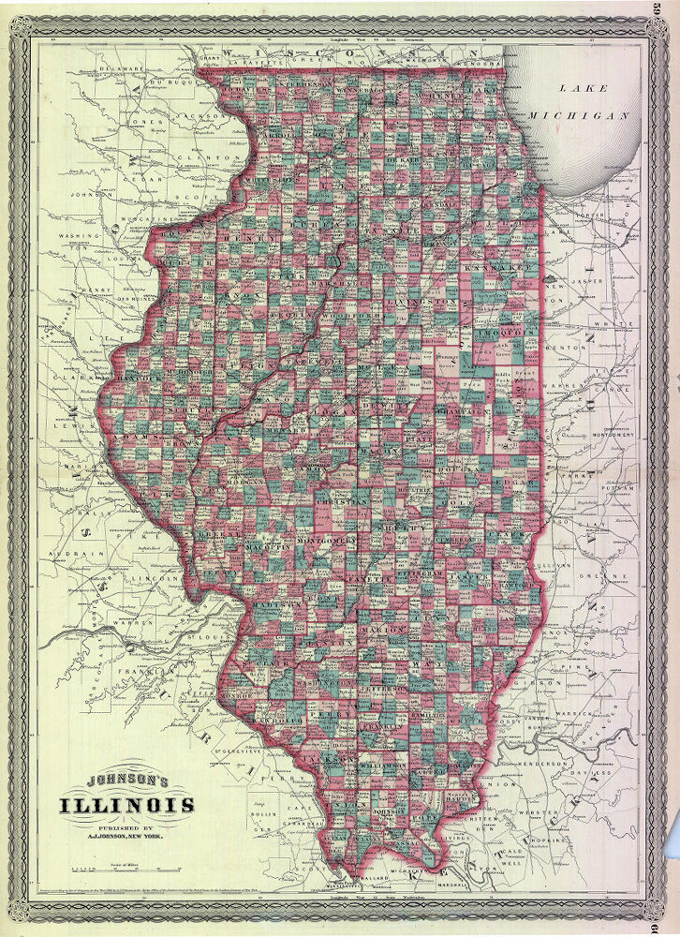
Q&A
Questions?
Johnson’s Illinois, 1864. University of Illinois Urbana-Champaign University Library, Public domain, via Wikimedia Commons
Notes:
That completes our formal presentation. Now we’ll open the floor to your Questions! Feel free to unmute your microphones or type into the Chat.

