Slide 1
Voyager Statistics: the Conspectus Queries
Cathy Salika

Slide 2
Conspectus
A tool for collection analysis
To evaluate one’s own collection
To compare collections to other libraries
To compare collections to standard bibliographies
Developed by RLG in the 1980s
Notes:
Developed as a way of assessing and comparing collections.

Slide 3
Conspectus
Titles are assigned to subject areas by Dewey and LC class numbers.
Three levels of specificity
Division
Category
Subject

Slide 4
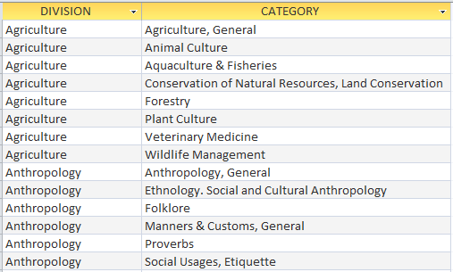
Notes:
To give you a feel for how specific the Divisions and Categories are.
There are 584 categories in 31 divisions.
Just browse a bit…

Slide 5
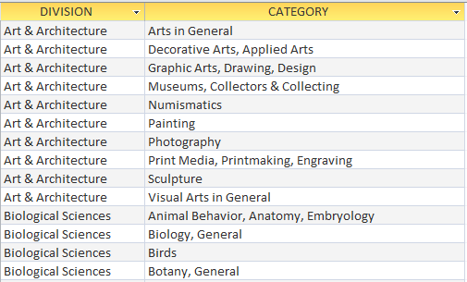

Slide 6
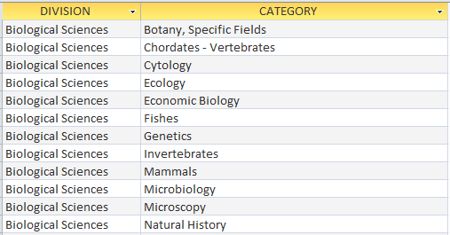

Slide 7
Conspectus
In time, the tool moved from RLG to WLN, and then to OCLC.
OCLC used it as the basis for WorldCat Collection Analysis.
OCLC published the class number mappings for divisions and categories.
Notes:
WorldCat Collection Analysis had a nice user interface
could count your current collection as reflected in WorldCat.
could show collection age
It couldn’t show what parts of your collection were circulating.
But I-Share has that data.

Slide 8
The Queries in I-Share
Conspectus 2009: Call#s in No Category
Conspectus 2009 Item Counts
Conspectus 2009 MFHD Counts
Conspectus 2009 Count of Bibs by Pub Date
Conspectus 2009 Count of Bibs by Pub Date Range
Conspectus 2009 Count of Bibs Created between Dates
Conspectus 2009 Charge Counts
Conspectus 2009 Renewal Counts
Notes:
Using the call number mappings that OCLC published, here’s what I came up with.
First, it’s good to know which call numbers in your collection fall in no category.
Homegrown, typos, etc.
Then counts of items and MFHDs
A MFHD is a holdings record in I-Share that contains the call#.
MFHD counts are pretty close the number of titles.
Counts by publication date
Counts showing when materials were added to your collection
Counts of circulation.
Notice the “2009”.

Slide 9
I developed these queries in 2006 and revised them in 2009.
Use the older versions if you want to be consistent with earlier runs; otherwise use the 2009 versions
Improvements in the 2009 versions:
Newer version of the call# mappings
Uses 852 Ind1 to distinguish classifications schemes
Doesn’t confuse SuDoc with LC
Provides counts by SuDoc agency
Notes:
“S” for Dept. of State won’t be confused with “S” for LC Agriculture.
Homegrown “CD”s won’t be confused with “CD” in LC: Diplomatics.

Slide 10
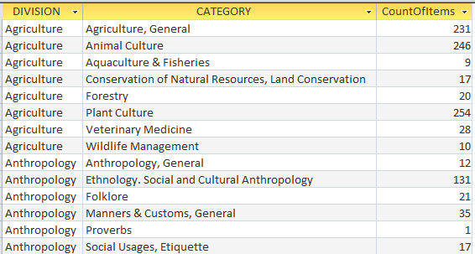
Notes:
Let’s look at a few…
Item counts
These figures are from one of our community colleges.

Slide 11
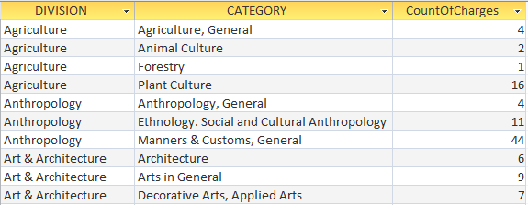
Notes:
Charges July 12-13

Slide 12
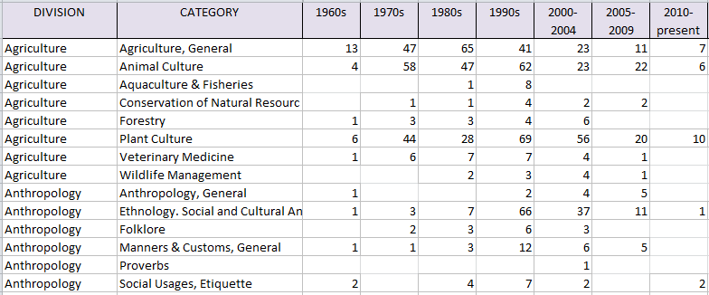
Notes:
By Pub Date
I know this is getting kind of small, so I trimmed a bit.
Ranges include
1800s
1900-1919
Rest of the 20th C by decade
21st C by half decade
Bottom line: This is a way to analyze your collection by fairly granular subjects.
Coordinate title and item counts, collection age, and circulation.

Slide 13
Creating the Conspectus
http://www.oclc.org/research/activities/conspectus.html?urlm=159880
Description of the queries
Search for “conspectus” on the CARLI web page.
support@carli.illinois.edu
Thank you!
Notes:
Here are some resources for more info.

